Slide 1
Thoughts On Valuations Across Utilities and Midstream
hosted by
Greg Gordon
Evercore ISI
Thursday, April 4th, 2019

Slide 2
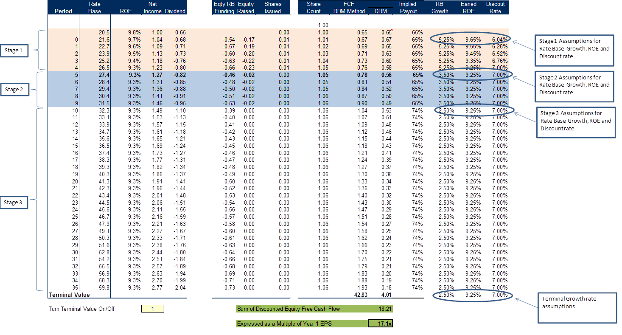
Our DDM Valuation Methodology
Our dividend discount model guides us to our target P/E multiple given the following inputs:
The group’s current equity discount rate, based on the current risk-free rate (10 year US Treasury bond), the current adjusted beta of the regulated utility group (average of a subset of regulated utilities vs. the S&P 500 over the past 3 years, trending toward one), and an assumed equity risk premium
An estimate of near term and longer term earned returns on equity (ROEs) and equity ratios from the valuation date
An estimate of near-term and longer term rate base growth from the valuation date
We consider three “stages” for these inputs:
The annual equity cash flows from stages 1, 2 and 3 as well as the terminal value is discounted back to a valuation date, and expressed as a multiple of first year’s EPS
Source: Evercore ISI Research, Factset.

Slide 3
Utilities - Stranded Asset Analysis
What Is The Theoretical Impact On The Value Of A Regulated Utility If They Have Stranded Generation And Or Transmission Assets Due To Radical Transformation Of Future Energy Infrastructure?
This scenario is a 4-stage dividend discount model that simulates a relatively quick transition from status quo assumptions about infrastructure investment and rate base growth
At a high level we simulate a massive technological disruption that makes vast portions of current investment in electricity infrastructure under or un-utilized.
We use our experience with stranded cost recovery models in the late 1990’s as a loose template.
The simulation assumes that rate base growth starts to decline after year 5 due to a scenario in which demand growth either slows or infrastructure investment is being facilitate by third party capital deploying new technologies near or at the load center.
We then assume beginning in year 10 that regulators determine large portions of the legacy generation and perhaps even the transmission grid should no longer be depreciated and recovered over their assumed remaining useful lives.
The model assumes that between years 10-20 a simple stranded cost recovery scheme in which those assets are depreciated the cash is returned to the company.
Lacking an opportunity to re-invest those cash flows in the business we assume that cash is returned to shareholders.

Slide 4
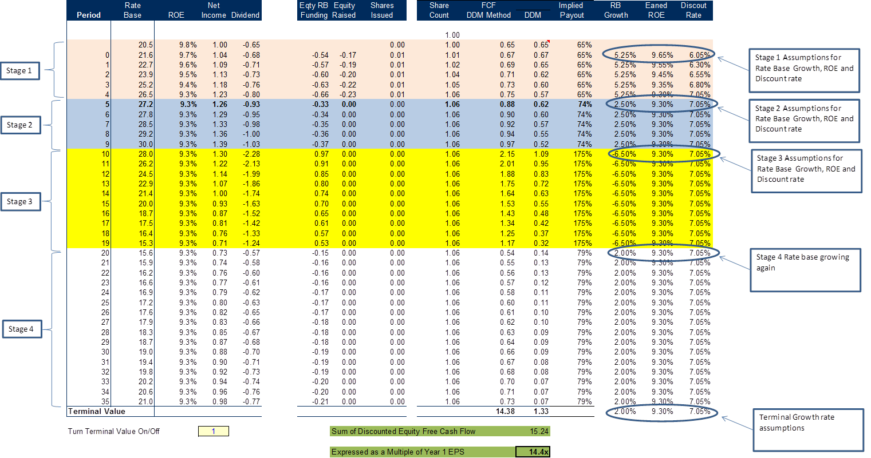
Utilities - Stranded Asset Analysis, Continued
What Is The Theoretical Impact On The Value Of A Regulated Utility If They Have Stranded Generation / Transmission Assets?
Our DDM derives a fair value for the regulated utility experiencing this scenario of 14.4x ‘21 EPS
Today the average regulated utility is trading at 18.0x ‘21 EPS with a range of 12.2x-19.9x
That is 20% lower than the current valuation. We think this understates the potential market reaction
Source: Evercore ISI Research, Factset.

Slide 5
Our Proprietary DDM Shows Electric Utilities Are Now Trading Above Fair Value
The forward P/E multiple that utility investors are willing to pay (based on our DDM) is highly influenced by how quickly investors believe the yield curve will steepen.
Back in December ’18 they were discounting something closer to case 2, in which utility companies’ ability to essentially over-earn is maintained (earnings declining but still robust authorized ROEs in a sustained low interest rate environment) and we achieve status quo rate base growth expectations.
When you look at the current valuation of ~18.0x ’21 it is once again partly reflective of our “case 2” scenario which means we are discounting some insurance premium against an economic downturn.
Our base case assumes an orderly transition to higher interest rates, with authorized ROEs falling to 9.25% from 9.75%, and 10- year Treasury yields rising over the next several years, resulting at the end in a 2.25% spread between the return on equity and the calculated cost of equity.
Using this framework our DDM analysis more or less explains the assumptions implicit in recent peak and trough valuations for electric and gas utility stocks. Our target P/E multiple of 17.1x ‘21 EPS is basically assuming we trend to economic assumptions in our base case.
Source: Evercore ISI Research, Factset.

Slide 6
Our Proprietary DDM Valuation of Water Utilities Is Higher Than That of Electric Utilities
Our utility dividend discount model (DDM) determines fair valuation for an average water utility at 23.3x ’21 P/E.
As it compares to our electric utility valuation, our water utility DDM is based on the following assumptions:
Higher projected rate base growth vs. electric utilities as we see more growth opportunities in the former.
Slower annual ROE fade of 5bp vs 10bp for electric utilities.
Lower final ROE of 8.75% vs 9.25% for electric utilities.
Modeling these assumptions derives our 23.3x ’21 P/E fair valuation for water utilities, which supports a 36% premium to the 17.1x fair value we derive for their electric peers.
Electric Utility Forward P/E – 17.1x
Water Utility Forward P/E – 23.3x
Source: Evercore ISI Research, Factset.

Slide 7
Our Proprietary DDM Shows Midstream FV 1.2x Below Utilities on a Forward P/E Basis
Our dividend discount model (DDM) computes fair valuation for an average electric utility at 17.1x on ’21 P/E.
Utilizing the same tool and adjusting the inputs to reflect the characteristics of our midstream coverage universe, we arrive at fair valuation for our stocks of 15.9x 2021 P/E (1.2x below utilities).
For valuing midstream stocks through our DDM we use a higher cost of capital, higher payout ratio, higher initial growth (but lower terminal growth) versus utilities.
Using current Utility P/E trading multiples ’21 P/E is above fair value in our DDM at 18.0X ’21 EPS vs fair value of 17.1X. Using that as a baseline, we estimate ‘fair value’ for our coverage group in this market is 16.8x, (1.2x lower than Utilities at 18.0x).
Utility Forward P/E – 17.1x
Midstream Forward P/E – 15.9x
Source: Evercore ISI Research, Factset, Company Reports

