Slide 1
Update on Electric Transportation
Charles Satterfield
Senior Manager, Electric Transportation
4/20/2023

Slide 2
Agenda
National and Regional EV Market Updates
Public Charging Updates
Federal Program Updates

Slide 3
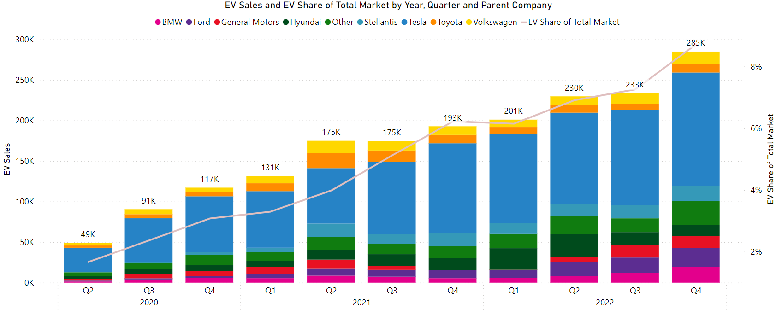
National EV Market Updates
EV Sales Reaching the Tipping Point in 2022
2022 sales of ~950 thousand EVs, 41% higher than 2021 and 280% higher than 2020
Market share steadily increasing; nearly 9% of total light-duty sales in Q4 of 2022 and over 10% in the month of December
Charging deployment also accelerating but not at the same pace as EV sales – 40% YOY increase in EV sales, but only 25% YOY increase in annual DCFC installations
Source: Atlas EV Hub https://www.atlasevhub.com/materials/automakers-dashboard/

Slide 4
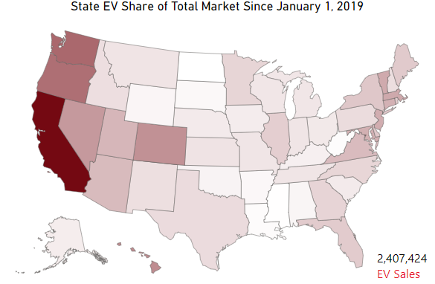
Regional EV Market Updates
EV Sales Rising, but stark regional differences
CA accounts for over 36% of total EV sales, FL in second with 7%
However, EV sales increasing everywhere even in small markets like LA, AR, MS
Lots of room for charging growth – large differences in charger density even in states with similar EV sales like AL and LA; important role for electric companies to play
Source: Atlas EV Hub https://www.atlasevhub.com/materials/automakers-dashboard/

Slide 5
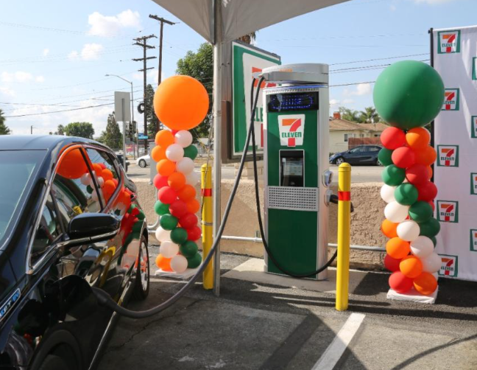
Public Charging Developments
High interest, low investment
Recent surge in number of interested companies
Still building out teams, current plans are mostly exploratory with a few significant investments (7-11, Walmart)
Unfamiliar with the business case of public charging and electric company industry
Most companies favor third-party approach currently, but may change in the near future
Federal funding will lead companies to fast-track plans; more voices for demand charge reform, new rate structures, streamlined permitting, etc.
Rates offerings are a major consideration for investment decisions
Policy push by some to limit electric company involvement

Slide 6
National Grid Electric Highways Study
Available at: https://www.nationalgrid.com/document/148616/download

Slide 7
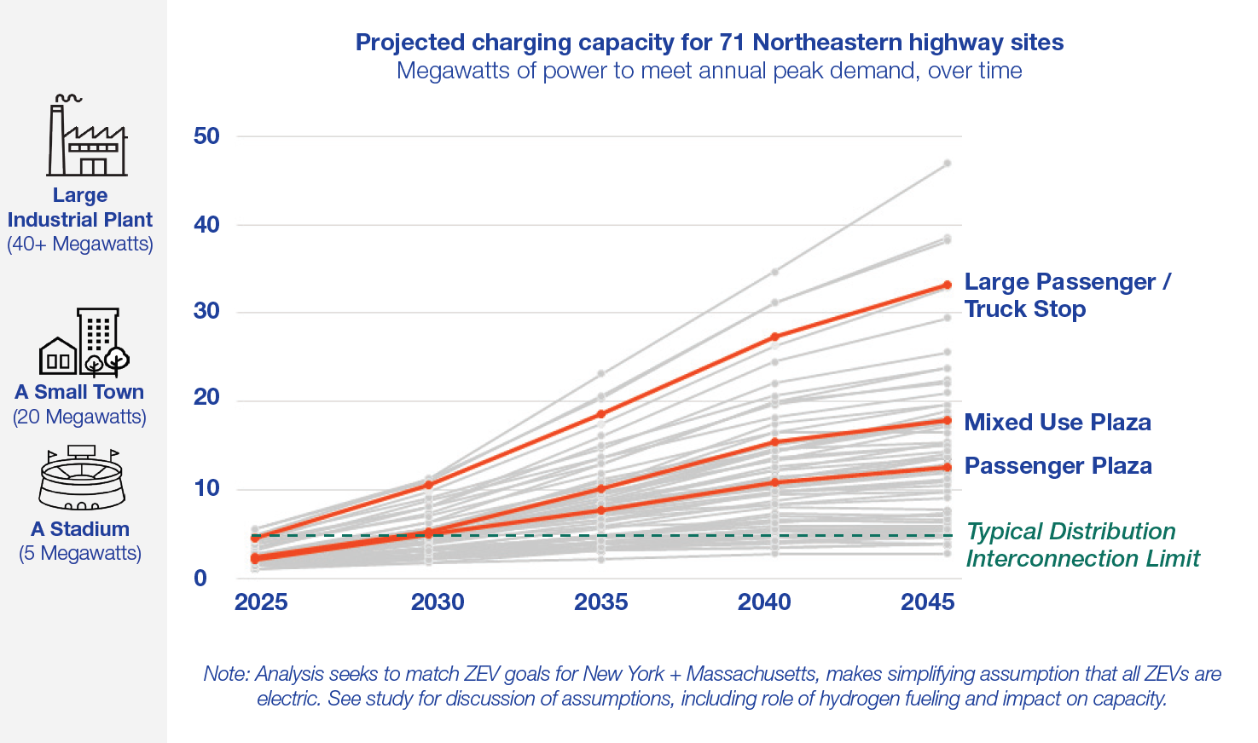
Electric Highways Study:
Over a quarter of highway sites studied exceed limits of a standard low-voltage distribution interconnection by 2030

Slide 8
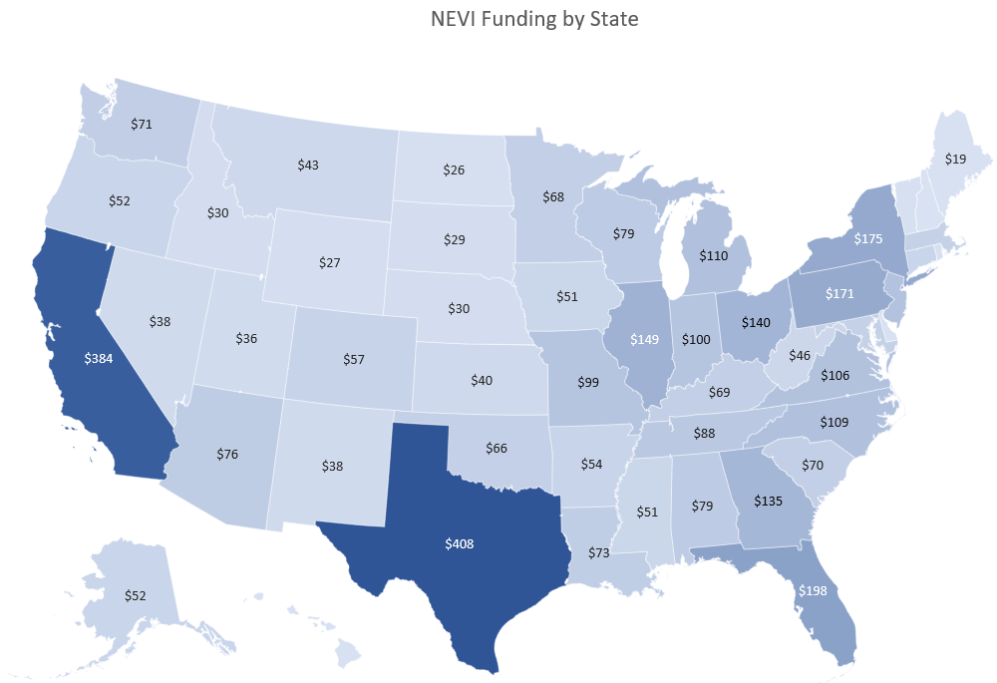
National EV Infrastructure Program
All Plans Approved, Funds Available
Final rulemaking announced on Feb 15; governs:
Charger technologies
Payment methods
Reliability/uptime standards
Data sharing and reporting requirements
RFIs issued by several states, RFPs still in development
Corridor and Fueling Infrastructure funding recently announced; $2.5 billion in supplemental funding
Watershed investment in many areas of the country with low EV adoption

Slide 9
IIJA: Major ET Programs
Program | Agency | Funding | Eligible Entities | Key Dates
National EV Infrastructure (NEVI) Formula Program EV fast charging on AFCs, interstates | FHWA (DOT) | $5 billion | State DOTs | State plans approved 9/27 Minimum standards still pending
Discretionary Grant Program for Charging and Fueling Infrastructure Corridor and community charging | FHWA (DOT) | $2.5 billion | State, local govt | Notice of Funding Opportunity expected this year (?)
Clean School Bus Program ZEV and clean school buses | EPA | $5 billion | School districts, bus sellers | Initial $965 million rebate awards on 9/29 (2,300+ EV school buses)
Low No Program ZEV and clean transit buses | DOT (FTA) | $5.625 billion | Transit agencies | $1.2 billion awarded on 8/16 (1,100 ZEV transit buses)
Port Infrastructure Development Program Port modernization projects | Maritime Admin. (DOT) | $2.25 billion | Ports | $700 million awarded on 10/28 ($150 million to electrification)
Notes:
Finally I want to provide an update on the federal programs focused on electric transportation starting with IIJA. We already covered NEVI, and the $2.5 billion discretionary grant program, but those are just two of several major sources of funding for electric transportation
On the fleet side, we have the clean school bus program which provides $5 billion for clean and zero emission school buses. This has been an incredibly popular program, so much so that they had to double the initial round of funding from $500 million to nearly $1 billion due to the number of applications they received. This is will likely be relevant for many of the folks in this room, since I believe every state received at least some funding for school bus electrification and, depending on where you are, this could be one of the first fleet electrification projects you encounter. We at EEI have been coordinating with the EPA to provide points of contact at member companies for school districts to reach out to.
Next is the Low-No Program which provides $5.6 billion for clean and zero emission transit buses. In many parts of the country, these are the first fleets that are electrifying at scale and we at EEI are working with the American Public Transportation Association to put together some resources for electric companies and transit agencies to help with the electrification process.
Finally there is the Port Infrastructure Development Program which provides two and a quarter billion for port modernization. This isn’t strictly for electrification projects, but they are covered by this funding, though most of the funding has not been for that.

Slide 10
IRA: Major ET Tax Credits
Credit | Credit Amount | Requirements
Clean Vehicle Credit (30D) Revised credit for new EV purchases | Up to $7,500 | Based on sourcing of battery components and critical minerals. MSRP and income caps.
Previously-Owned Clean Vehicles (25E) Newly created credit for used EVs | 30% of sale price up to $4,000 | Sale price cap of $25k. Income cap of $75k single/$150k household.
Qualified Commercial Clean Vehicles (45W) Newly created credit for new commercial EVs | 30% of incremental cost up to $7,500 (LD) or $40k (MD/HD) | 15% credit for plug-in hybrids. Guidance needed on calculating incremental cost.
Alternative Fuel Refueling Property (30C) Revised credit for EV charging infrastructure | 30% up to $100k | Labor standard for full credit amount. Only eligible in certain census tracts.

Slide 11
IRA: Major ET Programs
Program | Agency | Funding | Eligible Entities | Key Dates
Clean Heavy-Duty Vehicles Grants for Class 6/7 ZEVs and infrastructure | EPA | $1 billion | TBD | RFI open through 1/18. 40% allocated for non-attainment areas.
Grants to Reduce Air Pollution at Ports ZEV technology at ports | EPA | $3 billion | TBD | RFI open through 1/18. 25% allocated for non-attainment areas.
United Postal Service Clean Fleets ZEV delivery vehicles and infrastructure | USPS | $3 billion | USPS | $1.3 billion for vehicles, $1.7 billion for infrastructure.
Notes:
The IRA also included some funding for electric transportation including $1 billion for zero emission heavy-duty vehicles for government fleets; $3 billion for emissions reductions at ports which includes electrification projects, and finally $3 billion for electrification of the USPS fleet
There was also a slide which would appear to have not made it in here which covers the tax credit portions of the IRA, but those are 30D which is the $7,500 for passenger vehicles, 25E for $4,000 for pre-owned vehicles (big deal), the renewal of the 30C credit for infrastructure of up to $100,000 though with some new requirements on labor and eligibility is currently limited to certain census tracts; and 45W which is for commercial vehicles which is something you can take advantage of – that will be 30% of the incremental cost of an electric vehicle up to $7,500 for a light-duty vehicle and up to $40,000 for a medium- or heavy-duty vehicle. There’s also a 15% credit for plug-in hybrids. In theory, this 45W credit should be easier to take advantage of because it doesn’t carry the same restrictions as the normal 30D credit regarding sourcing of battery materials, but the issue of calculating the incremental cost of vehicles is a sticky one due which we are currently seeking further guidance on from. So stay tuned there to see how that could our members’ own fleet electrification efforts.

