Slide 1
Establishing Alternative
Proxy Groups
Society of Utility and Regulatory
Financial Analysts Forum
April 4, 2019
New Orleans, LA
J. Randall Woolridge
The Goldman, Sachs and Frank P. Smeal Professor of Finance The Pennsylvania State University University Park, PA 16802 814-865-1160
jrw@psu.edu.

Slide 2
Establishing Alternative Proxy Groups
Typical Proxy Group Screening Criteria
Characteristics of Non-Utility Companies
Issues with Applying DCF, CAPM, Expected Earnings Issues Applied to Non-Utility Companies
Additional Considerations in Establishing Alternative Proxy Groups

Slide 3
Screening Criteria
Credit Ratings
Value Line Risk Metrics
Safety, Financial Strength, Beta
Earnings Predictability, Price Stability?

Slide 4
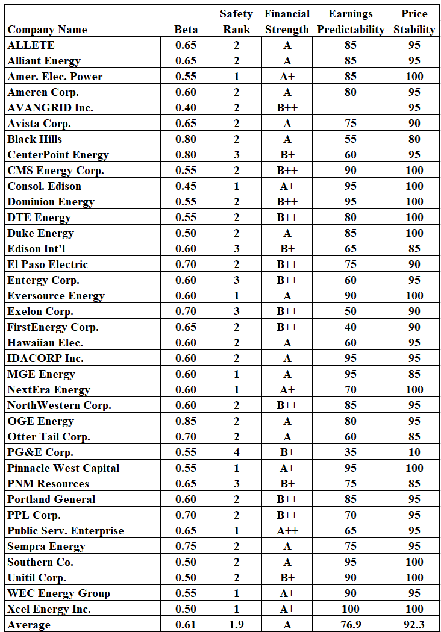
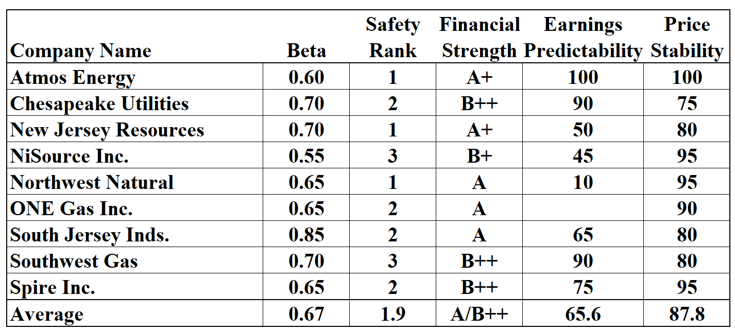
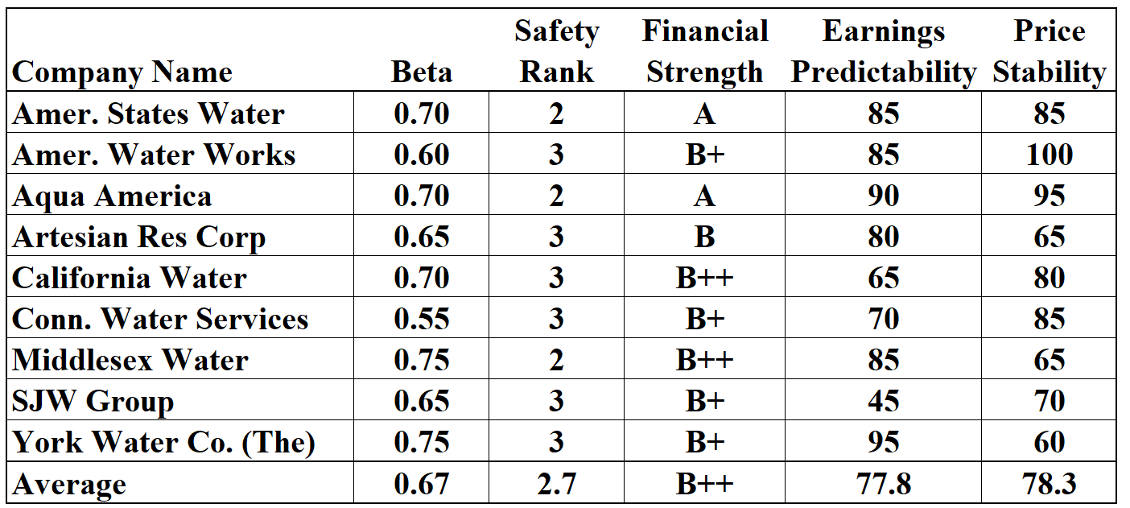

Slide 5
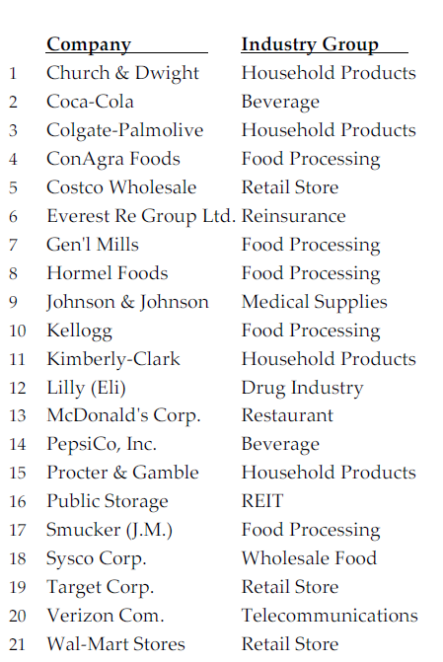

Slide 6
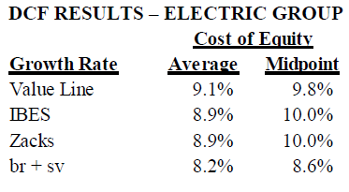
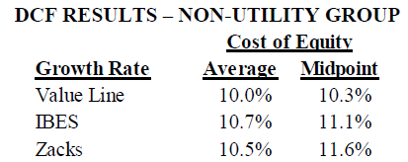
Establishing Alternative Proxy Groups

Slide 7
Establishing Alternative Proxy Groups
Discounted Cash Flow Analysis
Analysts’ Projected EPS Growth Rates 3-5 year Growth Rates
Projected vs. Actual EPS Growth Rates
Non-Utilities vs. Utilities
11%-12% vs. 6%-7%
No Accountability for 3-5 Year Rates
Buy vs. Sell Recommendations
Few Negative 3-5 Year Growth Rates
30% of Firms have Negative 3-5 Year Growth Rates
Drop Coverage

Slide 8
Establishing Alternative Proxy Groups
CAPM
CAPM Results Should be Similar for Utilities
and Non-Utilities
Risk-Free Rate, Beta, Market Risk Premium
Blume Effect – Betas Regress to 1.0
2/3 * Historic Beta + 1.0
Value Line – Bloomberg
Utility Betas do not Regress to 1.0
Implications for Screening and CAPM Results

Slide 9
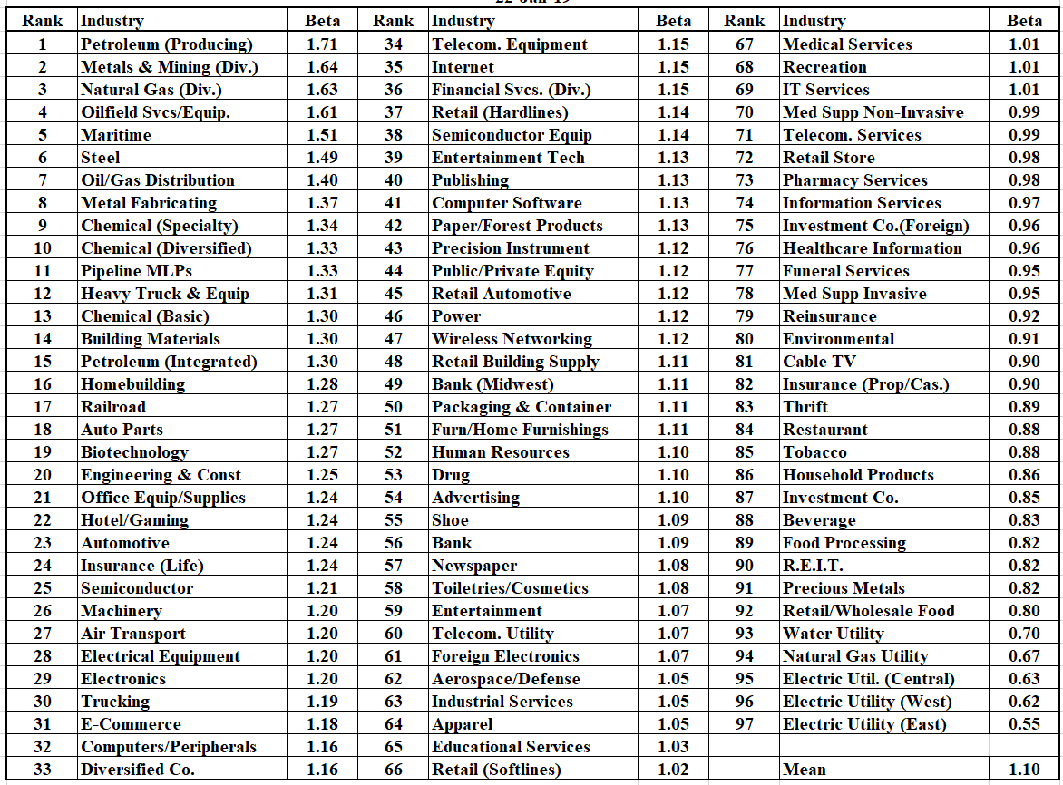

Slide 10
Establishing Alternative Proxy Groups
Betas
2-Year vs. 5-Year Betas
Adjusted vs. Raw Betas
S&P 500 Sectors

Slide 11
Establishing Alternative Proxy Groups
Expected Earnings
Does it Measure the Market Cost of Equity Capital?
ROEs Reflect More Than Risk and Return
Profitability Measures
Gross, Operating,Net Profit Margin
Nature of Company’s Assets / Capital
Intensity of Business
Asset Turnover, PPE/Assets
Financial Strategy and Use of Debt
Debt/Equity, Common Equity
Ratios

Slide 12
Establishing Alternative Proxy Groups

Slide 13
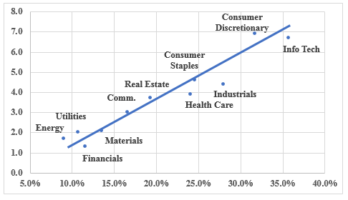
Establishing Alternative Proxy Groups

Slide 14
Establishing Alternative Proxy Groups

