Slide 1
FERC’s Methodology for Determining the Required
Rate of Return
Society of Utility and Regulatory
Financial Analysts Forum
April 5, 2019
New Orleans, LA
J. Randall Woolridge
The Goldman, Sachs and Frank P. Smeal Professor of Finance The Pennsylvania State University University Park, PA 16802 814-865-1160
jrw@psu.edu.

Slide 2
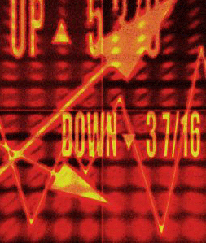
FERC’s Rate of Return Methodology
February 2, 2016 – WEA - GHD
Discounted Cash Flow Analysis
1ST Stage Growth - IBES Growth Rates
2ND Stage Growth – Projected GDP Growth
2/3 and 1/3 Weights and
3-5 Year Growth Rates

Slide 3
FERC’s Rate of Return Methodology
CAPM - Issues
The Uniqueness of Utility Betas
Being natural monopolies in their own geographic areas, public utilities have more influence on the prices of their product (gas and electricity) than other firms. The rate setting process provides public utilities with the opportunity to adjust prices of gas and electricity to recover the rising costs of fuel and other materials used in the transmission and distribution of electricity and gas.
The Order’s Proposed MRP Methodology
Apply DCF to S&P 500
Upward Bias in Analysts’ EPS Growth Rates
Unreasonable DCF growth rates and MRPs
MRPs of 10% - Larger than any MRPs
Found in Surveys, Historical
Returns, and Academic Studies
NETOs used DCF Growth Rates of 10% and GDP Growth Rates of 4.3%

Slide 4
FERC’s Rate of Return Methodology
CAPM – MRP
Long-Term Earnings Growth is Tied to GDP Growth
“The long-run performance of equity investments is
fundamentally linked to growth in earnings. Earnings growth, in turn, depends on growth in real GDP. This study demonstrates that both theoretical research and empirical research in development economics suggest relatively strict limits on future growth. In particular, real GDP growth in excess of 3 percent in the long run is highly unlikely in the developed world. In light of ongoing dilution in earnings per share, this finding implies that investors should anticipate real returns on U.S. common stocks to average no more than about 4–5 percent in real terms.”
Brad Cornell

Slide 5
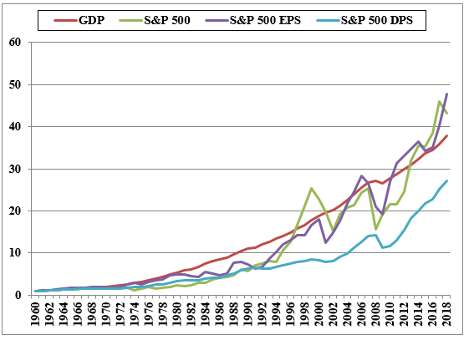
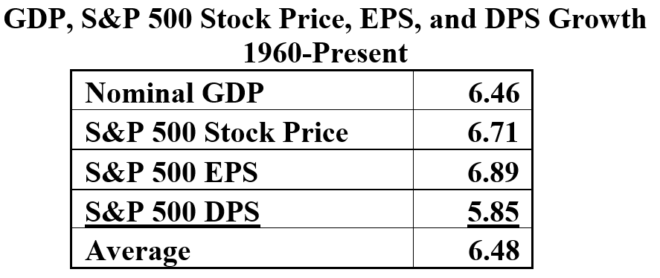
FERC’s Rate of Return Methodology
CAPM – MRP
Long-Term Earnings Growth is Tied to GDP Growth

Slide 6
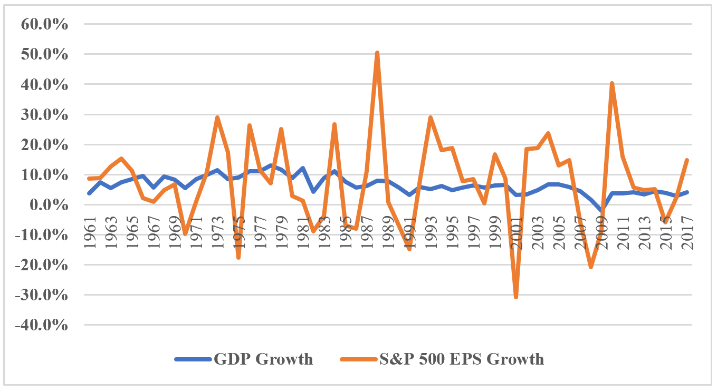
FERC’s Rate of Return Methodology
CAPM - MRP
Year-to-Year, Can Be Big Swings in EPS vs GDP

Slide 7
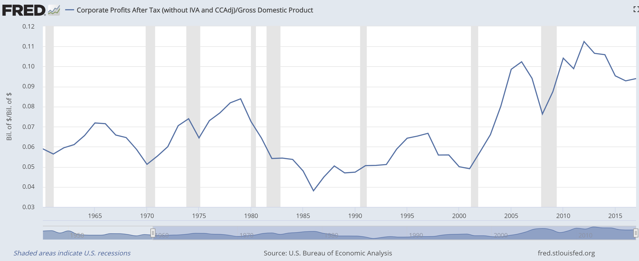
FERC’s Rate of Return Methodology
CAPM - MRP
In Long-Term, EPS Growth Constrained by GDP Growth. Historically, Corporate Profits have been About 6% of GDP

Slide 8
FERC’s Rate of Return Methodology
You know, someone once told me that New York has more lawyers than people. I think that’s the same fellow who thinks profits will become larger than GDP. When you begin to expect the growth of a component factor to forever outpace that of the aggregate, you get into certain mathematical problems. In my opinion, you have to be wildly optimistic to believe that corporate profits as a percent of GDP can, for any sustained period, hold much above 6%. One thing keeping the percentage down will be competition, which is alive and well. In addition, there’s a public-policy point: If corporate investors, in aggregate, are going to eat an ever-growing portion of the American economic pie, some other group will have to settle for a smaller portion. That would justifiably raise political problems--and in my view a major reslicing of the pie just isn’t going to happen.

Slide 9
FERC’s Rate of Return Methodology
CAPM - Size Premium
Not Specified in Order
Based on Historical Returns of Size Deciles Since 1926
Empirical Issues – Survivorship, Monthly
Rebalancing, Serial Correlation (Roll)
Debate Whether it Exists Anymore? Banz 1981
Does it Apply to Public Utilities?
Regulation, Government Oversight, Performance Review, Accounting Standards, Information Disclosure, and Insulation from Competition

Slide 10
FERC’s Rate of Return Methodology
Expected Earnings - Issues
Does it Measure the Market Cost of Equity Capital?
“More simply, the Comparable Earnings standard ignores capital markets. If interest rates go up 2% for example, investor requirements and the cost of equity
should increase commensurably,but if regulation is based on accounting returns, no immediate change in equity cost results.”
Roger Morin

Slide 11
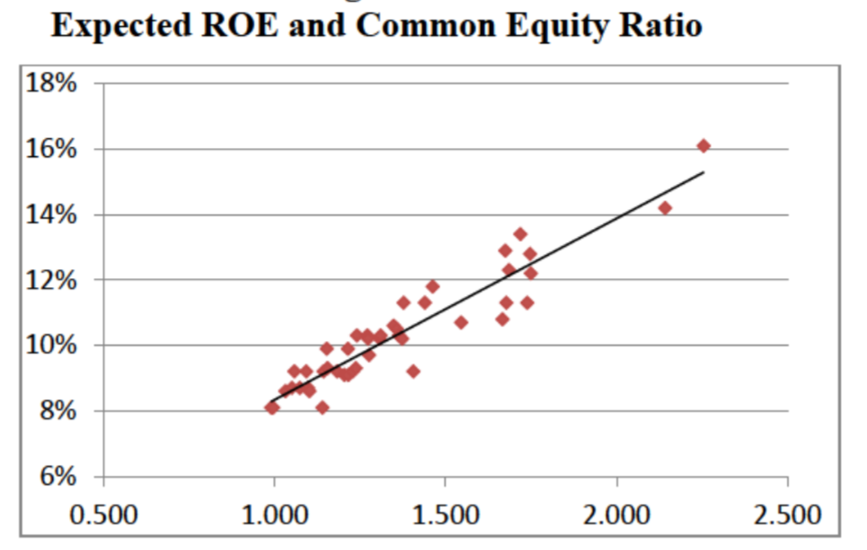
FERC’s Rate of Return Methodology
Expected Earnings - Issues
Circularity – Time Period – Business Cycle
Includes Adders and Unregulated Business
Not Related to Risk and Return - ROEs are Directly Related to M-B Ratio Not Risk Measures

Slide 12
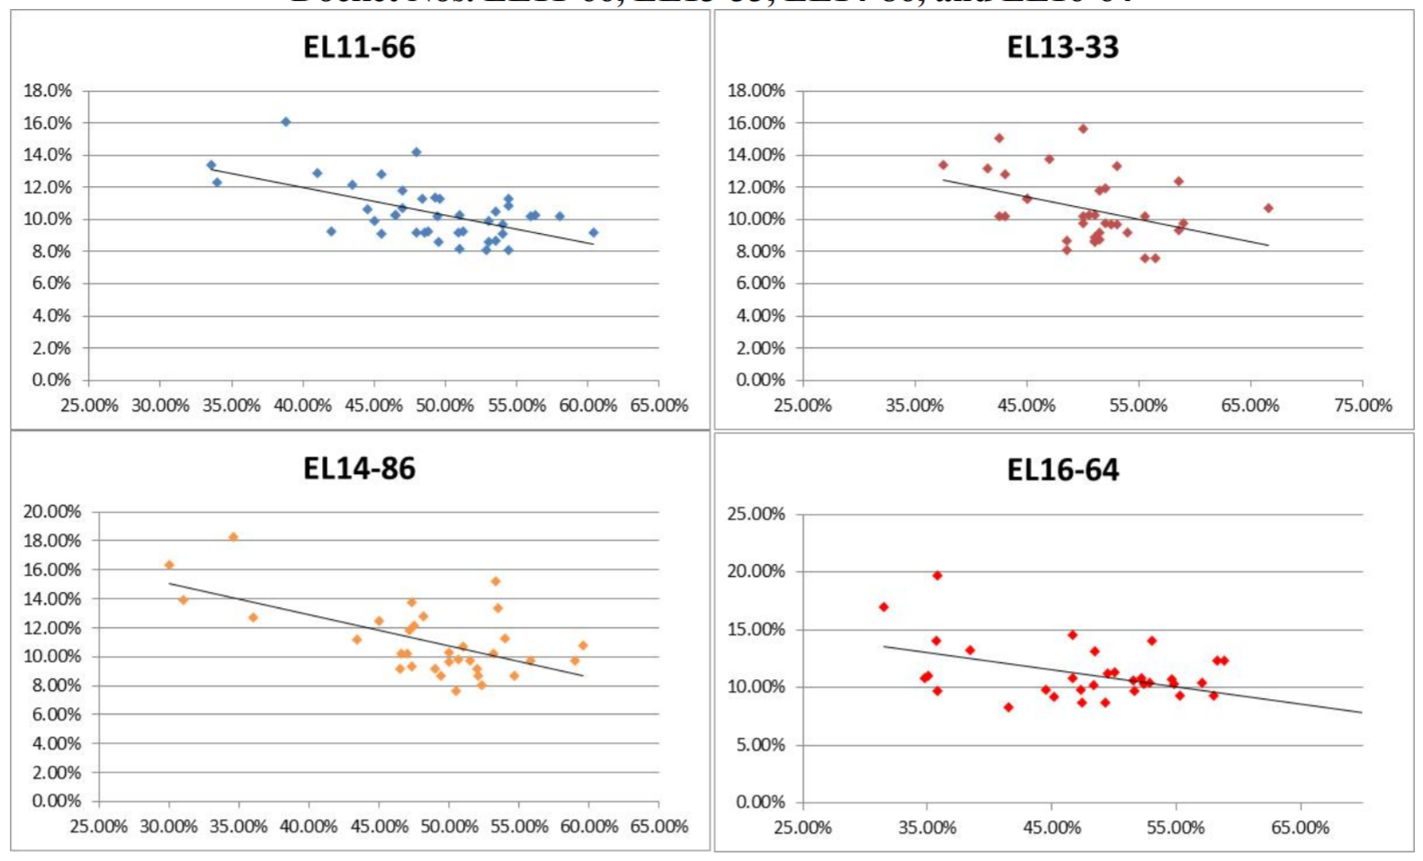
FERC’s Rate of Return Methodology
Expected Earnings - Issues
The Negative Correlation Between ROEs and Common Equity Ratios (High ROE-Low CE Ratio)
Average CE Ratio
NETOs 55%
Proxies 48%

Slide 13
FERC’s Rate of Return Methodology
Risk Premium
Order uses NETO’s FERC ROE Based Risk Premium Approach
Regression of:
Risk Premium (Authorized ROE – BBB Yield) on BBB Yield
Used FERC ROE Determinations (104 from 2006-2016)
Issues:
Should FERC Cases be Used in the RP study?
Data Issues in NETO’s Approach
Identified 25 Data Issues (Referenced ROEs)
Projected Bond Yields – Un-FERC Like!
Circularity Using FERC ROEs
Is there a Consistent Linear Relationship Between the Risk Premium and Interest Rates?
Utilities’ Risk Declined Over the Period

Slide 14
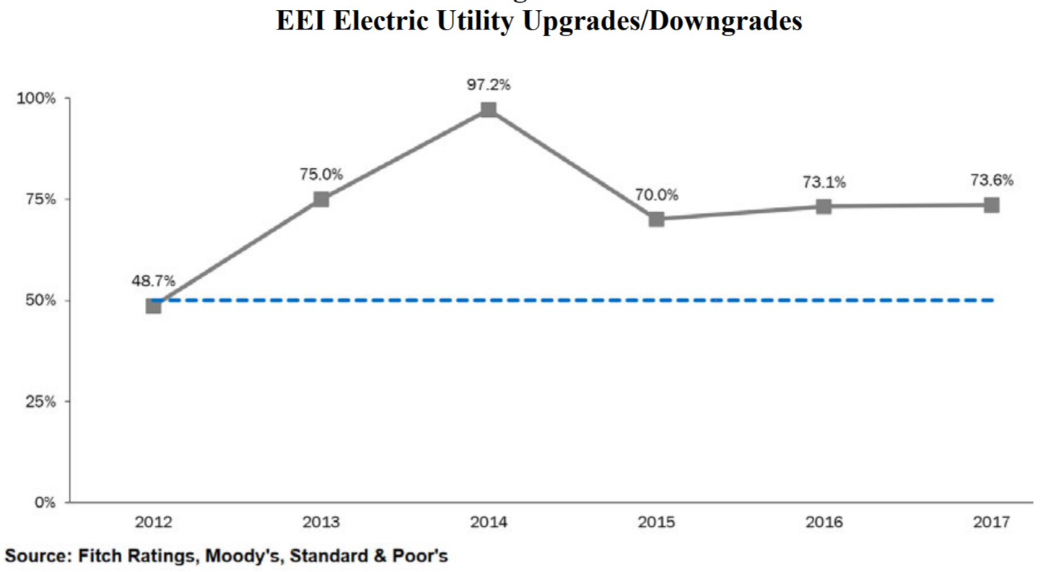
FERC’s Rate of Return Methodology
Risk Premium - Issues
Utilities Risk Declining Over Period

Slide 15
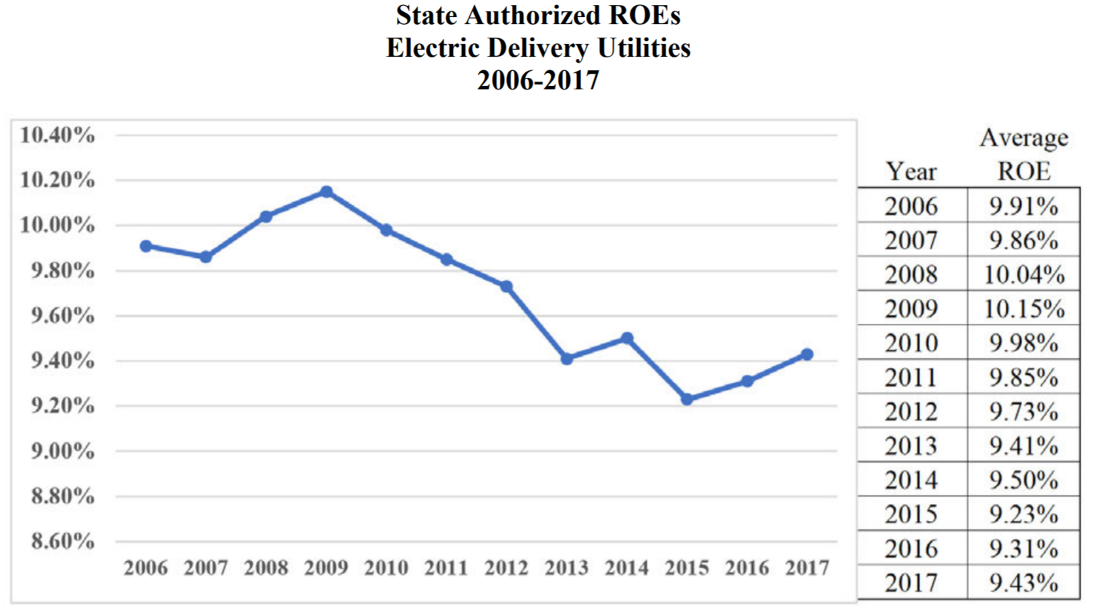
FERC’s Rate of Return Methodology
Risk Premium - Alternative ROE
Electric Delivery Authorized ROEs

Slide 16
FERC’s Rate of Return Methodology
Other Issues
Lower Risk of NETOs Relative to Proxies
FERCONOMICS Metrics
Midpoint/Median as Measures of Central Tendancy (Bezos Moves to DC)
Min/Max filters
Natural Break Test
Zone of Reasonableness

Slide 17
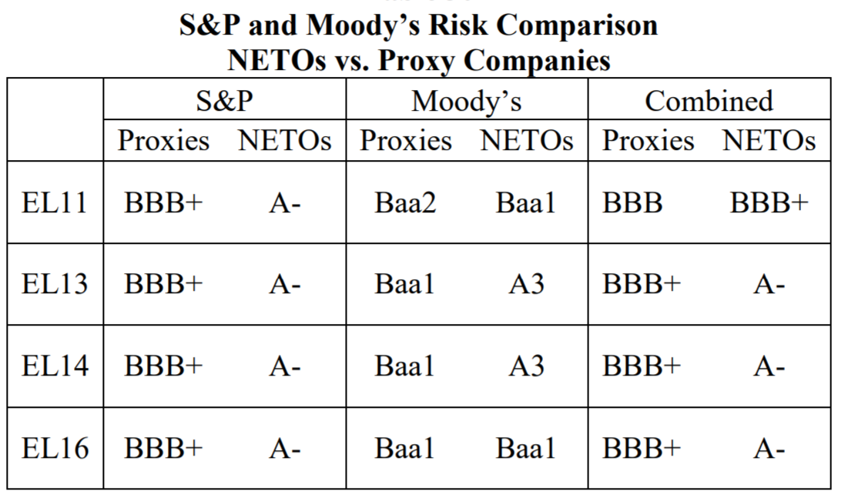
FERC’s Rate of Return Methodology
Risk Premium - Issues
NETO’s Risk Below Proxies

Slide 18
FERC’s Rate of Return Methodology
International Standards
Australia, Canada, UK, and
25 European countries
CAPM is Model of Choice in Determining ROEs for Electric Utilities
Predominantly use Historical Returns to
Estimate MRP – Credit Suisse
Lower ROEs than in US

