Slide 1


Joseph S. Fichera
CEO, Saber Partners, LLC
NRRI Fellow
Investor-Owned Securitization:
Debt for Equity

Slide 2


Slide 3

2000 – Present
$9,020,000,000
19 Years in Investor-Owned Utility Securitization Engagements; Advised 6 Commissions, 13 Transactions, $9,020,000,000, 8 utilities
2000 – Present
$9,020,000,000
Size of Bond Offering ($ in Millions)
2000 New York State Deregulation Study
Financial Advisor to Chairman of New York State Public Service Commission
2001 Reliant Energy Transition Bonds, $748.9
Financial Advisor to Public Utility Commission (PUC) Texas
2002 Central Power & Light Transition Bonds, $797.3
Financial Advisor to PUC Texas
2003 Oncor Electric Transition Bonds, $500.0
Financial Advisor to PUC Texas
2004 TXU Electric Delivery (Oncor) Transition Bonds, $789.8
Financial Advisor to PUC Texas
2004 VEPPI, Inc. Power Purchase Cost Mitigation Bonds
Financial Advisor to Vermont Public Service Board (Purchasing Agent, VEPP, Inc.)
2005 Wisconsin Electric Environmental Facility Bonds
Financial Advisor to Wisconsin Public Service Commission (PSC)
2005 PSE&G Deferred Balance Transition Bonds, $102.7
Financial Advisor to New Jersey Board of Public Utilities
2005 CenterPoint Energy Transition Bonds, $1,851.0
Financial Advisor to PUC Texas
2006 AEP Texas Central Transition Bonds, $1,739.7
Financial Advisor to PUC Texas
2007 Allegheny Power – Monongahela Power (MP), $344.5
Financial Advisor to PSC of West Virginia
2007 Allegheny Power – Potomac Edison (PE), $114.8
Financial Advisor to PSC of West Virginia
2007 Florida Power & Light Company, $652.0
Financial Advisor to Florida PSC
2009 Allegheny Power – Monongahela Power, $64.4
Financial Advisor to PSC of West Virginia
2009 Allegheny Power – Potomac Edison, $21.5
Financial Advisor to PSC of West Virginia
2014 Potomac Electric Power Company/DC Department of Transportation, $375
Financial Advisor to the Office of the People’s Counsel (i.e., Ratepayer Advocate) of the District of Columbia PSC
2016 Duke Energy Florida, $1,294
Financial Advisor to Florida PSC
2018, Financial Advisor to California Community Choice Association for financial analysis and testimony before the California Public Utilities Commission Rulemaking (CPUC)17-06-026 Proceeding
2018 – Present, National Regulatory Research Institute (NRRI) Fellow (Fichera) and author of securitization “Insights” article January, 2019
Notes:
We have been involve in this market since 2000

Slide 4

Since 1997 Utility Securitization Laws: 22 States + DC + Puerto Rico
Only 7 Active, 9 Considering
√
√
√
√
√
States with Previous Legislation
√
States Securitization Being Considered
√
√
States Securitization Active Legislation
Notes:
No One Template – But Best Practices Can Be Identified

Slide 5
Total ~$50.9 billion ISSUED, 65 Transactions
Deregulation – Stranded Costs
PG&E Bankruptcy Exit – Regulatory Asset Refinancing
First Use of Securitization for Storm Recovery / Environmental
Financial Crisis

Slide 6
Securitization Bond Issues By State 1997 - Present
$62.7
$2,596.6
$1,210.7
$482.9
$1,554.5
$712.3
$1,438.4
$4,264.0
$3,768.4
$8,778.2
$623.2
$925.5
$10,950.5
$8,940.6
$124.1
$2,480.4
$1,946.3
$150.0
Best Practice State
Dollar Volume in each State
(amount in $ Millions)

Slide 7
Securitization Bond Issues By State 1997- Present:
Dollar Volume and # of Issues in Each State
12
6
6
2
7
3
9
2
3
1
3
5
2
1
1
1
R
1
1
Notes:
64 Investor-Owned Utility Transactions
From (small) $21.5 Million to (large) $2.9 Billion In Size

Slide 8
Majority Issued Short-Intermediate Maturity…and Gone!
Cumulative 1997-Present
Outstanding April 2019
Significant Market Opportunity BUT
Challenge for Longer > 15 yr Maturities
$ Millions
$ Millions
Years
Years
*WAL = Weighted Average Life
Notes:
Generally a short-term instrument
The frontier is long term

Slide 9

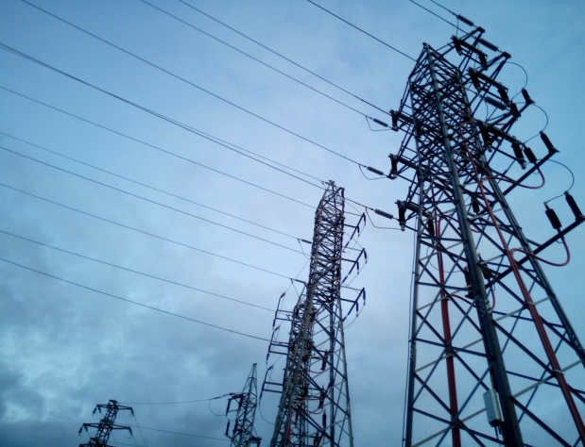


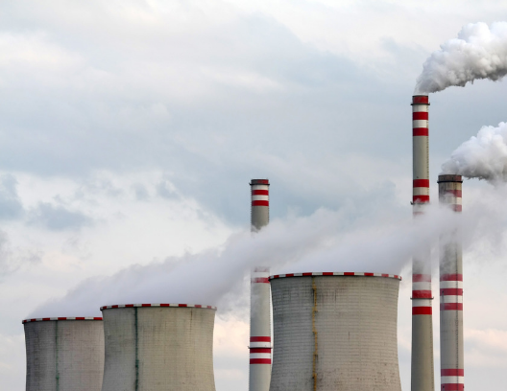

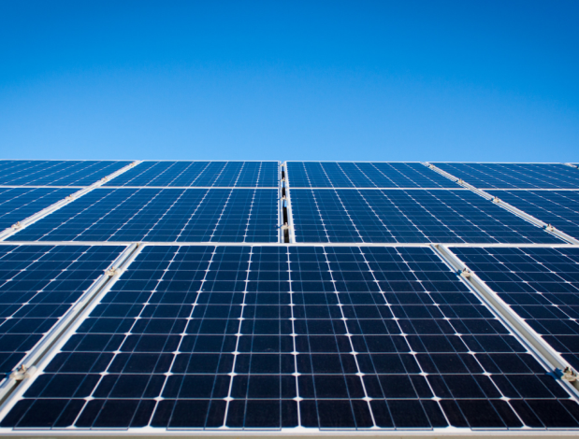
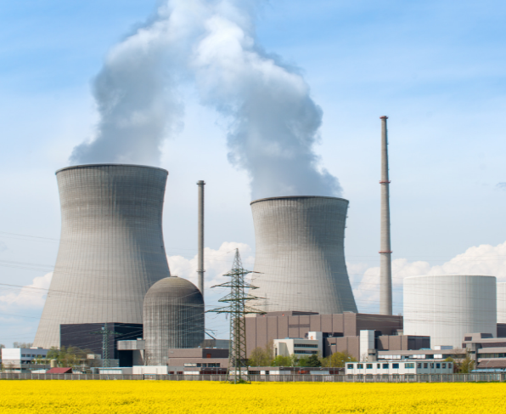
CT
Eight Primary Uses Over Time and Still Evolving
MI
PA
CT
NJ
MD
CA
IL
NH
NH
CA
AR
MA
NJ
OH
TX
1. Rate reduction to facilitate deregulation of energy market​
2. Recovery of stranded costs resulting from electric industry deregulation ​
3. Buydown of above market power purchase agreements​
4. Deferred balances and Regulatory Assets)
WI
WV
FL
TX
LA
HI
FL
5. Costs of new pollution control equipment
6. Storm recovery costs
7. Costs of new renewable distributed generation
8. Recovery of remaining costs of an early retired nuclear plant

Slide 10
Mostly Stranded Cost, Not that Many Utilities
Notes:
Generally a short-term instrument
The frontier is long term

Slide 11
New Uses Are Emerging
Wildfire costs
Grid expansion
Undergrounding distribution systems
Climate change initiatives
Accelerating Coal to Clean with new “Securitization Advocates”
  Sierra Club
  National Resources Defense Council
  Western Resource Alliance
  Rocky Mountain Institute
  Climate Policy Initiative

Slide 12
Environmentalists are promoting securitization to make “just and equitable” transition of over 70 GW of uneconomic coal (UC) in 16 regulated states
WA
6.9 GW UC
4.3 GW UC
4.3 GW uneconomic coal
ME
MT
ND
9.4 GW UC
NH
NH
OR
VT
ID
MN
NY
3.8 GW UC
SD
WI
MI
MA
WY
4.3 GW UC
RI
CT
3.1 GW UC
NV
IA
PA
NJ
NE
OH
3.4 GW UC
IL
IN
MD
UT
DE
CO
MO
WV
CA
KS
1.4 GW UC
VA
KY
2.7 GW UC
NC
5.6 GW UC
OK
AR
TN
AZ
NM
6.4 GW UC
1.4 GW uneconomic coal
SC
GA
3.3 GW UC
MS
AL
TX
LA
3.5 GW UC
FL
6.4 GW UC
AK
4.8 GW UC
3 GW UC
HI

Slide 13
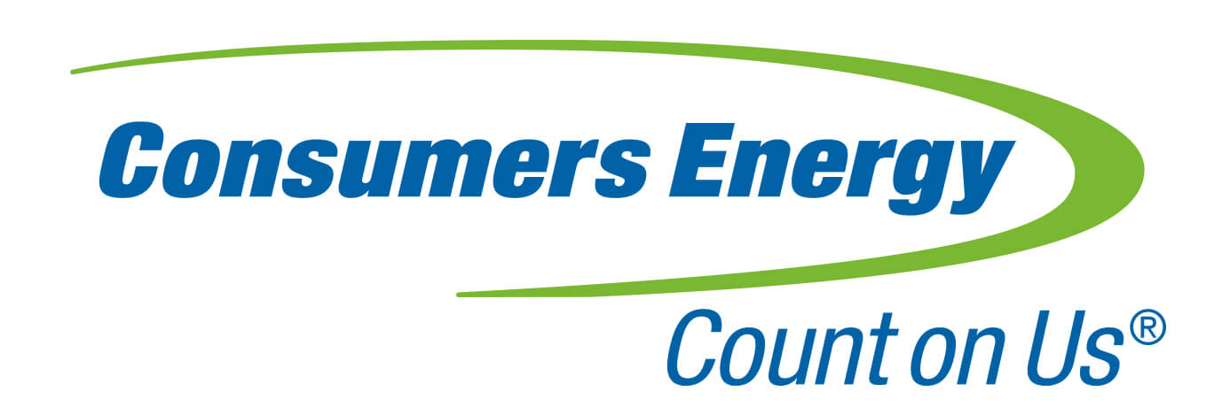



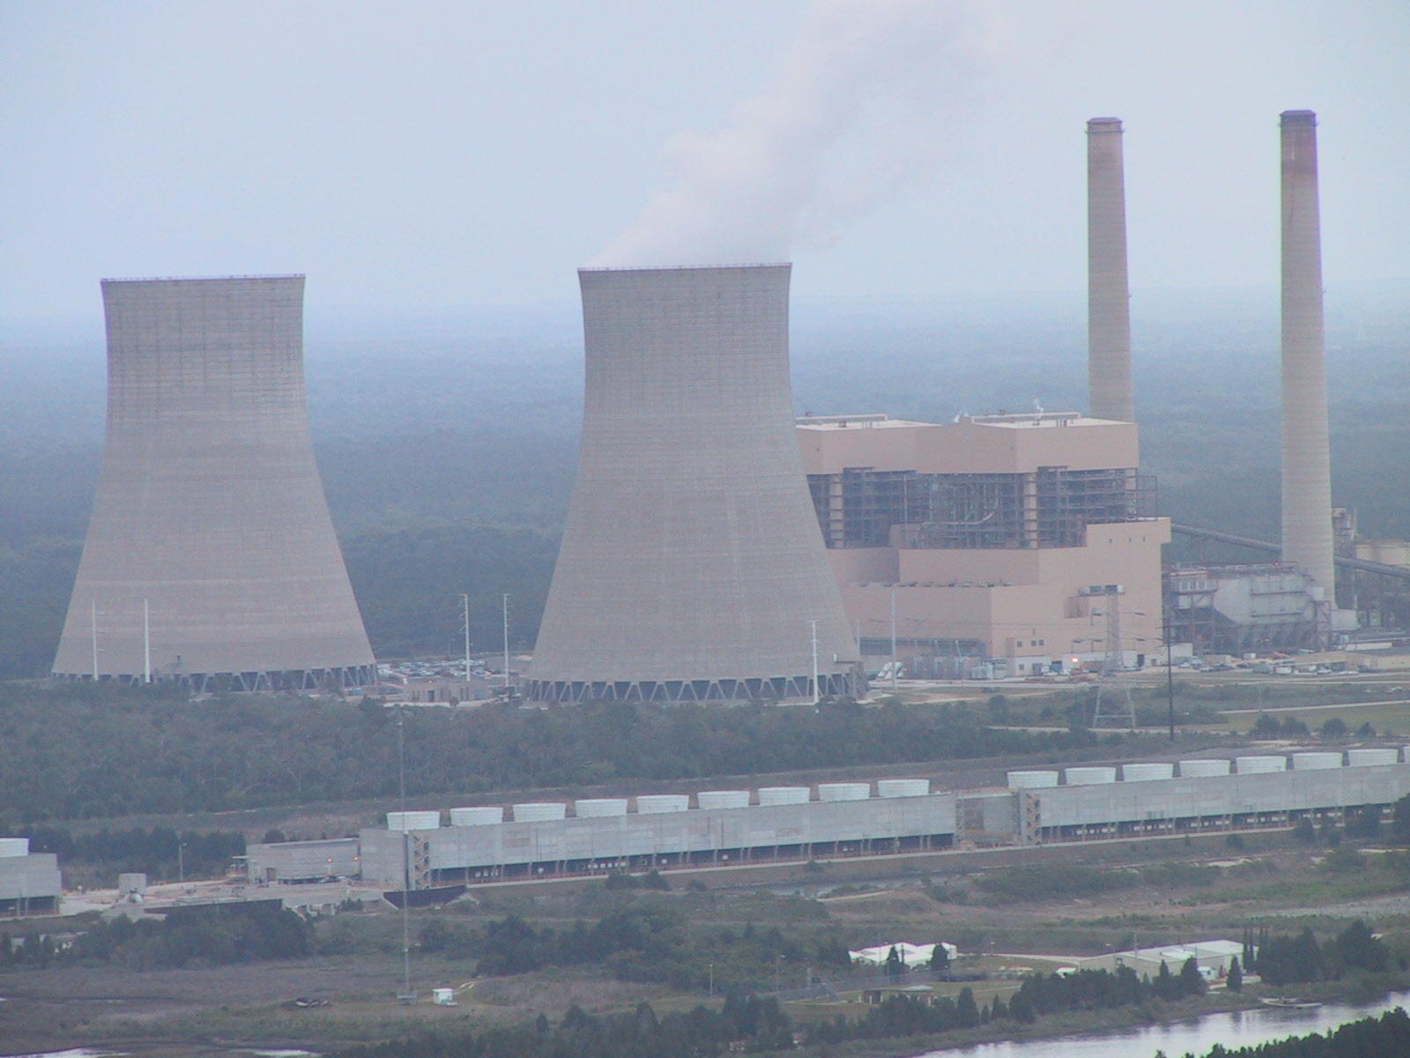
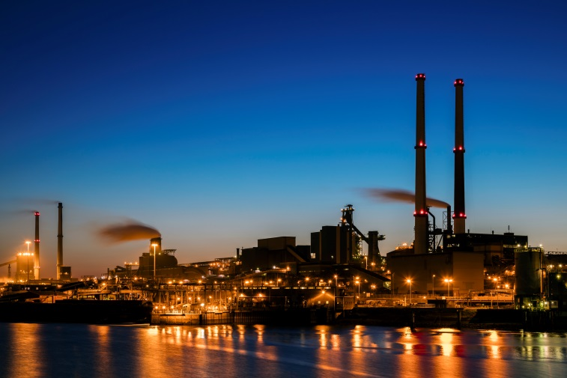
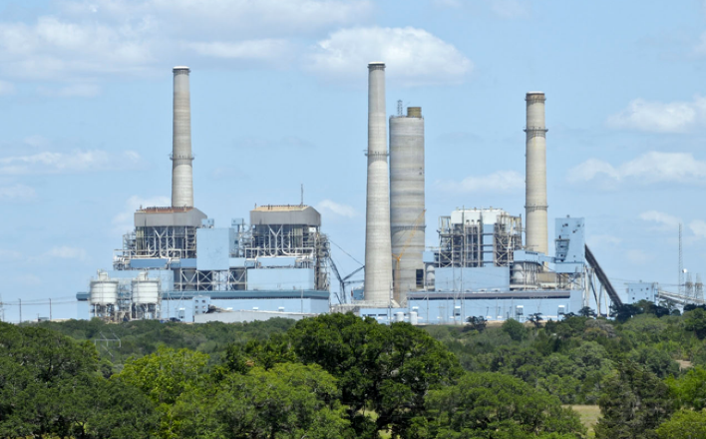
Securitization Has Resulted in Much Lower Revenue Requirements and Large Savings in Today’s Dollars (NPV) for Ratepayers
Duke Energy Florida (FL) 2016
  $1.294 billion in unrecovered depreciation of a closed/early retired nuclear plant.
  $680 million NPV Savings
Consumers Energy (MI) 2014
  $389.6 million unrecovered depreciation of 950 MW of coal-fired capacity retired in 2016.
  $135 million NPV Savings
Allegheny Energy (Monongahela Power & Potomac Edison) (WV) 2007, 2009
  $500 million in pollution control equipment and upgrades.
  $130 million NPV Savings
Notes:
Duke Energy Florida (FL) 2016
$1.294 billion in unrecovered depreciation of a closed/early retired nuclear plant.
$680 million NPV savings over 20 years.
Consumers Energy (MI) 2014
$389.6 million unrecovered depreciation of 950 MW of coal-fired capacity retired in 2016.
$135 million NPV Savings
Allegheny Energy (Monongahela Power & Potomac Edison) (WV) 2007, 2009
$500 million in pollution control equipment and upgrades.
$130 million NPV Savings

Slide 14
1
5 Components of Ratepayer Savings: Securitized “Debt for Equity”
Reductions in REVENUE REQUIREMENTS Lead to Large NPV Savings
2
Issue Stand-Alone, Non-Recourse Debt to Replace Shareholder Equity
55-57%
of NPV savings
Issue Stand-Alone, Non-Recourse Debt in place of Shareholder Equity
30-33%
Eliminate Utility’s Federal/State Income Taxes on Revenues Received to Pay Securitization Debt
of NPV savings
3
Level Principal and Interest Payments on the New Securitization Bonds vs. Traditional Declining Balance of Utility Debt & Equity at WACC
8-9%
of NPV savings
1-2%
Pay Lower Interest Rates due to AAA Bond Rating
vs. Utility’s lower Bond Rating (A3/ Baa1)
of NPV savings
4
<1%
Eliminate Other “Revenue Related” Fees
of NPV savings
5
Notes:
Not by just issuing more general corporate utility debt using utility’s balance sheet
Create new “stand-alone” credit directly on credit of ALL ratepayers jointly
Impose special charge (dedicated rate component) collected goes directly to new securitization bondholders
Give securitization bond investors no claim on any of Utility’s assets or income – only claim to special charge
versus traditional high-then declining-balance charges based on utility’s weighted average cost of capital (WACC)
on new stand-alone credit versus utility’s general corporate rated debt

Slide 15
Where Securitization Ratepayer NPV Savings Come From

Slide 16


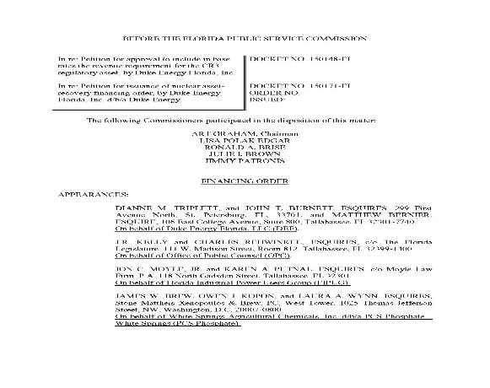

4 Phases of Utility Securitization
Special State
Authorizing
Legislation
Financing
Order Application
Write Detailed
Financing Order
Implement
Financing Order
  Testimony
  Transparency
  Utility Draft vs. Commission
  Estimates v Actual
  Structuring of Bonds
  Marketing
  Pricing

Slide 17
1
Key Components of a Special State Law Authorizing Securitization Primarily for Credit Rating Agencies Requirements
2
Create “Intangible Property Right” to a” Nonbypassable Charge” on All Ratepayers on Joint Basis –Right to Bill, Charge, Collect and Adjust
Issue Stand-Alone, Non-Recourse Debt in place of Shareholder Equity
Allow “True Sale” of the Property Right (transfer) to Ring Fenced /Bankruptcy Remote Entity
3
Allow Irrevocable Commission Financing Order – Require Foregoing Future Regulatory Review
Require Automatic Ongoing Commission True Up/True Down Adjustment of Nonbypassable Charge – No Cap
4
Require State Pledge of Non-Interference with
Bondholder Rights to Property/Charge
5
Notes:
Not by just issuing more general corporate utility debt using utility’s balance sheet
Create new “stand-alone” credit directly on credit of ALL ratepayers jointly
Impose special charge (dedicated rate component) collected goes directly to new securitization bondholders
Give securitization bond investors no claim on any of Utility’s assets or income – only claim to special charge
versus traditional high-then declining-balance charges based on utility’s weighted average cost of capital (WACC)
on new stand-alone credit versus utility’s general corporate rated debt

Slide 18
What’s the Difference Between Traditional Utility Bonds and Securitization Bonds?

Slide 19




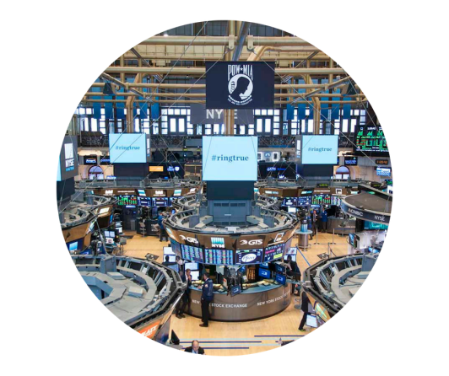
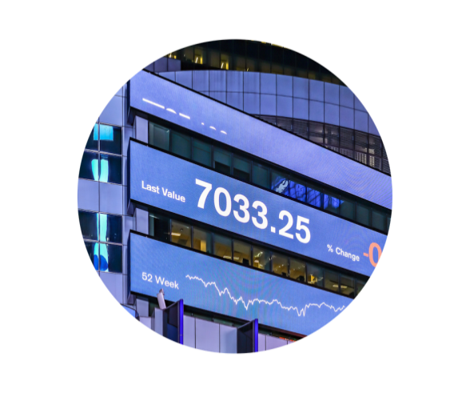
Is Utility Securitization a “Commodity” Product? All the Same?
“Cookie Cutter” Approach?? – State Specific
Standard
Documentation??
Sporadic Issuance and Amortizing Run Off of Bonds
Market Turnover in Personnel (Investors, Bankers etc.) since
2008-09 Financial Crisis Competing Investment for Yield vs Safety
Little Institutional
Memory

Slide 20



Traditional Utility Bond - Simple
Electric Service Customers
Public Utility Commission
Utility
Trustee
Semi-Annual Principal &
Interest Payments
Investors
Notes:
Traditional bonds are simple
Bond terms are negotiated with underwriters and investors…. Nothing “off the shelf” No Quicken Rocket Loans here

Slide 21

SECURITIZATION Bond: VERY Complex Transaction
Legislature
Electric Service Customers
4
Monthly Electric Service Bill Payments
6
After Bonds sold, charges (as Trued-up) Added to Monthly Electric Bill
Public Utility Commission
Irrevocable Financing Order
Utility
1
Sale of Property for Cash Payment
2
Cash Payment from Bond Proceeds
Utility Establishes a Newly Formed Ring-fenced/ Bankruptcy-remote Company
Securitization Finance Issuer
5
Utility Charges
3a
Pledge of Property
Bonds
3b
Bond Proceeds
Trustee
Semi-Annual Principal &
Interest Payments
Investors

Slide 22
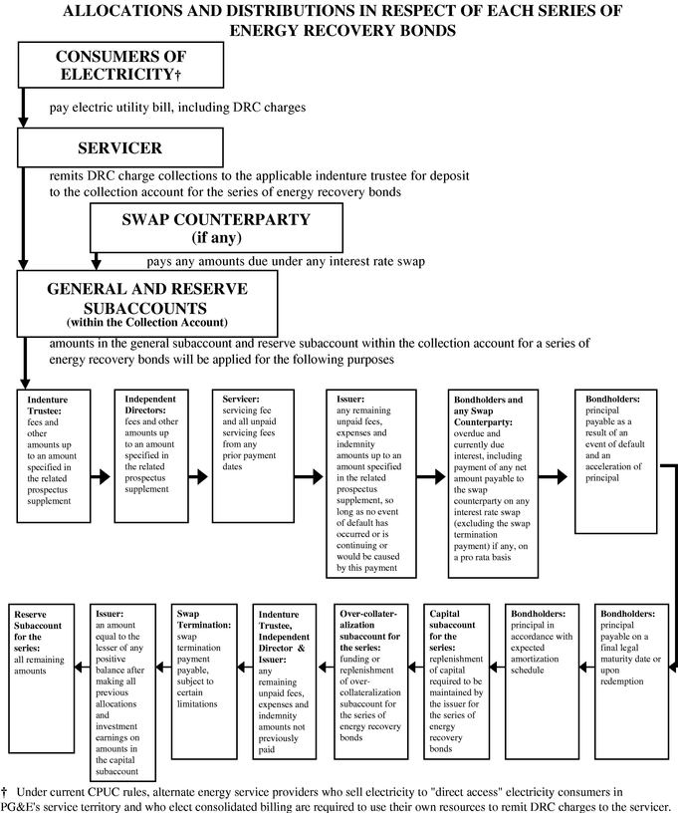
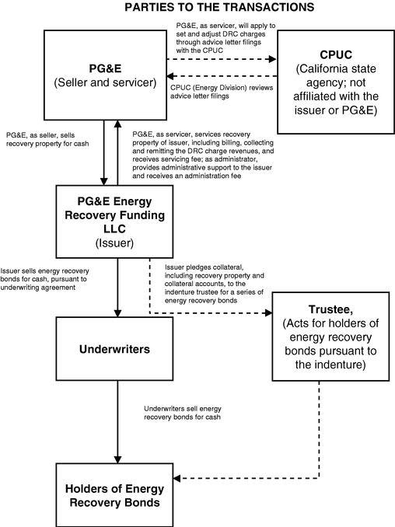
SEC Bond Offering Description Utility Securitization – PG&E

Slide 23

Financing Order is Just the Beginning
Selected Transaction Documents
Financing Order
Sale Agreements & Bill of Sale
Registration Statement
& Amendments (including
Prospectus and Supplement)
Service Agreement
Intercreditor Agreement
Indenture
Administration Agreement
Underwriting Agreement
Multiple Legal Opinions

Slide 24




Who are Principal Investors in Utility Securitization Bonds?
Money Managers
Corporations
Pension Funds
Insurance Companies

Slide 25
The KEY Issue for Regulators
Legistlature
Electric Service Customers
Public Utility Commission
Utility
Who represents customers/ratepayers in the structuring, marketing and pricing of the securitization bonds since utility not responsible for any costs??
In securitization, every dollar is a ratepayer dollar.
Issuer
Trustee
Semi-Annual Principal &
Interest Payments
How negotiated bond deals work…
Investors
Notes:
Cooperation (Commission & Utility) to Create Competition Among Underwriters & Investors

Slide 26

Why Transparency, Oversight and Commission/Utility Cooperation Are Needed
In traditional utility bond offerings, the negotiating parties have competing/conflicting economic interests.
Competing economic interests are balanced in the negotiation to lead to an “efficient” result.

Slide 27





Parties to a Bond Offering Negotiation in Structure, Marketing & Pricing
Utility/Issuers
Investors
Underwriters
Commission

Slide 28
Each Party Acts in Its Own Economic Interest and Competing Interests Are Balanced
Utility /Issuers
Investors
(when responsible for costs) seek lowest bond rates – can maximize allowed return by minimizing expenses between rate cases.
Seek highest return/rates for lending their capital in relation to bond’s credit risk (rating) and other factors
Underwriters
Commission
(middle person between issuer and investors) seek highest rates for the quickest sale while maintaining relationship with Utility/Issuer for future business
Retains full ongoing regulatory review over Utility’s cost of capital – Rate Cases

Slide 29



What is Different in Utility Securitization Bond Offering?
In Utility Securitization, Economic Interests of Parties
Are Not Balanced:
Utility
Investors
While still concerned about customers, Utility is not responsible for any bond costs – economic interest is to get the bond proceeds (money) as soon as possible
Seek highest return/rates for lending their capital even at top quality AAA rate – not all AAA bonds are priced alike
Ratepayers responsible for ALL costs!
Underwriters
Commission
(middle person between issuer and investors) continue to seek highest rates for quickest sale while maintaining relationship with Utility for future business
Must forego all POST ISSUANCE regulatory review over charge on bonds. Not permitted to adjust any other utility rates.

Slide 30


Leave It to the Underwriters?
Underwriters Have No Fiduciary Duty to Ratepayers nor Utility nor Commission
Excerpt from Securitization Bond “Underwriting Agreement” Underwriters Require of an Issuer
“Absence of Fiduciary Relationship"
[The utility] acknowledges and agrees that the Underwriters are acting solely in the capacity of an arm’s length contractual counterparty to the [utility] with respect to the offering of the Bonds ... (including in connection with determining the terms of the offering) and not as a financial advisor or a fiduciary to, or an agent of, (the utility) …
1
2
[The utility will] consult with their own advisors concerning such matters and shall be responsible for making their own independent investigation and appraisal of the transactions contemplated, and the Underwriters shall have no responsibility or liability to [the utility] with respect thereto.
3
Any review by the Underwriters … of the structure and terms of the transactions ...will be performed solely for the benefit of the Underwriters and shall not be on behalf of [the utility] . . . .”*
*See the language quoted above in AEP Texas securitization transaction 2012
https://www.sec.gov/Archives/edgar/data/18734/000090514812000765/efc12-292_ex11.htm

Slide 31


Conflicting Economic Interests That Are Not Balanced Create Hurdles to Lowest Cost Financing for Ratepayers
Underwriter Objectives vs. Ratepayer Interests
“Price it to sell quickly, move on”
Little investor education on unique securitization credit, true-up, charge on essential commodity
Investor and underwriter misperceptions of utility securitization credit and liquidity
Mispricing of bond credit and “relative value” to other investmernts
Higher cost to ratepayers.

Slide 32
Differences with Traditional Utility Bond Offerings
TRADITIONAL
OFFERING
SECURITIZATION OFFERING
Familiar Credit but Lower
Frequent Issuance
  Across yield curve
Broad Participation
  $250 Million Deal
  200 Investors
Bond Trade Frequently
New Credit & AAA Credit
Sporadic Issuance Market Wide
  One-off/Unique for the Utility
Narrow Distribution
  $1 Billion Deal
  20-30 Investors
Not much trading

Slide 33
Identifying Best Practices for Ratepayers

Slide 34
Protecting the Ratepayer Checkbook – Keeping Things in Balance

Slide 35
6 Basic Best Practices for Ratepayers
6. A 120-day post-issuance Commission review and audit of financing costs.
5. Commission Resources:
No artificial or arbitrary limits placed on the scope of the financial advisor’s or legal counsel’s activities or their fees, so long as they are agreed to by the Commission.
Payment of fees of the Commission experts, including any financial advisor and legal counsel, should be a transaction cost identical to treatment of utility advisors, counsel and underwriters.
4. The Commission needs access to expert resources with a duty of loyalty solely to the Commission to complement staff e.g., financial advisor and outside legal counsel to protect ratepayers’ interests and support a fiduciary duty to ratepayers.
3. Utility should certify with confirmation by the Commission after pricing but before closing that the lowest cost standard in fact has been achieved so that the Commission could stop the transaction if standard not achieved as allowed in other states.
2. A clear and meaningful “lowest cost to ratepayers” standard under market conditions at the time of pricing established.
1. Commission authority to include additional terms and conditions in the financing order for the benefit of ratepayers and to protect the public interest in structure, marketing and pricing..

Slide 36
Active Commission Oversight with Utility Cooperation Have Produced Better Market Results

Slide 37
Judging Success in Capital Markets - Focus on Credit Spread

Slide 38




Challenges in Structuring, Marketing & Pricing of Utility Securitization
Wide variances in total cost to ratepayers.
Wide variances in transaction costs.
Credit spreads vary dramatically.
  U.S. Agencies + Sovereigns
  Mortgage-Backed Securities
  Pure Corporates + Utilities
Not all AAA’s price alike. Debate over relative value of competing investments

Slide 39
Recent Examples of Different AAA Interest Rates in Market

Slide 40








All AAA rated securities do not price alike, as evidenced by pricing variations across various long-dated AAA rated corporate, agency, ABS / CMBS, and municipal bonds shown below
Secondary Trading Spreads – 10-Year AAA Comparables MARCH 29, 2019
Source: Bloomberg; TRACE. Includes trades of $1 million or more.
(1) Represents new-issue transaction and associated pricing.

Slide 41
Best Practice Examples

Slide 42
1999 Texas Public Utilities Regulatory Act (PURA) Mandate –
Began the “Active Commission Involvement” Practice - A Best Practice
“The commission shall ensure that securitization provides tangible and quantifiable benefits to ratepayers, greater than would have been achieved absent the issuance of transition bonds.”
“The commission shall ensure that the structuring and pricing of the transition bonds result in the lowest transition bond charges consistent with market conditions and the terms of the financing order.”
See https://statutes.capitol.texas.gov/Docs/UT/htm/UT.39.htm
Notes:
As you seen from the graph showing the pricing of transactions in Texas and Florida, saving some Securitization are not automatic. There is a need for transparency and oversight – regulator and utility working together – to get the best results from often brutal capital markets

Slide 43
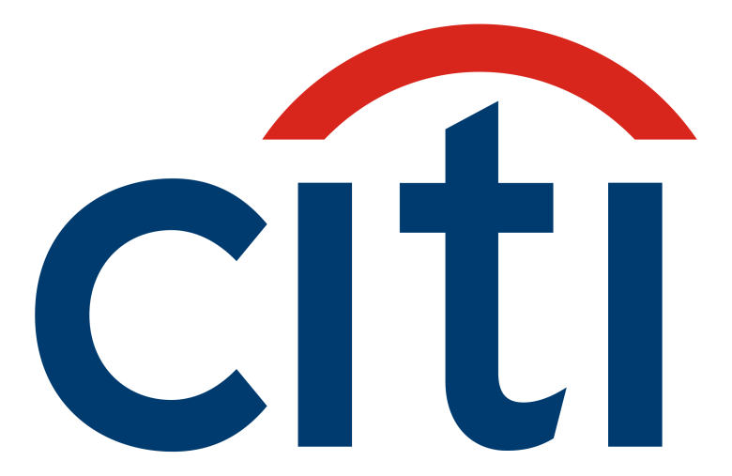
Subject: TX savings summary (revised)
Date: Fri, 19 Sep 2003 17:44:00 -0400
From: "Donskaya, Marina [FI]" marina.donskaya@citigroup.com
To: "Joseph Fichera (E-mail)" jfichera@saberpartners.com
Cc: "Humphrey, Paul G [FI]" paul.g.humphrey@citigroup.com...
“To summarize, the difference in total savings vs other transition bonds
Reliant: $3,773,775 or 6.5 bps/yr (nominal), $2,955,295 or 5.1 bps/yr (PV)
CPL: $12,951,663 or 20.3 bps/yr (nominal), $9,748,976 or 15.3 bps/yr (PV)
Oncor: $6,629,694 or 19.4 bps/yr (nominal), $5,278,669 or 15.4 bps/yr (PV)
Total: 23,355,132 (nominal), 17,982,941 (PV)”
Example: Citigroup and Other Studies Confirmed Savings From Active Commission Oversight – First 3 Texas Deals 2001-2003
Prior to the first Texas sale in 2001, $21 billion utility securitization bonds were sold with no active Commission involvement…
Citi’s analysis showed $23 million+ savings to Texas customers from active PUC Texas oversight with their advisors on Texas’ first three securitization offerings.
Notes:
FROM SLIDE 36
Example: Citigroup and Other Studies Confirmed Savings From Active Commission Oversight
$23 million+ savings to Texas customers from active PUC Texas oversight with advisors on Texas’ first three securitization offerings
Subject: TX savings summary (revised)
Date: Fri, 19 Sep 2003 17:44:00 -0400
From: "Donskaya, Marina [FI]" marina.donskaya@citigroup.com
To: "Joseph Fichera (E-mail)" jfichera@saberpartners.com
Cc: "Humphrey, Paul G [FI]" paul.g.humphrey@citigroup.com...
“To summarize, the difference in total savings vs other transition bonds
Reliant: $3,773,775 or 6.5 bps/yr (nominal), $2,955,295 or 5.1 bps/yr (PV)
CPL: $12,951,663 or 20.3 bps/yr (nominal), $9,748,976 or 15.3 bps/yr (PV)
Oncor: $6,629,694 or 19.4 bps/yr (nominal), $5,278,669 or 15.4 bps/yr (PV)
Total: 23,355,132 (nominal), 17,982,941 (PV)”
For complete report/email See
https://saberpartners.com/testimonial/citigroup-shows-saber-partners-saves-texas-electricity-customers-23-million /
Basis points (bps) = .001th% PV= Present Value

Slide 44
Best Practice Example: Active Commission Ratepayer Savings 2001-2005
Basis points (bps) = .001th%
Notes:
FROM SLIDE 37
From An ACTIVE Commission Vs. Other STATES
2001-2005 Comparing New Issue Pricings/Interest Rate Credit Spreads of Securitization Bond Offerings
Differences Between 2 Lines = COSTS in % Vs Benchmark By Bond Maturity

Slide 45
Best Practice Example: Florida Ratepayer Savings From An ACTIVE Commission Vs. Other States 2010-2016
2016 Florida Public Service
Commission
Established Lowest Cost Objective
Created Bond Team – Commission and Utility
Sold $500+ million LONG Duration 15-20 years
Largest offering of its kind to date
Untested long term market
Other States
Florida
Notes:
*FROM SLIDE 38/39

Slide 46
Best Practice Example: Florida Ratepayer Savings From An ACTIVE Commission Vs. Other States 2010-2016
Notes:
*FROM SLIDE 38/39

Slide 47
Transparency, Oversight, Cooperation, Collaboration

Slide 48
Besides Pricing, Emerging Utility Securitization Issues
Should securitization be a permanent part of ongoing capital structure or “one-off”? Smaller balance sheet? Safer?
Always voluntary at will of utility or can it be mandated?”
How much securitization is too much?

Slide 49
Joseph S. Fichera
CEO, Saber Partners, LLC
NRRI Fellow
Investor-Owned Securitization
Debt for Equity
Thank you for the privilege of your time.

