Slide 1
SURFA
Entergy Corp. Securitizations
Cfshare/steve/2019/surfa.pptx

Slide 2
Purpose
Entergy Securitizations
Closing Date | Size ($M) |  | Purpose
2007 | 55.2 | MS | Hurricanes Katrina / Rita - 2005
2007 | 329.5 | TX | Hurricane Rita
2008 | 278.4 | LA | Hurricanes Katrina / Rita
2008 | 687.7 | LA | Hurricanes Katrina / Rita
2009 | 545.9 | TX | Hurricanes Ike / Gustav - 2008
2010 | 244.1 | LA | Hurricanes Ike / Gustav
2010 | 468.9 | LA | Hurricanes Ike / Gustav
2010 | 124.1 | AR | 2009 ice storms
2011 | 207.2 | LA | Construction costs – Little Gypsy
2014 | 243.8 | LA | Hurricane Isaac - 2012
2014 | 71.0 | LA | Hurricane Isaac
2015 | 98.7 | CNO | Hurricane Isaac
 | $3.3Bn

Slide 3



Use of Proceeds
Entergy Securitizations
Date | Size ($M) |  | construction costs | carrying costs | storm reconstruction costs | build up storm reserves | issuance expenses
2007 | 55.2 | MS
2007 | 329.5 | TX
2008 | 278.4 | LA
2008 | 687.7 | LA
2009 | 545.9 | TX
2010 | 244.1 | LA
2010 | 468.9 | LA
2010 | 124.1 | AR
2011 | 207.2 | LA
2014 | 243.8 | LA
2014 | 71.0 | LA
2015 | 98.7 | CNO

Slide 4
Use of Proceeds Examples
Entergy Securitizations
Date | Size ($M) |  | construction costs | carrying costs | storm reconstruction costs | build up storm reserves | issuance expenses
2007 | 55.2 | MS
2007 | 329.5 | TX
2008 | 278.4 | LA
2008 | 687.7 | LA
2009 | 545.9 | TX | 0 | ~$44M | ~$496M | 0 | ~$5M
2010 | 244.1 | LA
2010 | 468.9 | LA
2010 | 124.1 | AR
2011 | 207.2 | LA | ~$201M | ~$3M | 0 | 0 | ~$3M
2014 | 243.8 | LA
2014 | 71.0 | LA
2015 | 98.7 | CNO | 0 | ~$ | ~$32M | ~$64M | ~$3M

Slide 5
Savings Example
Entergy Securitizations

Slide 6

Credit Support Example - 2010 Arkansas
Entergy Securitizations
 | Arkansas Electric Utility Storm Recovery Securitization Act | APSC Financing Order of May 25, 2010 | Entergy Arkansas Restoration Funding, LLC | Entergy Arkansas
a financing order will be irrevocable
State pledge to not impair value of the storm recovery property
Recovery charge will be nonbypassable within service territory
A security interest can be perfected in storm recovery property / valid lien
True sale under Arkansas law
Bankruptcy remote SPE
True Up Mechanism ensures transition charge revenues sufficient to make bond payments
Capital subaccount funded at closing to cover any payment shortfalls

Slide 7
Ratings
Entergy Securitizations
Closing Date | Size ($M) |  | Ratings (S&P/M/F)
2007 | 55.2 | MS | AAA / - / -
2007 | 329.5 | TX | AAA / Aaa / AAA
2008 | 278.4 | LA | AAA / Aaa / AAA
2008 | 687.7 | LA | AAA / Aaa / AAA
2009 | 545.9 | TX | AAA / Aaa / AAA
2010 | 244.1 | LA | AAA / Aaa / AAA
2010 | 468.9 | LA | AAA / Aaa / AAA
2010 | 124.1 | AR | AAA / Aaa / AAA
2011 | 207.2 | LA | AAA / Aaa / AAA
2014 | 243.8 | LA | AAA / Aaa / -
2014 | 71.0 | LA | AAA / Aaa / -
2015 | 98.7 | CNO | AAA / Aa1 / -

Slide 8
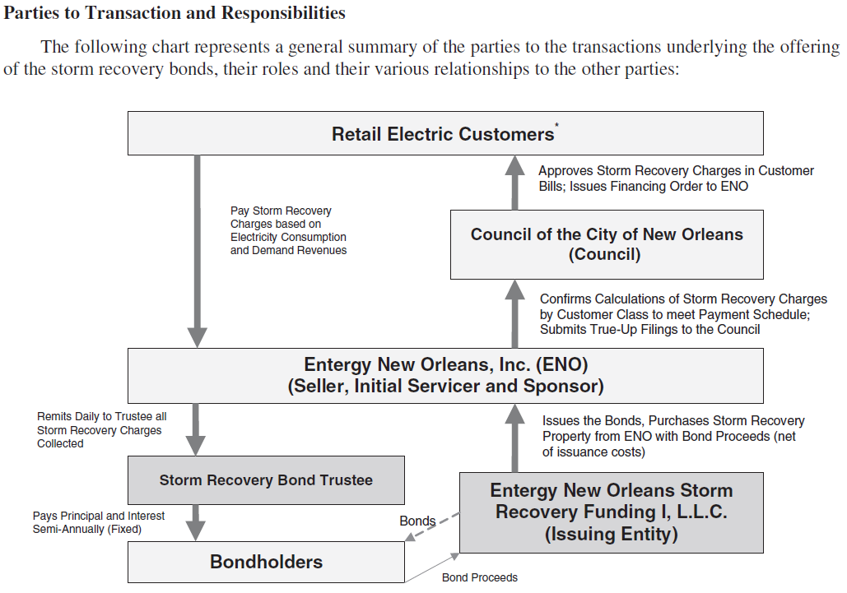

Slide 9
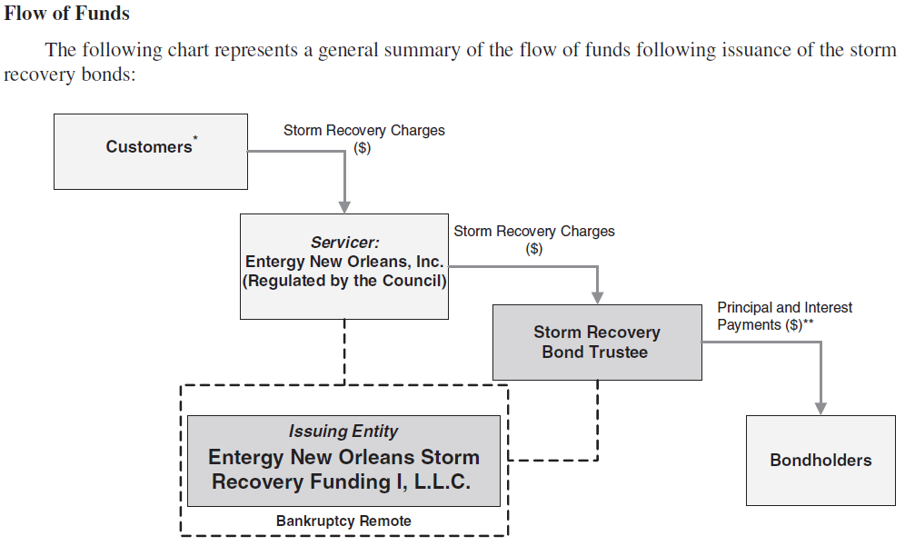

Slide 10
Parties Involved
(example: 2011 Louisiana issuance)
Entergy Securitizations
Company / Servicer: Entergy Louisiana
Company Counsel: Sidley Austin; Phelps, Dunbar
Company Auditors: Deloitte
Company Financial Advisor: Morgan Stanley
Issuer: Entergy Louisiana Investment Recovery Funding I, LLC
Issuer Counsels: Sidley; Phelps; Richard, Layton & Finger
PUC Counsel: Crawford Lewis; Stone Pigman
PUC Advisor: Sisung Group
Trustee: Bank of New York Mellon
Trustee Counsel: Gregory A. Pletsch & Associates
Underwriters: MS, Citi, Morgan Keegan, Stephens
Underwriters’ Counsel: Dewey LeBoeuf
Rating Agencies: Moody’s, S&P
Others: Bondholders, Customers

Slide 11
Amortization Schedules
Entergy Securitizations
$millions

Slide 12
Tranches’ Coupon Rates
Entergy Securitizations

Slide 13
Tranches’ Sizes
Entergy Securitizations

Slide 14
Tranches’ Scheduled Maturities
Entergy Securitizations

