Slide 1

The Utility Industry: Capital Markets Outlook
Michael Gaugler
Managing Director
mgaugler@janney.com
215.665.1359

Slide 2

Who we are:
Tracing our roots to 1832, a Philadelphia-based full service financial services firm, owned by Penn Mutual Life Insurance Company with $135 billion in client assets under management.
Janney has 130 offices in 21 states, with more than 850
financial advisors and more than 200 capital markets professionals. Total employees exceeds 2,800.
Capital Markets Capabilities
Notes:
Just some background about Janney – we’ve been around a long time – 186 years in the Philadelphia area. We’re owned by Penn Mutual Life Insurance based on Horsham, Pennsylvania. We’re a full-service financial services firm, which continues to grow its presence along the eastern seaboard and throughout the Midwest. Our capital markets presence includes research, investment banking, sales & trading and fixed income.

Slide 3
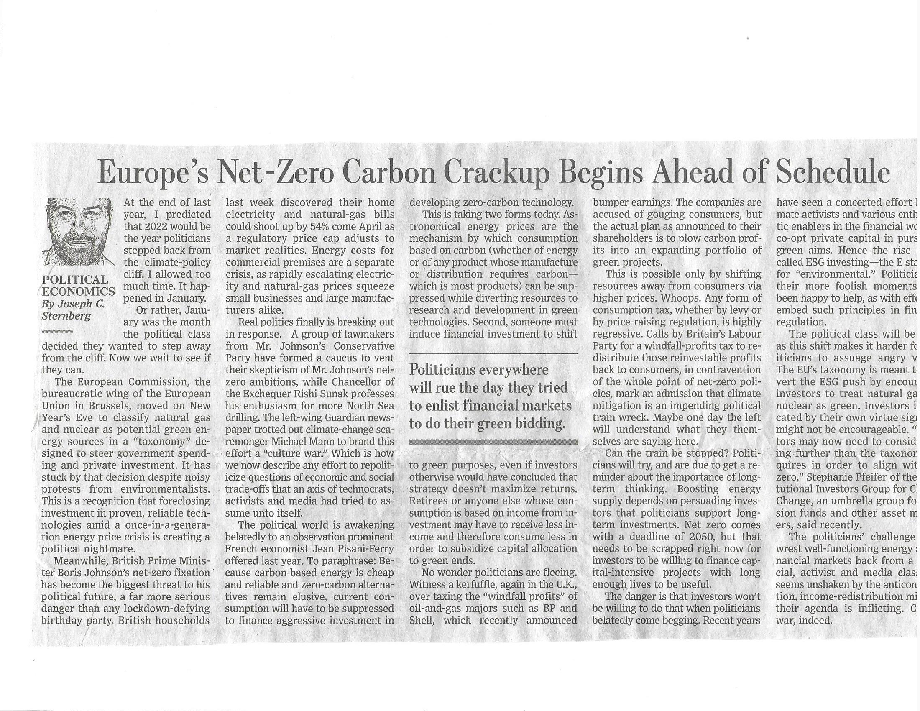
Our Favorite Headlines
Notes:
I cover the utility and infrastructure sectors in Janney’s research department, this slide shows our utility coverage universe in gas, electric and water. Our focus is primarily the Mid-Atlantic and the Northeast, and the companies shown on this slide in yellow are based from D.C. to Maine. As we originally looked at coverage a few years ago, we decided to focus on the Mid-Atlantic and Northeast, given this is where the growth is, primarily driven by Marcellus Shale opportunities. Full disclosure, Janney has had corporate relationships with many of the companies on this years dating back for several decades.

Slide 4
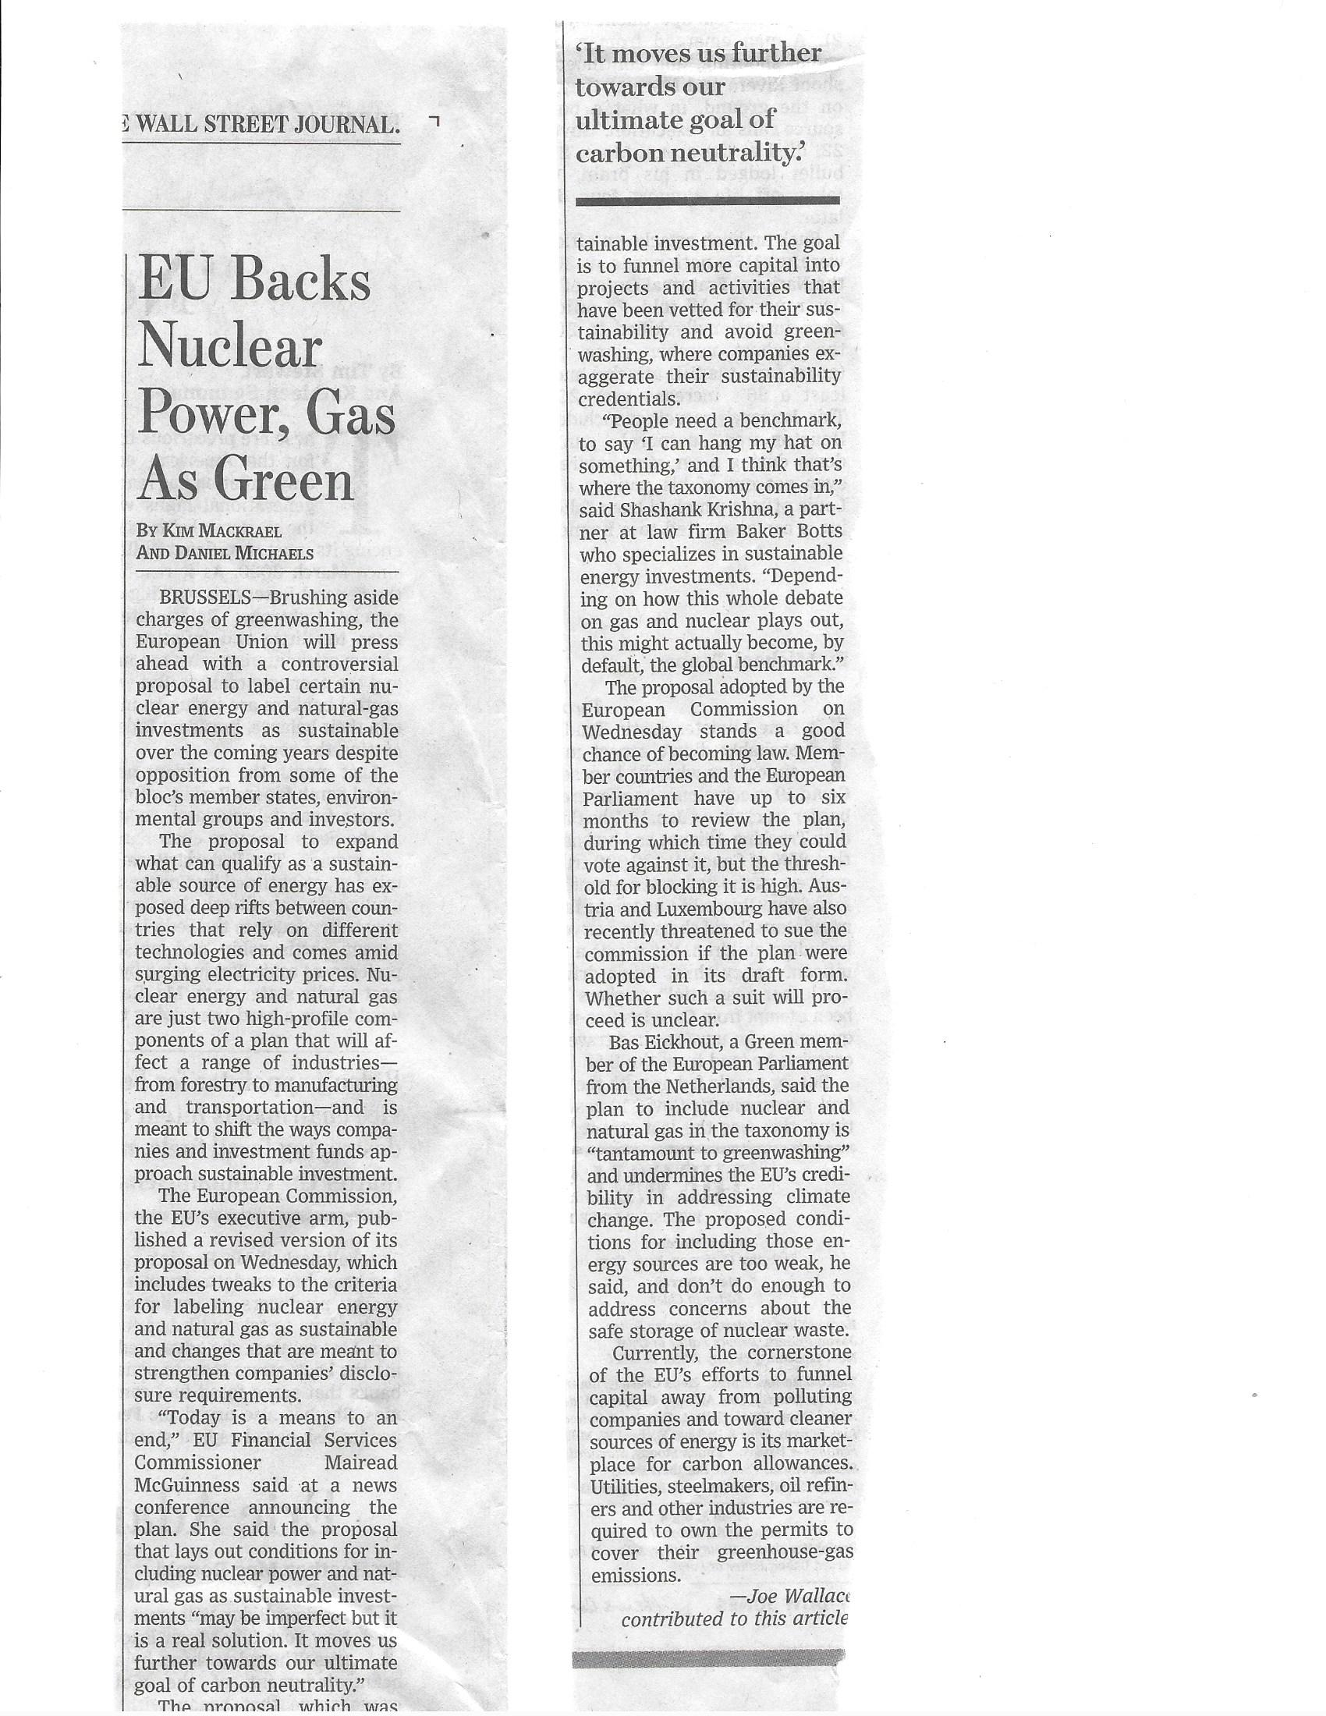
Notes:
I thought we’d open taking a long range view of natural gas prices, and the following chart covers the last 10 years. Prior to 2008, natural gas prices had been rather volatile; improvements in fracking for both oil and gas made that production method more affordable, and prices for natural gas have largely moved lower as production processes continued to improve, which continues today. In the Mid-Atlantic, dry gas in the Marcellus Shale region in Pennsylvania has opened up substantial and inexpensive supplies, with the potential to supply the Mid-Atlantic, Northeast and Southeast for decades to come. Supplies are so abundant that natural gas prices have traded in a very narrow range for the last several years. Forward outlooks are for this trend to continue, as supply far outstrips demand at the current time.

Slide 5
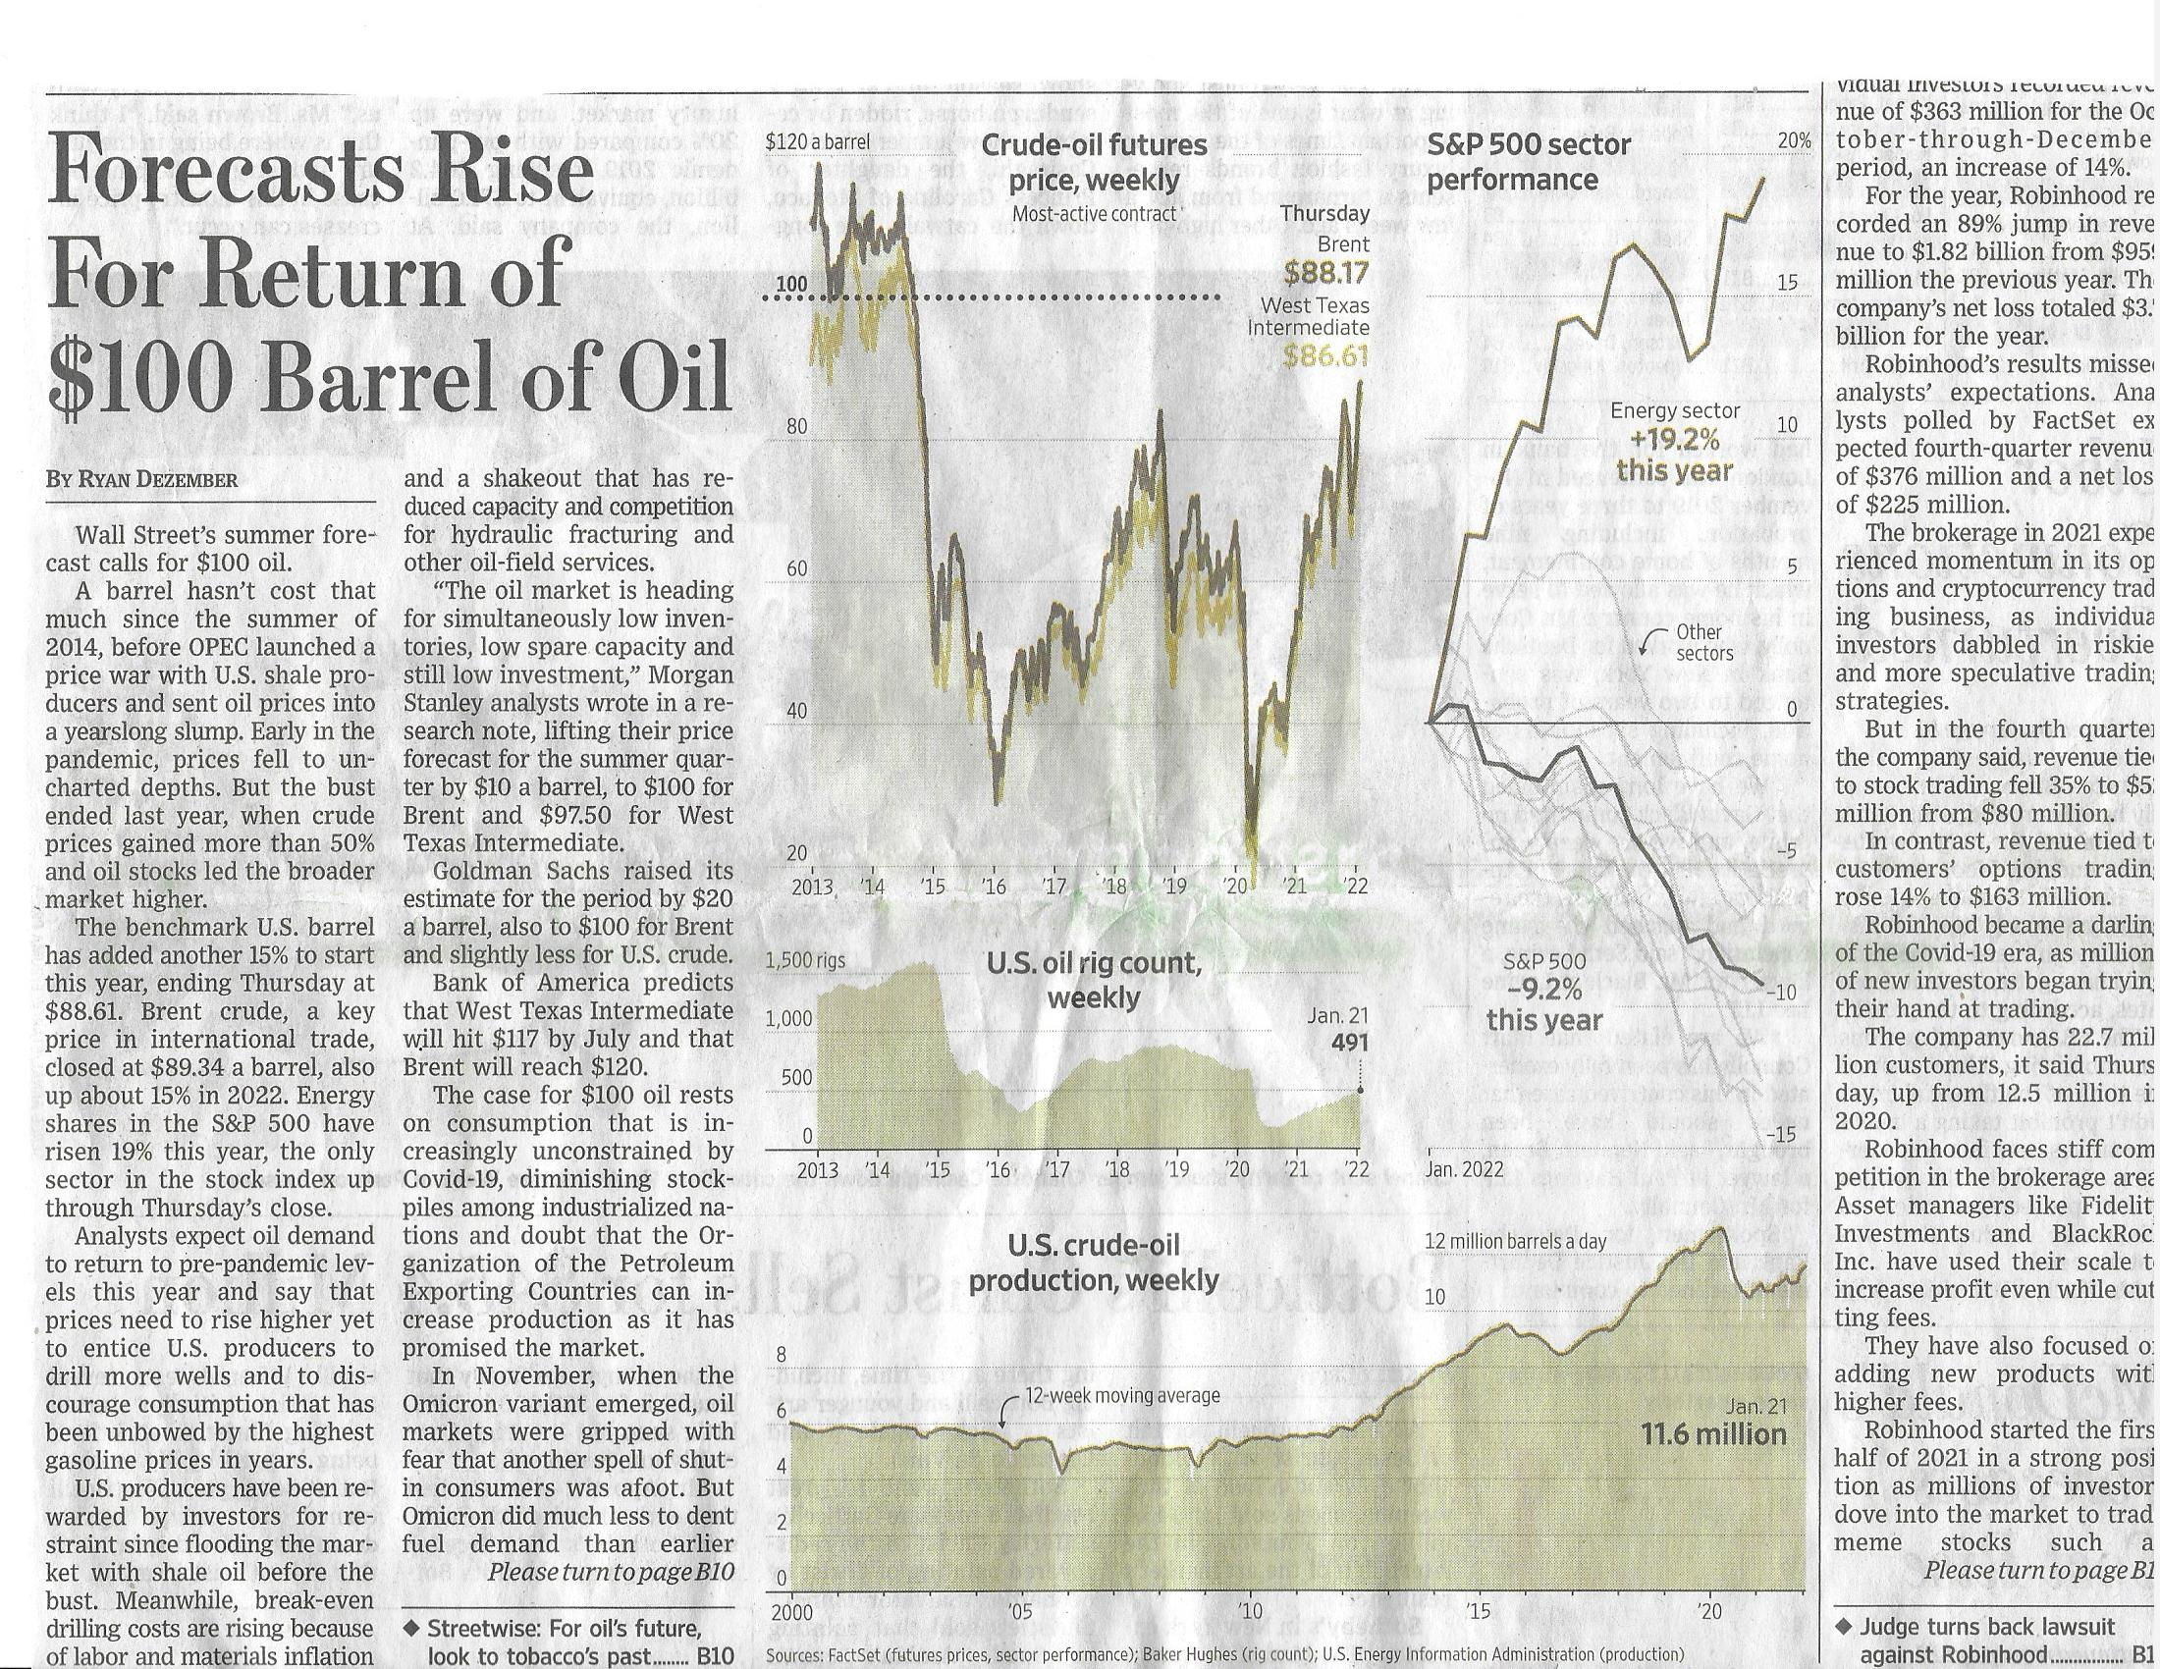
Notes:
One problem with Marcellus Shale gas is getting it to where its needed. I’m sure everyone here is aware pipeline capacity out of Marcellus to specific Mid-Atlantic and Northeast regions is very tight and largely inadequate. Compounding this problem is retirements of coal and nuclear generating stations, which are largely being replaced by natural gas and renewables.
I grabbed these power daily pricing charts from the recent cold snap experienced at the end of 2017 and into the beginning of 2018. You can see that in the New England ISO, power prices were more than 2x those in the PJM Interconnection. The primary reason is lack of adequate natural gas supply for generators in New England, which to be absolutely fair is the regions fault. In its rush to retire coal and nuclear stations (and replace them with natural gas), they never stopped to consider the infrastructure needs.
Turns out they need more pipeline capacity; unfortunately building a pipeline in New England is probably impossible given the political climate, which seems to believe it can get by with adding renewables. It might actually work; there are projects on the drawing boards to bring sufficient hydropower from Canada to the New England ISO, which is absolutely the cheapest power available. The problem for New England is getting through the next 5-10 winters until that supply comes online; parts of New England oppose the transmission lines necessary to bring that power into that region. The lack of coordination on energy policy among the states has driven electricity prices significantly higher, and that doesn’t look set to change anytime soon. Grid reliability is also an issue, given razor thin reserve margins.

Slide 6
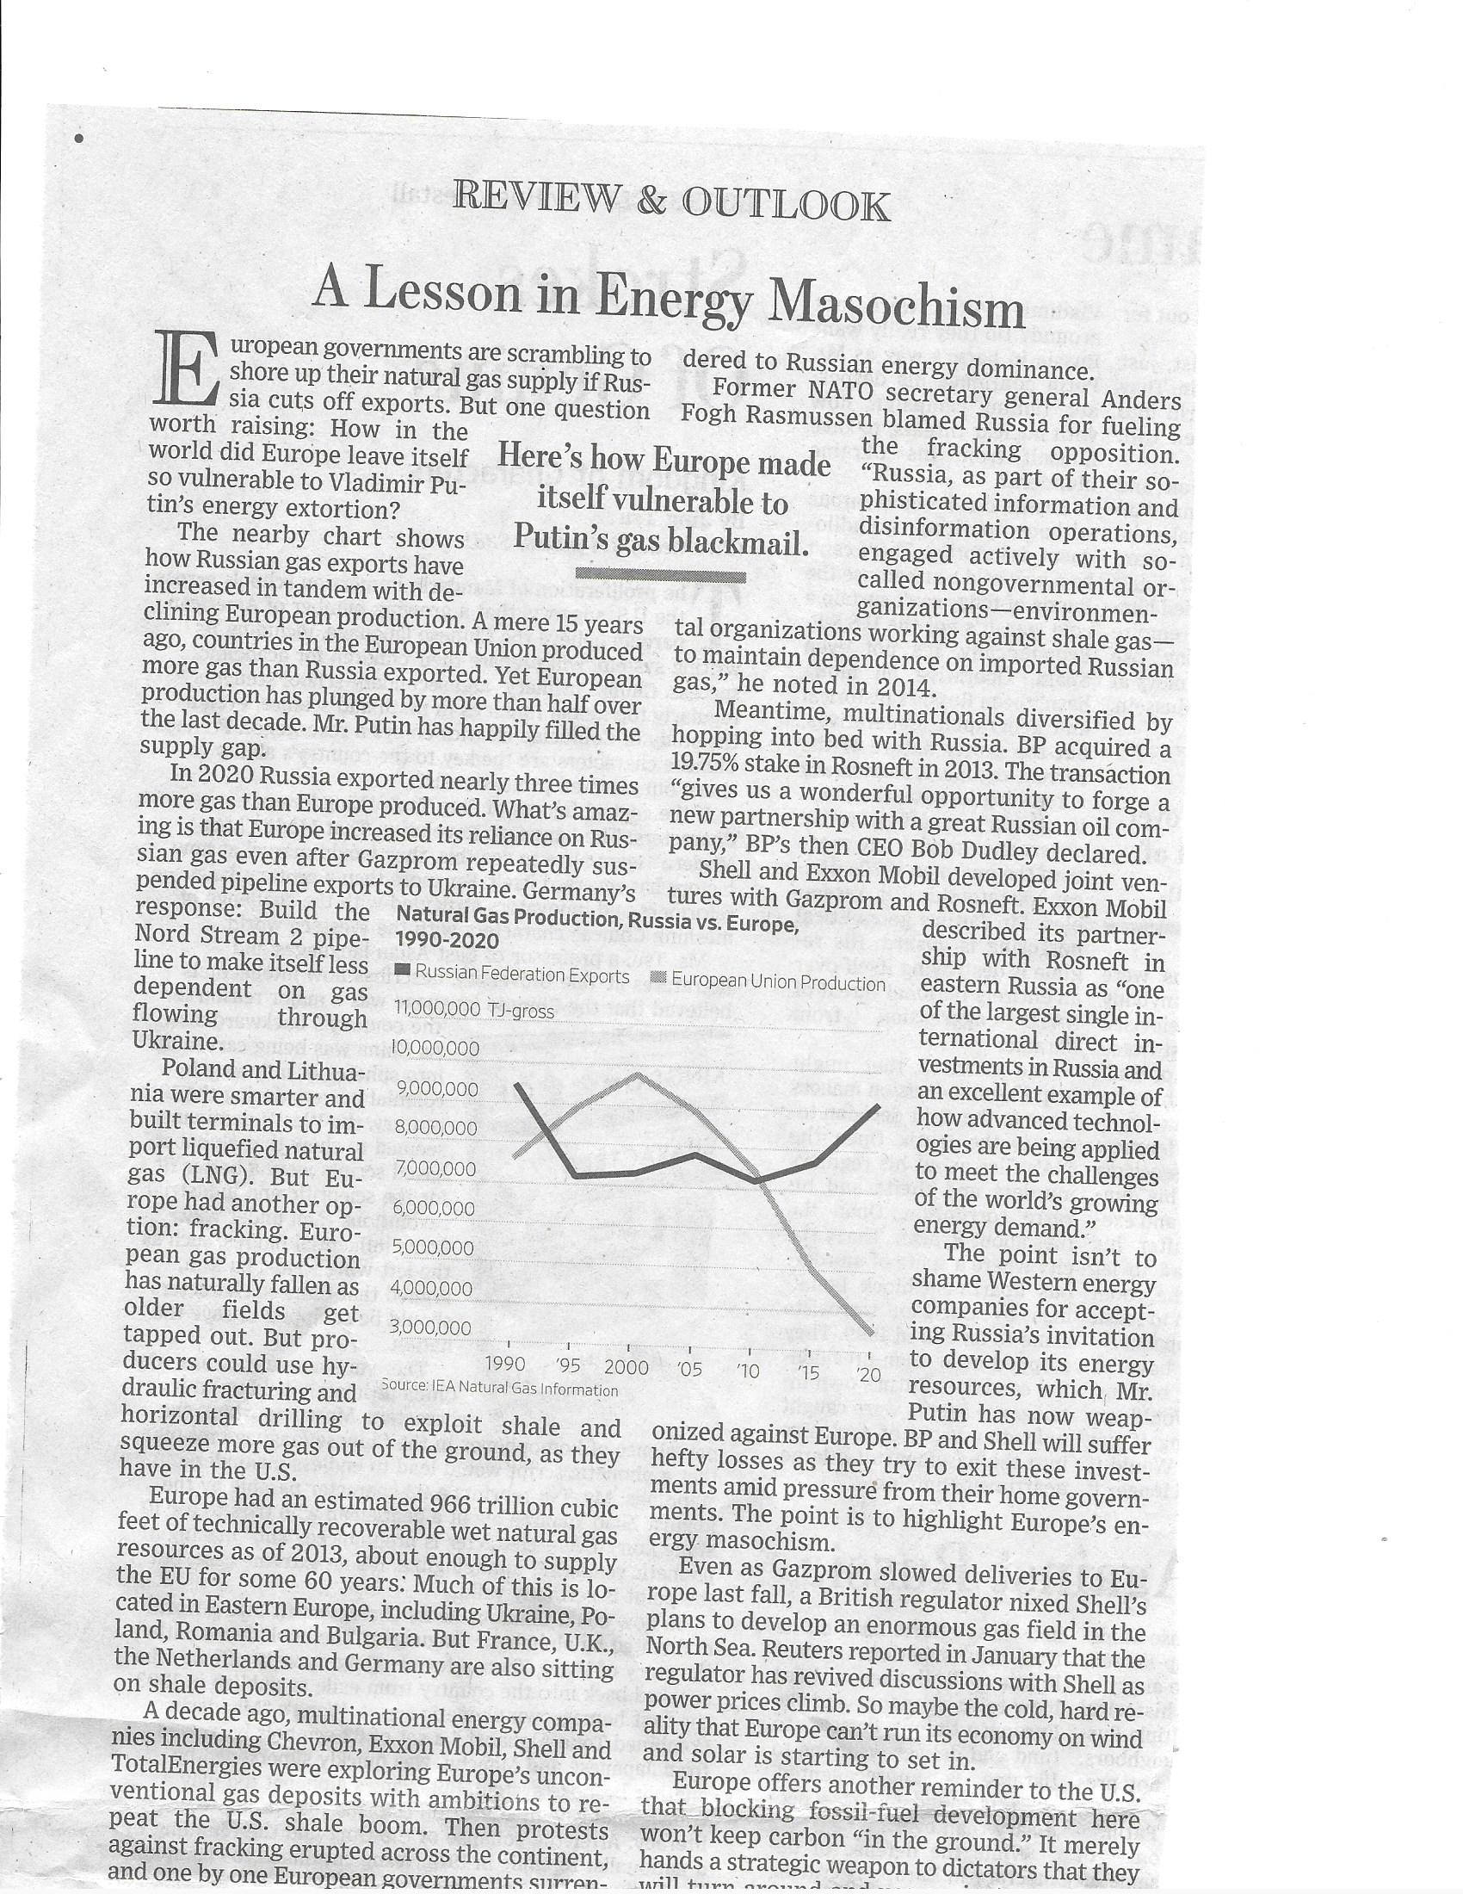
Notes:
The next three slides depict the major pipelines serving the mid-Atlantic and northeast regions. This one shows the long view, from the gulf of mexico into the northeast; these lines are older, have been around for many years, and move natural gas substantial distances to final delivery points.

Slide 7
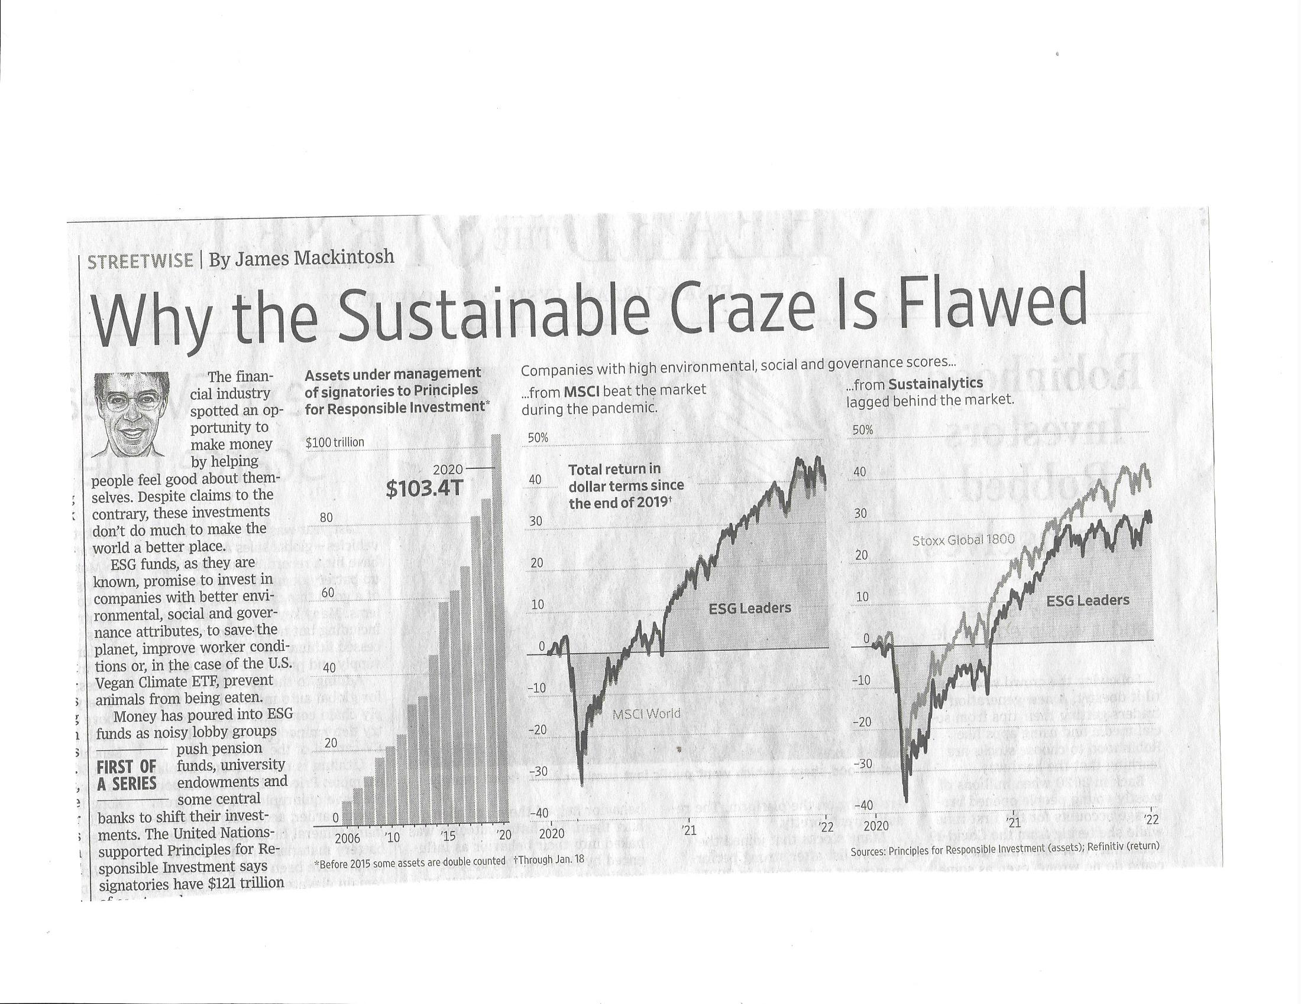
Notes:
This slide zooms in a bit more, showing the mid-Atlantic/Northeast pipeline footprint, highlighting areas of congestion.

Slide 8
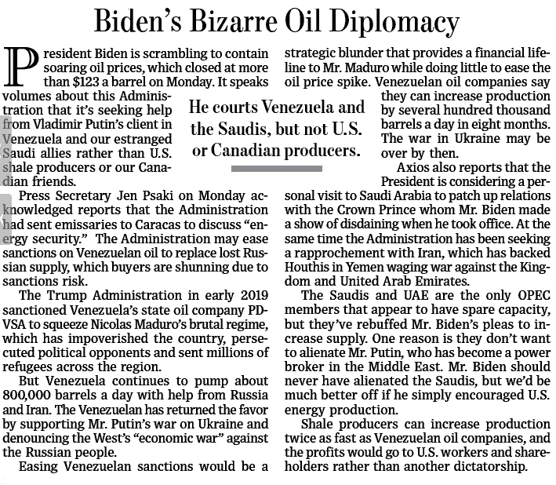
Notes:
This slide zooms in a bit more, showing the mid-Atlantic/Northeast pipeline footprint, highlighting areas of congestion.

Slide 9
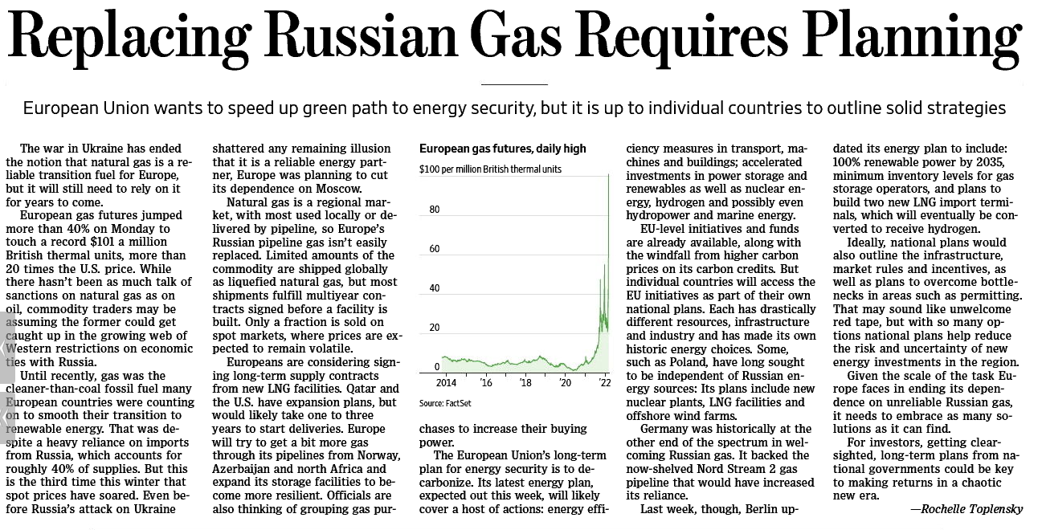
Notes:
This slide zooms in a bit more, showing the mid-Atlantic/Northeast pipeline footprint, highlighting areas of congestion.

Slide 10
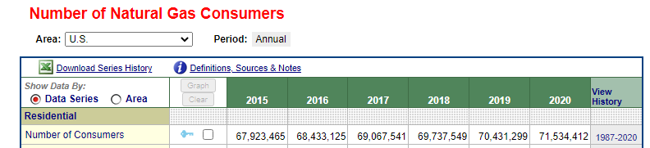
Notes:
This slide zooms in a bit more, showing the mid-Atlantic/Northeast pipeline footprint, highlighting areas of congestion.

Slide 11
Wrapping Up
Oil prices in U.S. likely to remain high for years; global market. LNG exports should accelerate materially. Europe’s energy needs (oil & gas) will draw on supplies.
Heating oil likely will be less affordable for many years (perhaps never again); NG was 35% cheaper in 12/21 when oil was $65 to $75 BBL; opportunity exists to convert large amounts of customers due to economic necessity.
With energy-driven inflation across the economy, natural gas customers will not want to give up NG services to switch to higher-cost alternatives like electric.
2020 natural gas customers = 71.5MM; 2020 presidential voters = 154MM, winner garnered 80MM. NG customers reeling from inflation will want to defend a cheap energy source in the 2024 election cycle.
2025 likely ushers in new energy policy; projects shelved or previously unable to be permitted could have a window of opportunity to move forward. Republicans controlled the Presidency for 12 years after the Carter administration.
Notes:
This slide zooms in a bit more, showing the mid-Atlantic/Northeast pipeline footprint, highlighting areas of congestion.

Slide 12
Disclosures
IMPORTANT DISCLOSURES
Research Analyst Certification
I, Michael Gaugler, the Primarily Responsible Analyst for this research report, hereby certify that all of the views expressed in this research
report accurately reflect my personal views about any and all of the subject securities or issuers. No part of my compensation was, is, or will
be, directly or indirectly, related to the specific recommendations or views I expressed in this research report.
Janney Montgomery Scott LLC ("Janney") Equity Research Disclosure Legend
Individual disclosures for the companies mentioned in this report can be obtained by accessing our Firm’s Disclosure Site
https://jms.bluematrix.com/sellside/Disclosures.action?encrypt=d5a9bb5a-57a8-4d10-a44b-008354befa8f?
Definition of Ratings
BUY: Janney expects that the subject company will appreciate in value. Additionally, we expect that the subject company will outperform
comparable companies within its sector.
NEUTRAL: Janney believes that the subject company is fairly valued and will perform in line with comparable companies within its sector.
Investors may add to current positions on short-term weakness and sell on strength as the valuations or fundamentals become more or less
attractive.
SELL: Janney expects that the subject company will likely decline in value and will underperform comparable companies within its sector.
Janney Montgomery Scott Ratings Distribution as of 03/31/18
IB Serv./Past 12 Mos.*
Rating Count Percent Count Percent
BUY [B] 116 48.95 34 29.31
NEUTRAL [N] 119 50.21 26 21.85
SELL [S] 2 0.84 0 0.00
*Percentages of each rating category where Janney has performed Investment Banking services over the past 12 months.
Other Disclosures
Janney Montgomery Scott LLC, is a U.S. broker-dealer registered with the U.S. Securities and Exchange Commission and a member of the
New York Stock Exchange, the Financial Industry Regulatory Authority and the Securities Investor Protection Corp.
This report is for your information only and is not an offer to sell or a solicitation of an offer to buy the securities or instruments named or
described in this report. Interested parties are advised to contact the entity with which they deal or the entity that provided this report to
them, should they desire further information. The information in this report has been obtained or derived from sources believed by Janney
Montgomery Scott LLC, to be reliable. Janney Montgomery Scott LLC, however, does not represent that this information is accurate or
complete. Any opinions or estimates contained in this report represent the judgment of Janney Montgomery Scott LLC at this time and are
subject to change without notice.
Investment opinions are based on each stock's 6-12 month return potential. Our ratings are not based on formal price targets, however,
our analysts will discuss fair value and/or target price ranges in research reports. Decisions to buy or sell a stock should be based on the
investor's investment objectives and risk tolerance and should not rely solely on the rating. Investors should read carefully the entire
research report, which provides a more complete discussion of the analyst's views. Supporting information related to the recommendation,
if any, made in the research report is available upon request.

