Slide 1

SURFA Conference
4/29/22
Durgesh Chopra
Durgesh.Chopra@evercoreisi.com
212.653.8998
Michael Lonegan
Michael.Lonegan@evercoreisi.com
212.653.8997
Sharon Wang
Sharon.Wang@evercoreisi.com
212.653.8999
*See the last page for important disclosures regarding these stocks and this report.

Slide 2
US Electricity Demand Growth Since 1950—We Are Well Past A High Growth Period
In the chart below, we show US electric demand growth over three periods:
  High Growth Period - 1949 to 1980: Electricity demand grew almost twice as fast as GDP. Consumption was driven by increased penetration of electric appliances in the residential and commercial sectors and energy intensive industrial production (steel, manufacturing, etc.).
  Moderate Growth Period - 1980 to 2000: Electricity demand grew at 0.8x GDP. Demand growth slowed with the transition toward a less energy intensive industrial sector and increased energy efficiency.
  Low Growth Period - 2000 to 2020: Electricity demand grew by less than 1% (0.21x GDP). Industrial demand declined, and residential demand grew slightly more than the US population. Commercial demand increased slowly but saw a fall in 2019 and 2020. The impact of energy efficiency began to outweigh growth of electric appliances.
Updated 03/18/22, Source: EIA

Slide 3
The US Becoming Less Energy Intensive
The table below shows demand growth by sector
In its 2021 Annual Energy Outlook (AEO), the EIA projected that the energy intensity of the U.S. economy continues to fall as end-use sector intensities decline at varying rates
  Total U.S. energy intensity—measured as the amount of primary energy consumed per dollar of GDP—continues to decrease slowly as real GDP increases faster than total energy consumption. In 2020, U.S. energy intensity is about half of what it was in 1990. In 2050, the ratio is projected to be about two-thirds of what it was in 2020.
  The U.S. economy becomes steadily less energy-intensive, although the rate of decrease is slower relative to recent history
Source: EIA

Slide 4
Demand Growth Has Been Relatively Flat Across All Sectors For A Decade
Source: Retail Sales of Electricity to Ultimate Customers, EIA. U.S. Dept of Commerce - Bureau of Economic Analysis

Slide 5
Despite That, Net PPE More Than Doubled From ‘11 to ‘21
Source: FactSet, SNL & Evercore ISI Research, for companies in our coverage universe.

Slide 6
So Earnings Power Grew With Only Modest Customer Rate Increases ~ 2%/yr
Source: EIA, Henry Hub Natural Gas Spot Price Dollars per Million Btu
Notes:
Check headline

Slide 7
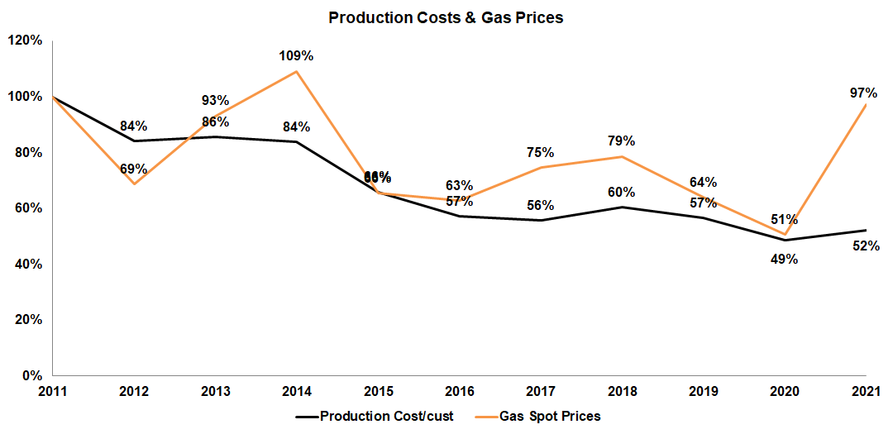
Fuel Costs Are A Key Component Of This Calculus
Source: EIA, Henry Hub Natural Gas Spot Price Dollars per Million Btu & SNL for companies in our coverage universe

Slide 8
O&M Controls Kicked In Big Time After The ’09 Recession! It Spiked in 2018 With Utilities Pulling Forward Spending with Favorable Weather
Source: Inflationdata.com

Slide 9
Financing Costs Are Lower With Utility Yield Dropping ~150 BP
Source: FactSet, Yields as of year end

Slide 10
Authorized ROE’s Have Come Down, But Much Slower Than Interest Rates
Allowed ROEs Highly Correlated with BBB Yields
  Over the last 12 months, the average state level authorized ROE has been ~9.38%.
  The ROE spread versus interest rates is very wide.
  ROE risk is definitely an issue for longer term earnings power.
  Mark-To-Market ROE based on Baa Yields would “should be” 9.86%.
The ROE Spread to Yields is Wide and Should Tighten
Source: SNL Research, FactSet, Evercore ISI Research

Slide 11
Absolute Valuation Close to Pre COVID recession levels, below peak
Utes are trading close to 12-month pre COVID recession levels on an absolute basis and 5% below the valuation peak.
On an absolute basis, NTM PE’s for Utes averaged ~15x 12mths leading up to the 08/09 recession peaking at ~17x, below where the group is trading currently.
In the COVID recession however, absolute P/E for Utes averaged ~21x 12mths prior and peaked at 23x, which would be 5% upside from current levels at ~22x.
Updated as of 4/22/22
Source: FactSet, Evercore ISI Research
Notes:
L:\Presentations\Marketing Deck\Supporting Data\Historical Model Output (BY-DY, NTM FactSet PE)
For 1995-present average data, see Regulated 1, tab F

Slide 12
Group’s NTM P/E relative to S&P 500 is below the peak experienced in prior recession
NTM relative PEs for Utes averaged 1.07x 12mths leading up to the 08/09 recession peaking at 1.13x, below 1.16x where the group is trading currently
In the COVID recession however relative P/E for Utes averaged 1.22x 12mth prior and peaked at 1.30x which would be ~12% upside from current levels at 1.16x assuming S&P500 stays flat.
Updated as of 4/22/22
Source: FactSet, Evercore ISI Research
Notes:
L:\Presentations\Marketing Deck\Supporting Data\Historical Model Output (BY-DY, NTM FactSet PE)
For 1995-present average data, see Regulated 1, tab E

Slide 13
Utility Stock Price Performance vs. SP500 From YE ’17 To Present
Updated as of 4/22/22, compounded return, 7 day intervals
Source: FactSet, Evercore ISI Research
Notes:
L:\Presentations\Marketing Deck\Supporting Data\Stock Price Performance Main Sheet - Indexed Utes and SP500

Slide 14
History Lesson: Utility Stock Price Performance vs. SP500 From 2006 To Present
This shows the performance of regulated utilities vs. the SP500 from YE ‘06, through the recessions, until present.
Assuming compounding returns and dividends reinvested, utilities are up ~367% vs. ~323% for the SP500 from YE ‘06 to present.
Updated as of 4/22/22
Source: FactSet, Evercore ISI Research
Notes:
L:\Presentations\Marketing Deck\Supporting Data\Stock Price Performance Main Sheet - Indexed Utes and SP500

Slide 15
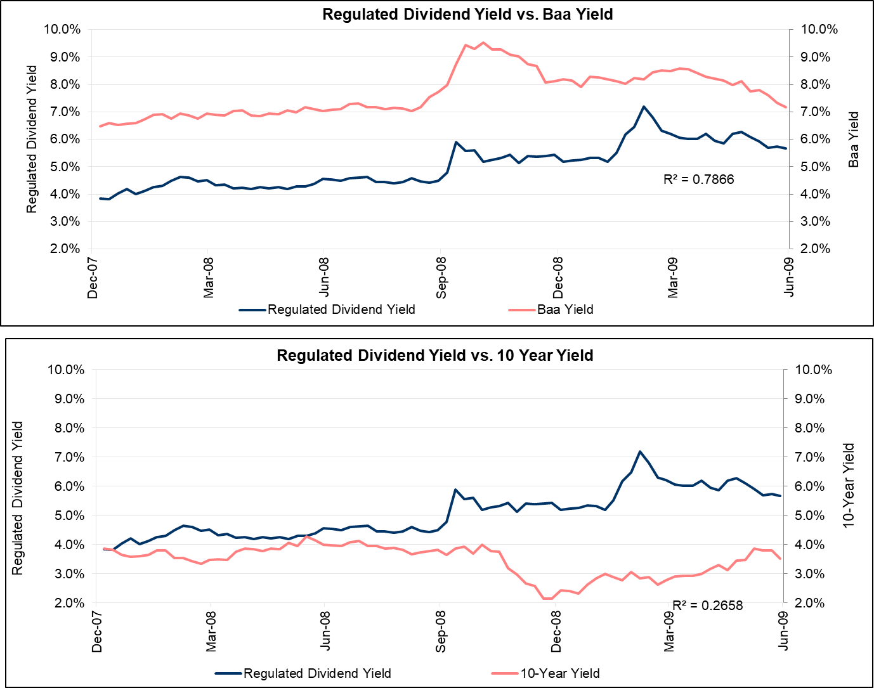
Regulated Dividend Yields vs. 10Y UST and Baa Yields During ’08/’09 Financial Crisis
During the last recession, correlation between regulated dividend yield and Moody’s Baa Yield was at ~79% vs. ~27% correlation for dividend yield and 10yr Treasury Yield.
Source: FactSet, Evercore ISI Research
Notes:
L:\Presentations\Marketing Deck\Supporting Data\Dividend Yields - 10Y UST and Moodys Baa

Slide 16
Utilities Are 20% Expensive on ‘23 Yields Assuming Yields Remain Unchanged
Regulated utilities now look ~24% expensive on current yields
If rates stay unchanged for the next 12 months, regulated utilities now 20% expensive
Updated as of 4/22/22
Source: FactSet, Evercore ISI Research
Notes:
L:\Presentations\Marketing Deck\Active Files\regulated 1
-Implicit corporate bond yield discount. On ISI DY-BY, go to regressions and to the confidence interval table. Use the manual override and plug in a Baa value until the Predicted AND Current Valuation equate and there is 0% upside for index. That gives you the implied corporate bond yield and can solve for the implied UST10Y
-EVRISI’s base case forecast for the UST10Y and Baa yield comes from Stan Shipley – check the latest Macro report or ask Stan for it. Best to get an idea of what the 2019 and the 2020 forecast will be. Then straight-line that relationship to approximate what it will be in 12 months. E.g. assume the following Baa’s: 2019E = 5.35%, 2020E = 5.45%. If we are running this analysis on 3/31/2019, the Baa estimate in 12 months would be 5.35% + (5.45% - 5.35%)*(1/4) = 5.375%
-Plug in the EVRISI base case Baa yield

Slide 17
Bond regression model output below pre-recession peak
The group was 16% expensive on average when compared to Moody’s Baa yield in our bond regression model 12mths prior to the 08/09 recession with group valuation peaking at 24%.
Utes were 4% expensive on average in our bond regression model 12mths leading up to the COVID recession peaking at 12%.
Prior peak suggests ~3% multiple expansion (assuming yields stay flat) considering bond model readings in 08 recession
Updated as of 4/22/22
Source: FactSet, Evercore ISI Research
Notes:
L:\Presentations\Marketing Deck\Supporting Data\Historical Model Output (BY-DY, NTM FactSet PE)

Slide 18
The Spread Between Corporates And Treasuries Below The Historical Average
  The spread between corporates and Treasuries has averaged 222bp since 1970.
  At the beginning of 2015 the 10-year was ~2.2% and corporates were 4.7%, a spread of 250bp.
  The wide spread between US Treasuries and corporates was the key factor that made utilities look fully priced in our bond model from October 2015 through early April 2016.
  Prior to COVID, that spread peaked last at 363bp on 2/16/16, with the 10-year yield at 1.74% and corporate bond yield average at 5.37%. On 3/20/20 during COVID, the spread peaked at ~450bp.
  On 12/31/18 the spread was 245bp and is currently at 186bp.
Daily Moody’s Baa / 10 Year Spread
Monthly Moody’s BAA / 10 Year Spread
Updated as of 4/22/22
Source: FactSet, Evercore ISI Research
Notes:
This is linked to the regulated 1 file still (tab I, K). If you want after you update in the excel file can just click update excel links in this file and it should correct the charts. If not just copy and paste as image. Only value that needs to be updated in the text is the current Baa to 10yr spread

