Slide 1
The Market Risk Premium Based on Duke’s CFO Survey
John Graham
Duke University
Fuqua School of Business

Slide 2
Equity Market Risk Premium:
$$r_{m}−r_{f}^{}$$
2
Market risk premium measures the return per unit of risk (and beta measures units of risk)
$$E[r_{E}]=r_{f}+β_{E}(r_{m}−r_{f})$$

Slide 3
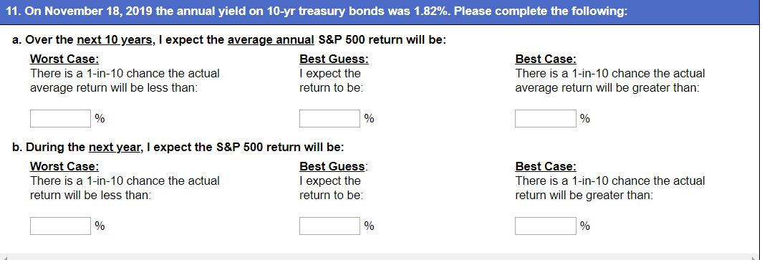
3
Notes:
WILL I HAVE ENOUGH TIME TO GO OVER Dupont 2 CAREFULLY?

Slide 4
The Expected Equity Risk Premium
Forward-looking view from U.S. CFOs
Source: Graham and Harvey (SSRN)
Notes:
Nomura … post reading online

Slide 5
Equity Market Risk Premium:
$$r_{m}−r_{f}^{}$$
5
Market risk premium measures the return per unit of risk (and beta measures units of risk)
r_{m} should include all investments (stocks, bonds, real estate, international, etc.)
We use the return on the S&P 500 as a proxy
Long-term vs. short-term r_{f}
Traditionally, use T-bills
Recently, some use longer term rate, like the 10-yr T-bond. (Previous graphic does this.)
Traditionally the risk premium measured as a historical average
Gather annual data on r_{m} − r_{f} for many years, then take an average
Risk premium averages about 7% if you use 100 years of US data and short-term bills for r_{f}
The CFO Survey based risk premium is forward-looking (an expectation of the future)
We do not ask for the “risk premium” a CFO’s company uses, we ask for their expected market return
$$E[r_{E}]=r_{f}+β_{E}(r_{m}−r_{f})$$

Slide 6
The Expected Equity Risk Premium
Forward-looking view from U.S. CFOs
6
Sept 2020
Average
March 2022
Source: though end of 2019 Graham and Harvey (SSRN); Recent: Duke/FED
Notes:
Nomura … post reading online

Slide 7
Expected Stock Market Returns
7
Sept 2020
Average
March 2022
Notes:
Nomura … post reading online

Slide 8
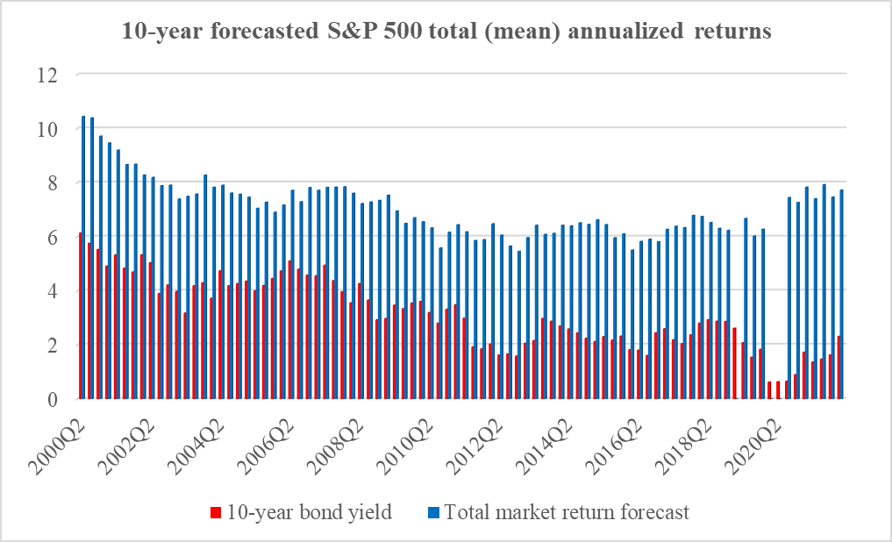
Expected Stock Market Returns
Sept 2020
Average
March 2022

Slide 9
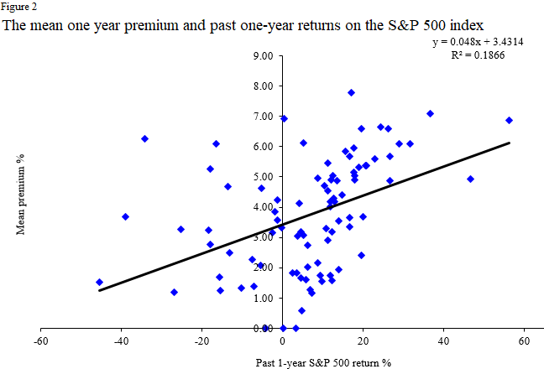
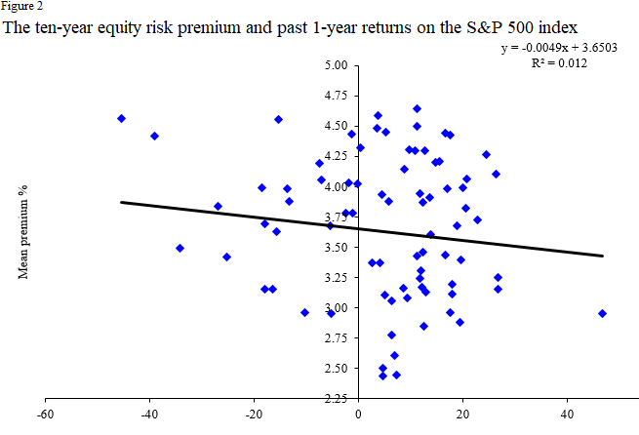
Does ‘momentum’ explain recent increase in risk premium?
9
Source: Graham and Harvey (SSRN)
Notes:
Nomura … post reading online

Slide 10
The Expected Equity Risk Premium
Forward-looking view from U.S. CFOs
10
Sept 2020
Average
March 2022
Source: though end of 2019 Graham and Harvey (SSRN); Recent: Duke/FED
Notes:
Nomura … post reading online

Slide 11
Market Risk Premium for Various Countries (2021)
11
 | $$r_{m}−r_{f}^{}$$ | $$r_{m}$$ | $$r_{f}^{}$$
United States (N=1756) | 5.5% | 7.3% | 1.8%
Spain (539) | 6.4% | 7.4% | 1.0%
Australia (31) | 6.4% | 9.0% | 2.6%
Austria (96) | 5.9% | 6.6% | 0.6%
Belgium (98) | 5.9% | 6.5% | 0.6%
Brazil (42) | 7.7% | 14.2% | 6.5%
Canada (38) | 5.6% | 7.6% | 1.9%
China (30) | 6.2% | 9.0% | 2.8%
Portugal (46) | 6.8% | 8.1% | 1.4%
Mexico (76) | 6.4% | 12.1% | 5.8%
Source: Fernandez, Banuls, Acin (SSRN), survey asks profs and practitioners “what market risk premium do you use?”
Notes:
WILL I HAVE ENOUGH TIME TO GO OVER Dupont 2 CAREFULLY?

Slide 12
U.S. Market Risk Premium for Various Years
12
Source: Fernandez, Banuls, Acin (SSRN)
$$2021$$ | $$2020$$ | $$2019$$ | 2018 | 2015
5.5% | 5.6% | 5.6% | 5.4% | 5.5%
Source: Ivo Welch, SSRN and Journal of Business
$$Welch$$ $$2007$$ | $$Welch$$ $$2001$$ | $$Welch$$ 1997-98
5.9% | 5.4% | 7%
Notes:
WILL I HAVE ENOUGH TIME TO GO OVER Dupont 2 CAREFULLY?

Slide 13
Market Risk Premium and Inflation
13
The market risk premium is a real quantity.
Expected inflation is in both r_{m} and r_{f}, and therefore is subtracted out:
That said, there is a negative relation between inflation and real growth
the risk premium increases during recessions.
Recessions often follow inflation surges (see next slide).
CFOs assigned a higher probability of recession in most recent survey.
$$r_{m}−r_{f}^{}$$

Slide 14
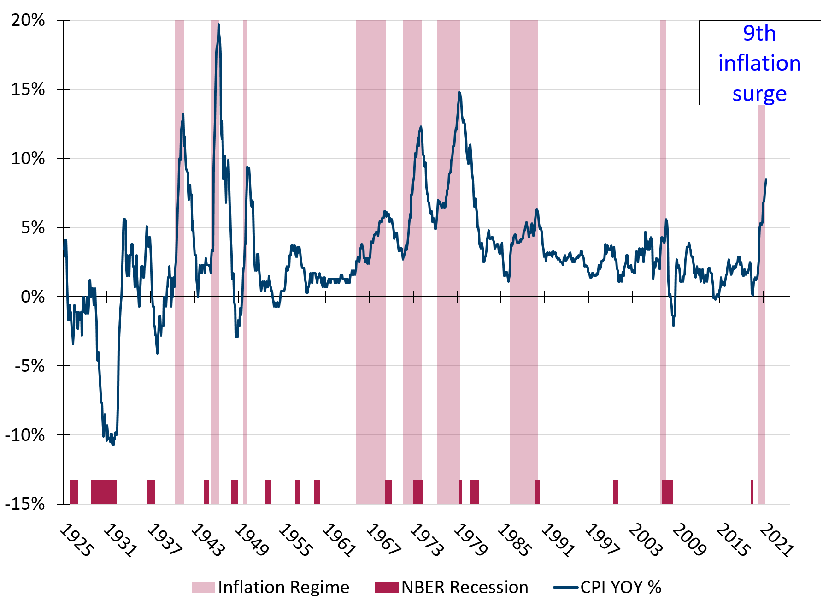
Recessions Often Follow Inflation Surges
14
Headline CPI,
United States
Source: Cam Harvey, 2022
Notes:
If a recession occurs, we might expect to see the market risk premium increase

Slide 15
Hurdle Rates, Interest Rates, and the Cost of Capital
Hurdle Rate
6%
WACC
Source: Graham, Corporate Finance and Reality
Notes:
Hurdle rates are not interest rate sensitive. Is investment? (Sharpe and Suarez)
➔ cash flows likely matter more than discount rates in explaining the dynamics of corporate investment

Slide 16
The Expected Equity Risk Premium
Forward-looking view from U.S. CFOs
16
Sept 2020
Average
March 2022
Source: though end of 2019 Graham and Harvey (SSRN); Recent: Duke/FED
Notes:
Nomura … post reading online

Slide 17
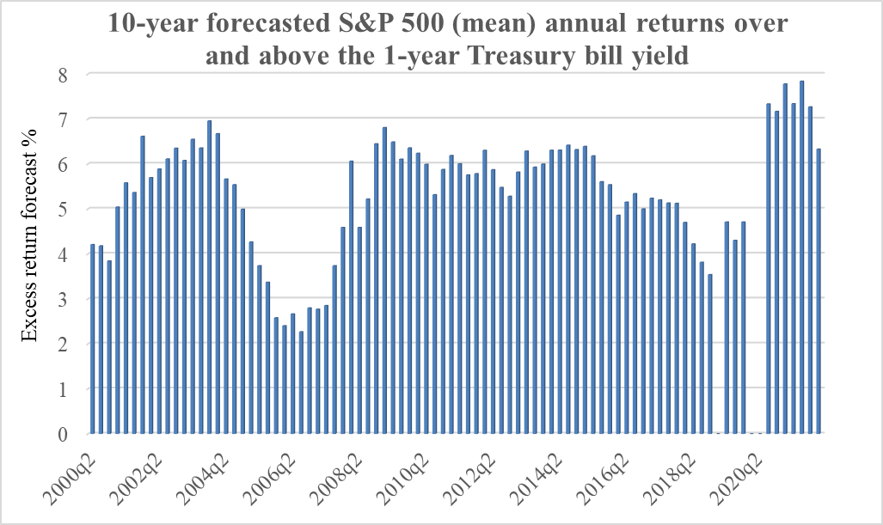
The Expected Equity Risk Premium
(Same as Slide 6 except relative to T-note)
17
Sept 2020
Average
March 2022
Source: Graham and Harvey (SSRN); Recent: Duke/FED
Notes:
Nomura … post reading online

Slide 18
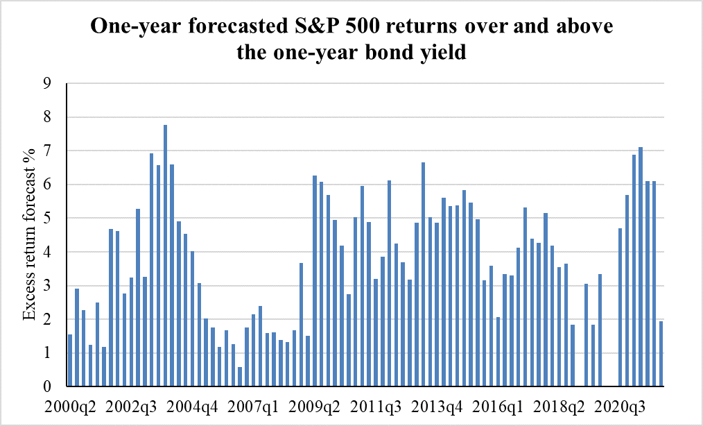
Expected Equity Risk Premium
(Similar to Slide 6 except 1-yr r_{M} minus 1-yr T-note)
18
Sept 2020
Average
March 2022
Source: Graham and Harvey (SSRN); Recent: Duke/FED
Notes:
Nomura … post reading online

