Slide 1
The Equity Risk Premium (ERP) in Utility Regulation
&
Steve Kihm, DBA, CFA
Regulatory Strategist
Citizens Utility Board of Wisconsin
Senior Fellow-Finance
Michigan State University Institute of Public Utilities
Society of Utility and Regulatory Financial Analysis
53rd FINANCIAL FORUM April 28 – 29, 2022
Richmond, VA

Slide 2
The Commission is not bound to the use of any single formula or combination of formulae in determining rates.
Under the statutory standard of "just and reasonable," it is the result reached, not the method employed, which is controlling.
The fact that the method employed to reach that result may contain infirmities is not then important.
This has invited intellectual sloppiness into regulation.

Slide 3
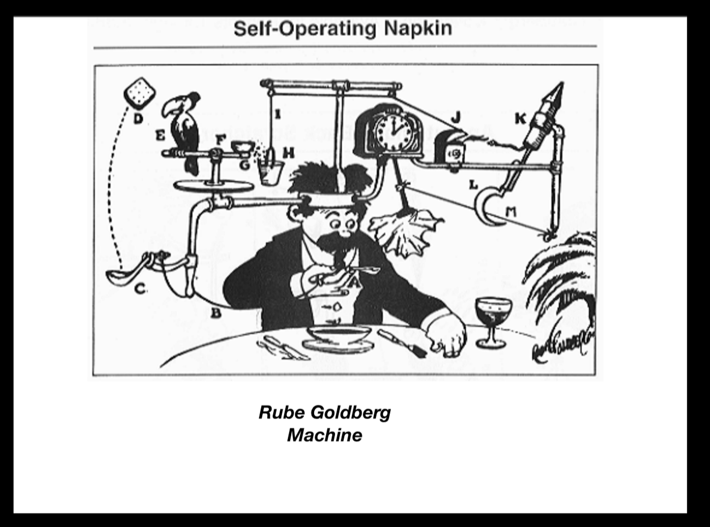
We have created a Rube Goldberg machine that ultimately can be manipulated into supporting any ROE a majority of Commissioners favors at a given moment.
James P. Danly, Commissioner, dissenting:
FERC Docket No.ER16-2320-002
March 17, 2022

Slide 4
Understanding that book rate measures [return on equity] and DCF rate measures [cost of equity] are not different estimates of the same thing but rather estimates of different things should eliminate at least part of the confusion surrounding rates of return on investment.

Slide 5
Morningstar on Xcel Energy (2022)
Beyond 2024, we assume a systemwide 10% average allowed ROE and less than 1% average annual long-term gas and electricity demand growth. We assume a 7.5% cost of equity in our discounted cash flow valuation.

Slide 6
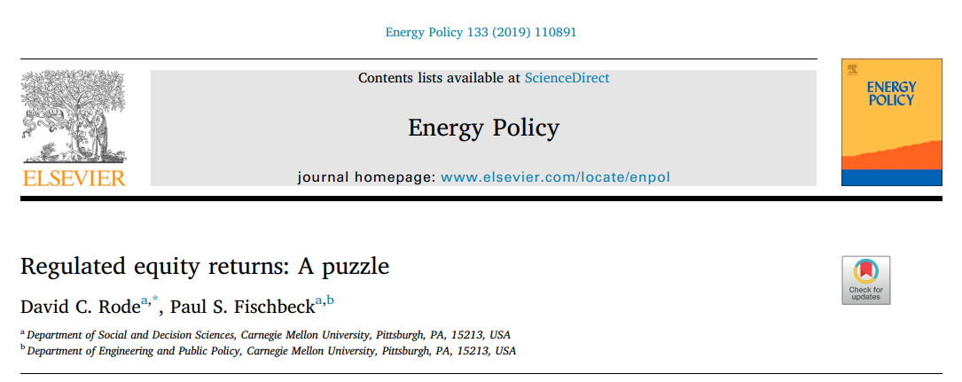
In the end, we may observe simply that what regulators should do, what regulators say they're doing, and what regulators actually do may be three very different things.

Slide 8
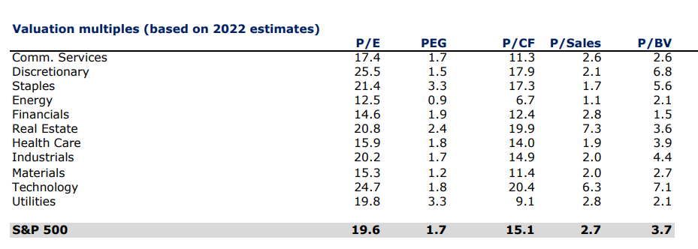
Data on Sector ETFs from AltaVista Research https://www.sectorspdr.com/sectorspdr/Pdf/All%20Funds%20Documents/AltaVista%20Research/Sector%20Analyzer%20Report
April 2022

Slide 9
What do finance principles tell us about
sell-side stock analyst growth rates?

Slide 10
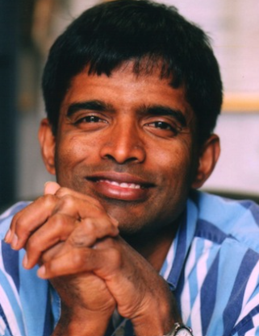
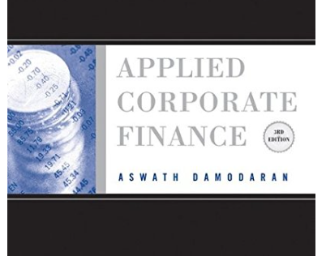
Re: sell-side analyst
long-term growth rate forecasts
Trusting analysts (no matter how well informed they may be) to come up with the most important input in a valuation is not prudent.

Slide 11
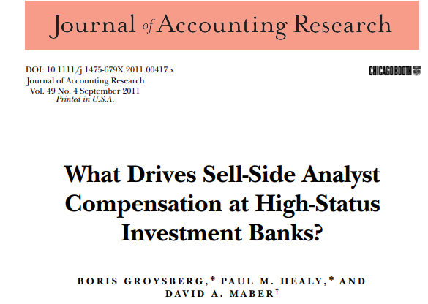
We find no evidence that compensation is related to earnings forecast accuracy... Taken as a whole, our evidence is consistent with analyst compensation being designed to reward actions that increase brokerage and investment-banking revenues.

Slide 12
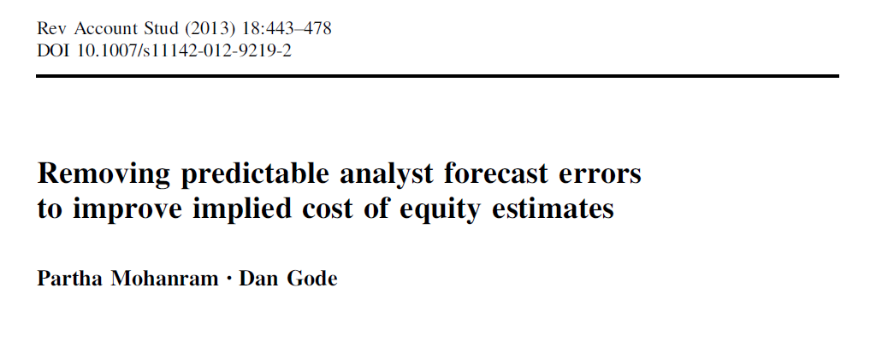
We show that removing predictable errors from analyst forecasts leads to a much stronger association between implied cost of equity estimates obtained from adjusted forecasts and realized returns after controlling for cash flow news and discount rate news.

Slide 13
9.5%
sell-side
analyst growth
4.2%
GDP growth
While it may be unreasonable to expect an individual company to sustain high short-term growth rates in perpetuity, the same cannot be said for a broad representative market index that is regularly updated to include new companies (i.e., a portfolio of companies behaves differently than an individual company). Accordingly, we reject Joint Parties’ proposal to use a two-step DCF result for calculating the market return in the CAPM analysis.
Opinion No. 569, 169 FERC ¶ 61,129 at P 266.

Slide 14
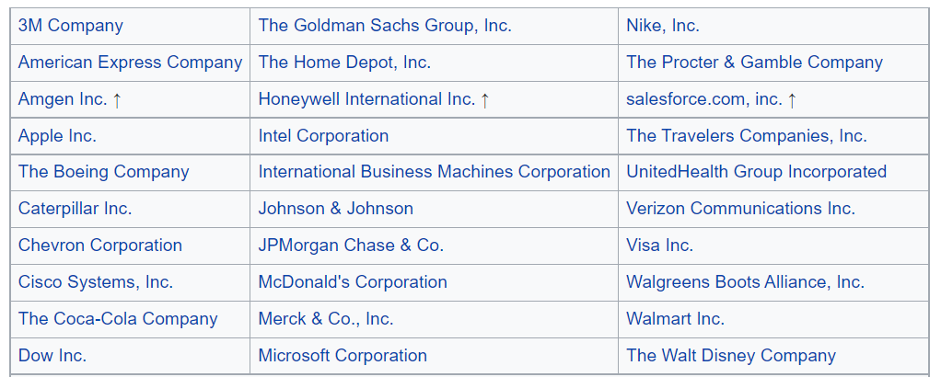
Dow Jones Industrial Index Components
2022

Slide 15
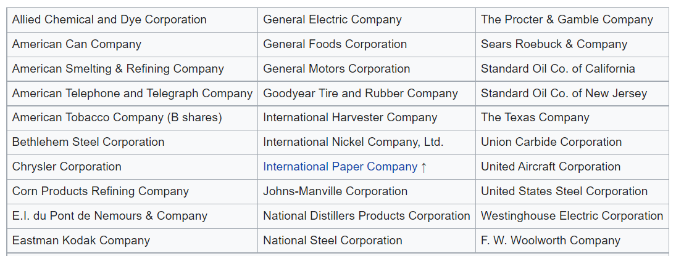
Dow Jones Industrial Index Components
1956

Slide 16
Analytical battle
FERC—the earnings per share for the S&P 500 can grow at the sell-side analysts’ growth projections, which are about twice the GDP growth rate, over the long term
2X GDP
Finance principles—the GDP growth rate is not the average long-run growth rate for all companies it is the maximum growth rate for any company, so even if there is a portfolio updating effect it will not push the S&P 500 growth rate about that limiting factor
GDP

Slide 17
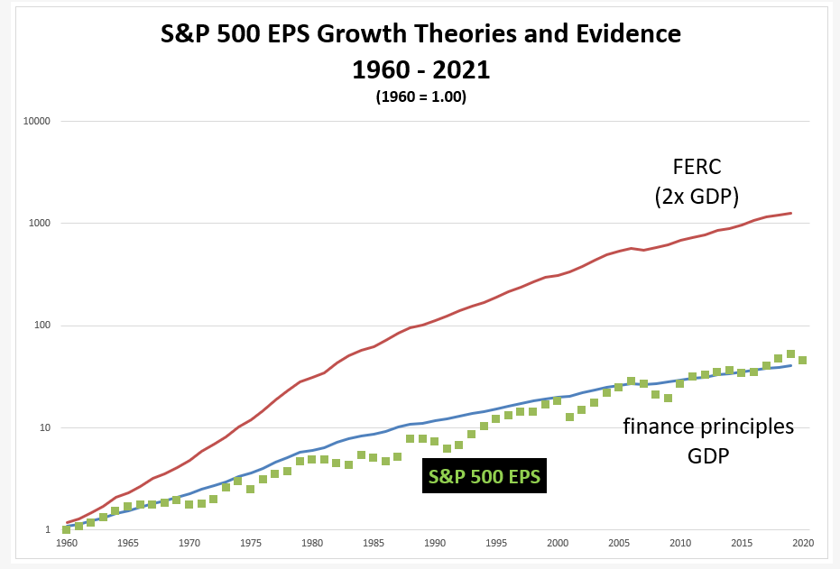
sell-side
analyst
growth
forecasts

Slide 18
S&P 500 Cost of Equity Estimates
Long-Run Projected
S&P 500 Return
Asset Managers
BlackRock 7.3%
FactSet 6.9%
Charles Schwab 6.4%
FERC’s
unsupported
model
11.8%

Slide 19
What do finance principles suggest is the best way to estimate the cost of equity for the market?

Slide 20
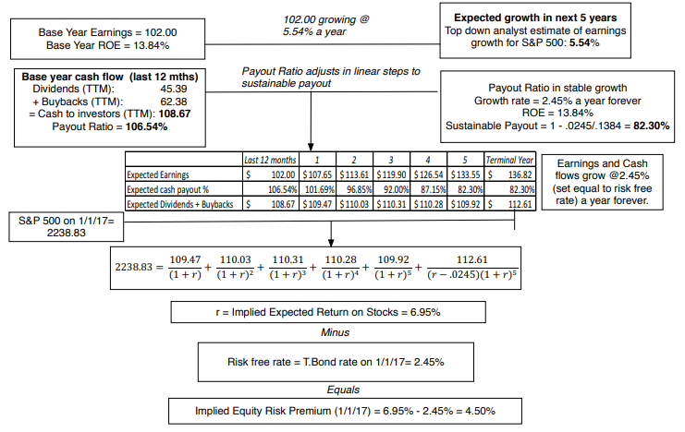
Damodaran

Slide 21
Firms today return more cash to investors
via stock repurchases than through dividends

Slide 22
Sell-side analyst growth rates are too high even for the short-run

Slide 23
Regulators ignoring superior information

Slide 24
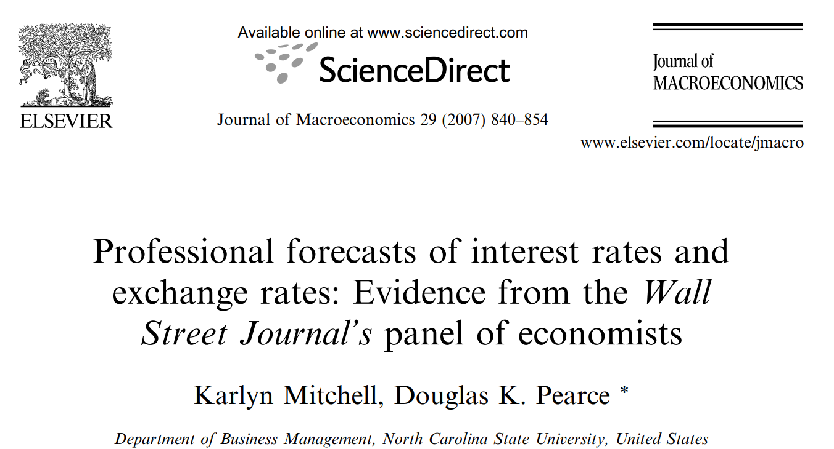
Even though economists are warned in graduate school to avoid making forecasts that can readily be evaluated, professional economists’ forecasts are a staple of the financial press.

Slide 25
What is perhaps surprising is that many of the panel forecast significantly worse than the random walk model, especially when predicting the long-term interest rate.

Slide 26
We analyze these bond yield forecasts to determine whether the consensus forecast is helpful to anyone making decisions based on this forecast. The analysis suggests it is helpful only to the extent that one should believe the opposite of the forecast change in yield.

Slide 27
A better model
33%
From 1982 to 2002, the proportion of times, professionals correctly predicted the direction of interest rates
(Mitchell & Pearce 2007)

Slide 28
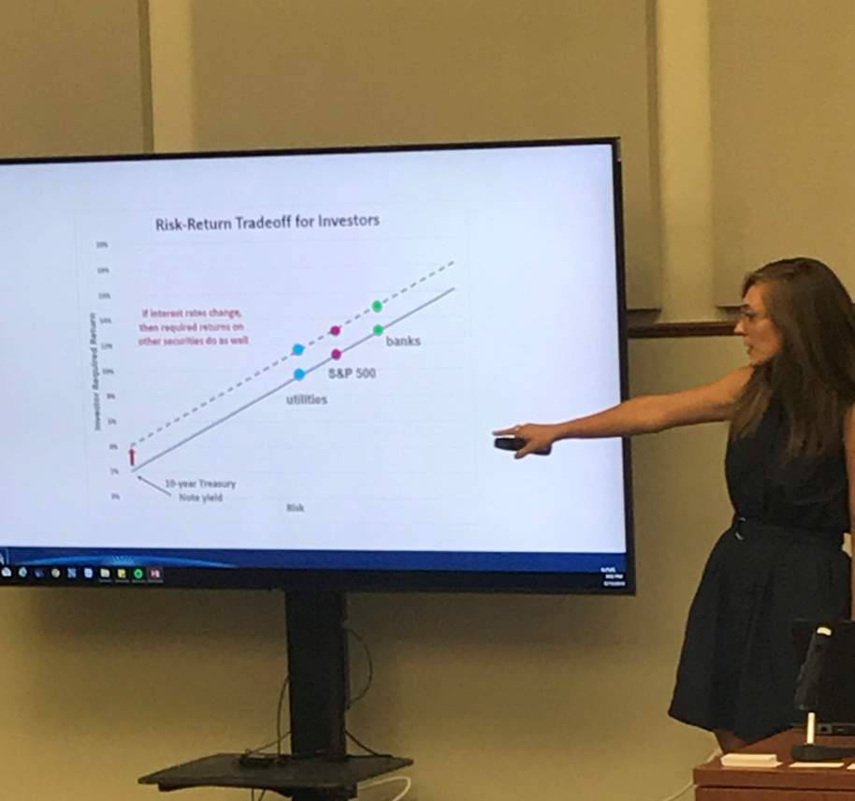
Analysis of 10-Year Treasury Bond Yield Forecast
in the Federal Reserve Bank of Philadelphia’s
Survey of Professional Forecasters
2001 to 2018
Years in which the consensus forecasts was too HIGH
2001 2002 2003 2004 2005 2006 2007 2008 2009
2010 2011 2012 2013 2014 2015 2016 2017 2018
Years in which the consensus forecasts was too LOW
none
Calice and Kihm
Presentation to the Hawaii Public Utilities Commission
Honolulu, HI, August 2019

Slide 29
10-year T Note
Year 2009

Slide 30
Year 2009
Year 2020

Slide 31
Inflation estimate (April 22, 2022)
the yield on U.S. 30-year conventional T-Bond 2.9%
less the yield on U.S. 30-year inflation projected T-Bond 0.3%
Long-run inflation estimate 2.6%

Slide 32
Most risks utilities face matter to the
managers, but not to their investors

Slide 33
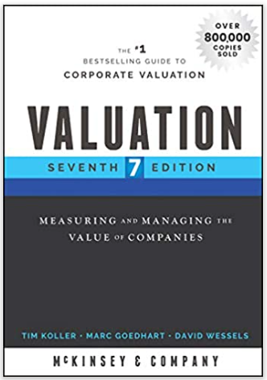
Most risks can be diversified away by investors
so most risks a firm faces do not affect its
cost of capital.
The only risks that matter in this regard are
the firm’s exposure to macroeconomic
shifts such as the threat of a recession or
a change in interest rates.

Slide 34
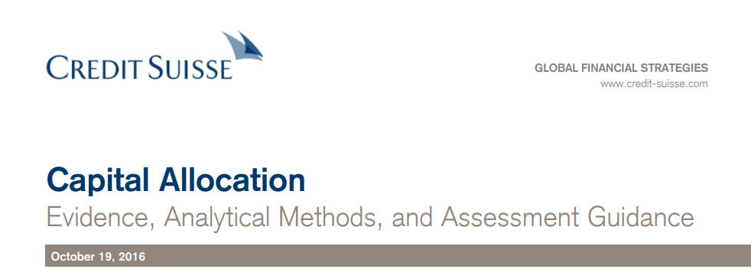
A company’s managers face many more risks than its
investors do—and are much more cautious than investors.
The second area of conflict is with tolerance for risk. Since shareholders
tend to hold stocks as part of a diversified portfolio and managers
are disproportionately exposed to their own company, managers may seek
less risk than shareholders would deem appropriate.

Slide 35
Not all Estimates of the
Equity Risk Premium are Reasonable

Slide 36
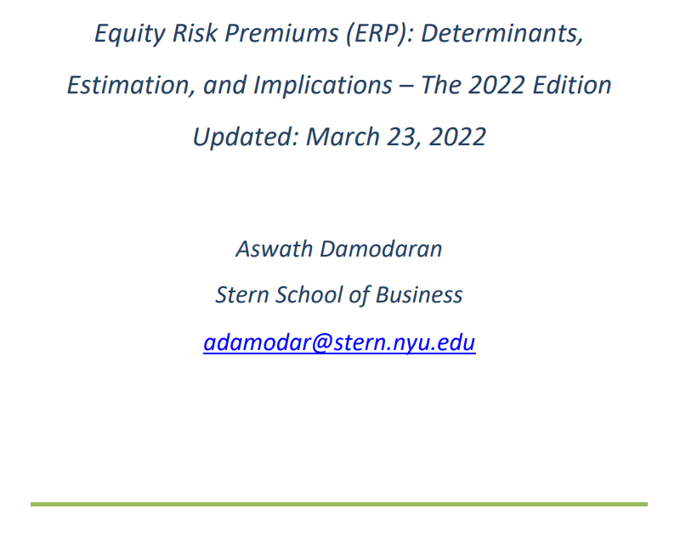
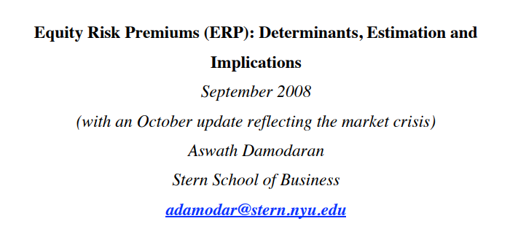
2008
updated every year
2022

Slide 37
Defining ERP
Expected return on S&P 500
less the
yield on 10-year Treasury note
Damodaran, A. Equity Risk Premiums (ERP): Determinants, Estimation and Implications – The 2022 Edition

Slide 38
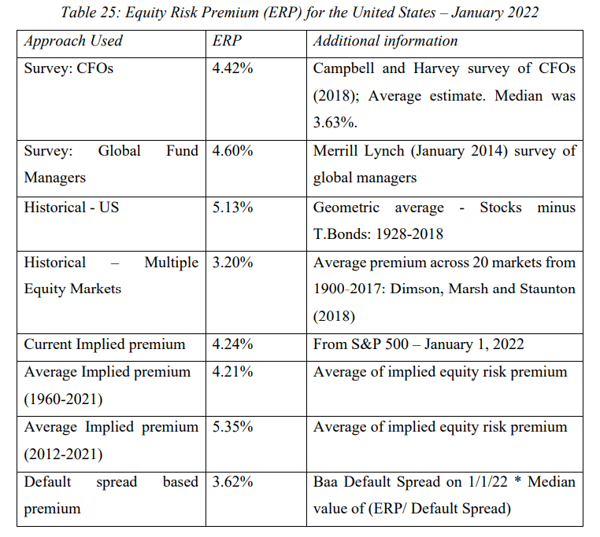
median ERP = 4.3%
Damodaran, A. Equity Risk Premiums (ERP): Determinants, Estimation and Implications – The 2022 Edition

Slide 39
S&P 500 cost of equity
2.7% + 4.3% = 7.0%
Damodaran, A. Equity Risk Premiums (ERP): Determinants, Estimation and Implications – The 2022 Edition

Slide 40
S&P 500 Cost of Equity Estimates
Long-Run Project
S&P 500 Return
Asset Managers
BlackRock 7.3%
FactSet 6.9%
Charles Schwab 6.4%

Slide 41
utility cost of equity
2.7% + 0.90 (4.3%) = 6.6%
Damodaran, A. Equity Risk Premiums (ERP): Determinants, Estimation and Implications – The 2022 Edition

Slide 42
Understanding that book rate measures [return on equity] and DCF rate measures [cost of equity] are not different estimates of the same thing but rather estimates of different things should eliminate at least part of the confusion surrounding rates of return on investment.

Slide 43
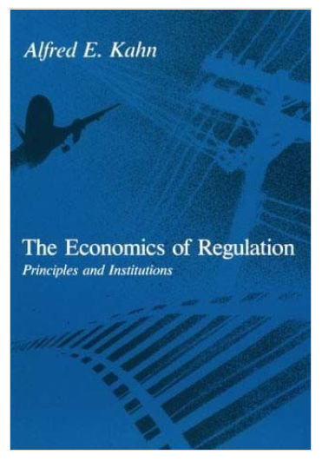
The cost of equity analysis is the beginning of the return on equity discussion.
Use policy analysis to set the ROE. No discussion about risk or capital attraction—the cost of equity completely addresses both. It’s about rewards/penalties and incentives. No models here.
See Kahn, pp. 42-54

Slide 44
We have created a Rube Goldberg machine that ultimately can be manipulated into supporting any ROE a majority of Commissioners favors at a given moment.
James P. Danly, Commissioner, dissenting:
FERC Docket No.ER16-2320-002
March 17, 2022

Slide 45
Is a cost of equity estimate of 6.6%
consistent with current utility stock prices?

Slide 46
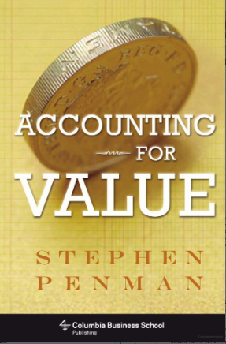
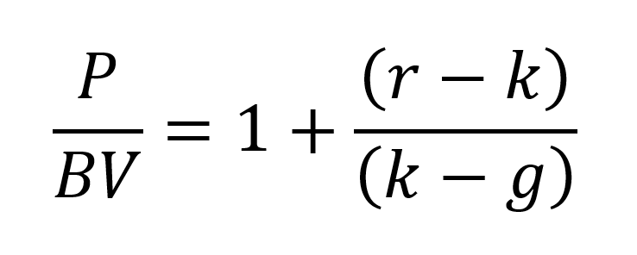
Residual income model
(dividend discount model in algebraic disguise)

Slide 48
Value Line utility median 3-to-5-year projected ROE
10.5%
Implies a sustainable growth rate of
10.5% x 0.30 [earnings retention rate] = 3.2%

Slide 49
Market Value Test

Slide 50
Data on Sector ETFs from AltaVista Research https://www.sectorspdr.com/sectorspdr/Pdf/All%20Funds%20Documents/AltaVista%20Research/Sector%20Analyzer%20Report
April 2022

Slide 51
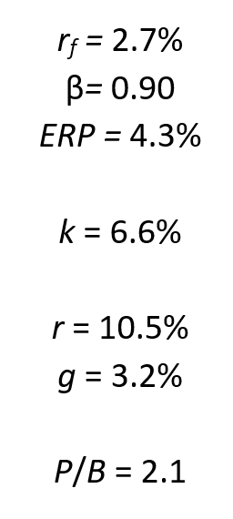
Market Value Test
The finance frame
produces results
that hang together
nicely.
The regulatory frame
that assumes that return
on equity equals cost
of equity does not.
+

Slide 52
How do firms attract capital?
The important role of market pricing.

Slide 53
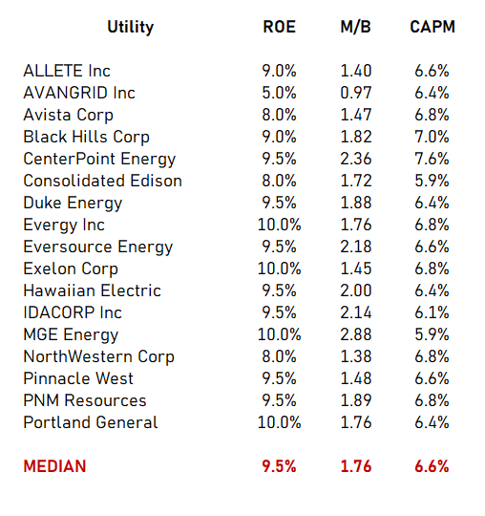
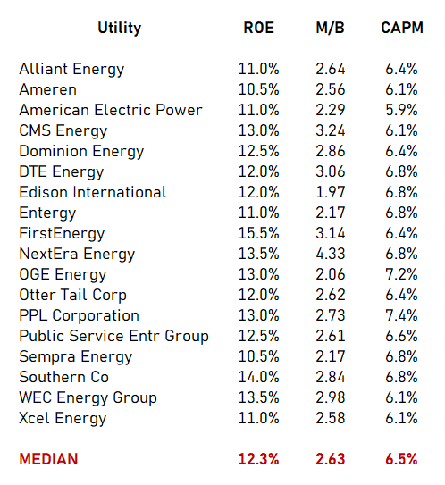
LOW ROE COMPANIES (HONDA)
HIGH ROE COMPANIES (BMW)

Slide 54
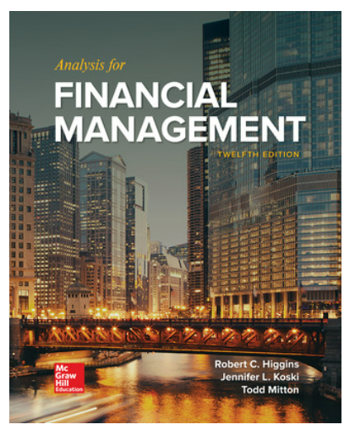
It is not enough for investors to find companies capable of generating high ROEs…the possibility of high returns will melt away in higher stock prices.
Investors expect to earn
costs of equity not returns on equity.

Slide 55
LOW ROE COMPANIES (HONDA)
HIGH ROE COMPANIES (BMW)

Slide 56
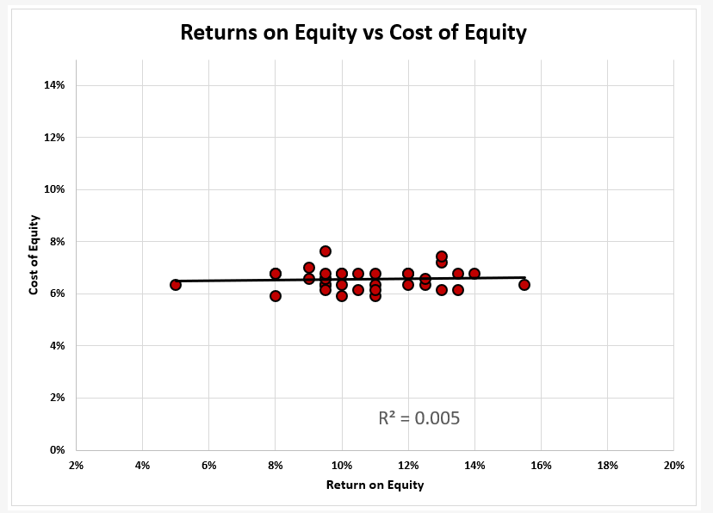
Value Line electric utilities
April 2022

Slide 57
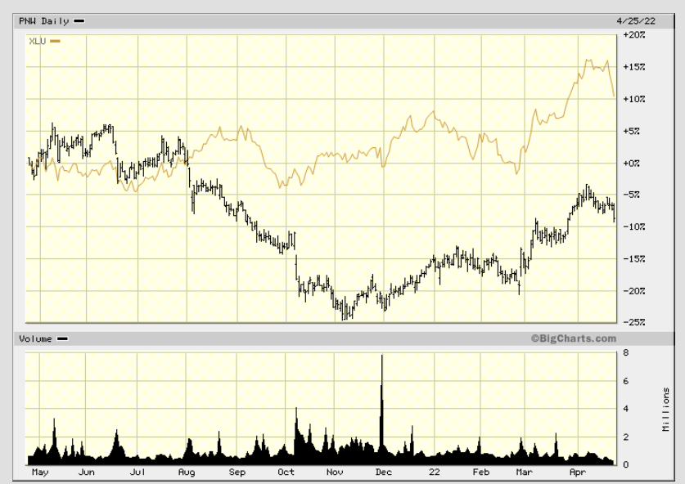
Before ROE reduction
(priced to produce a
6.6% investor return)
ROE=10%
XLU
(Utility ETF)
PNW
After ROE reduction
(repriced to produce
the same 6.6% investor
return)
ROE=8.7%

Slide 58
Conclusion

Slide 59
median ERP = 4.3%
Damodaran, A. Equity Risk Premiums (ERP): Determinants, Estimation and Implications – The 2022 Edition

Slide 60
In the end, we may observe simply that what regulators should do, what regulators say they're doing, and what regulators actually do may be three very different things.

Slide 61
Steve Kihm, DBA, CFA
Regulatory Strategist
Citizens Utility Board
Senior Fellow-Finance
Michigan State University Institute of Public Utilities
kihm@cubwi.org

