Slide 1
The Market Risk Premium:
An In-Depth Review
April 28, 2022
Presented by:
Carla S. Nunes, CFA, ABV

Slide 2

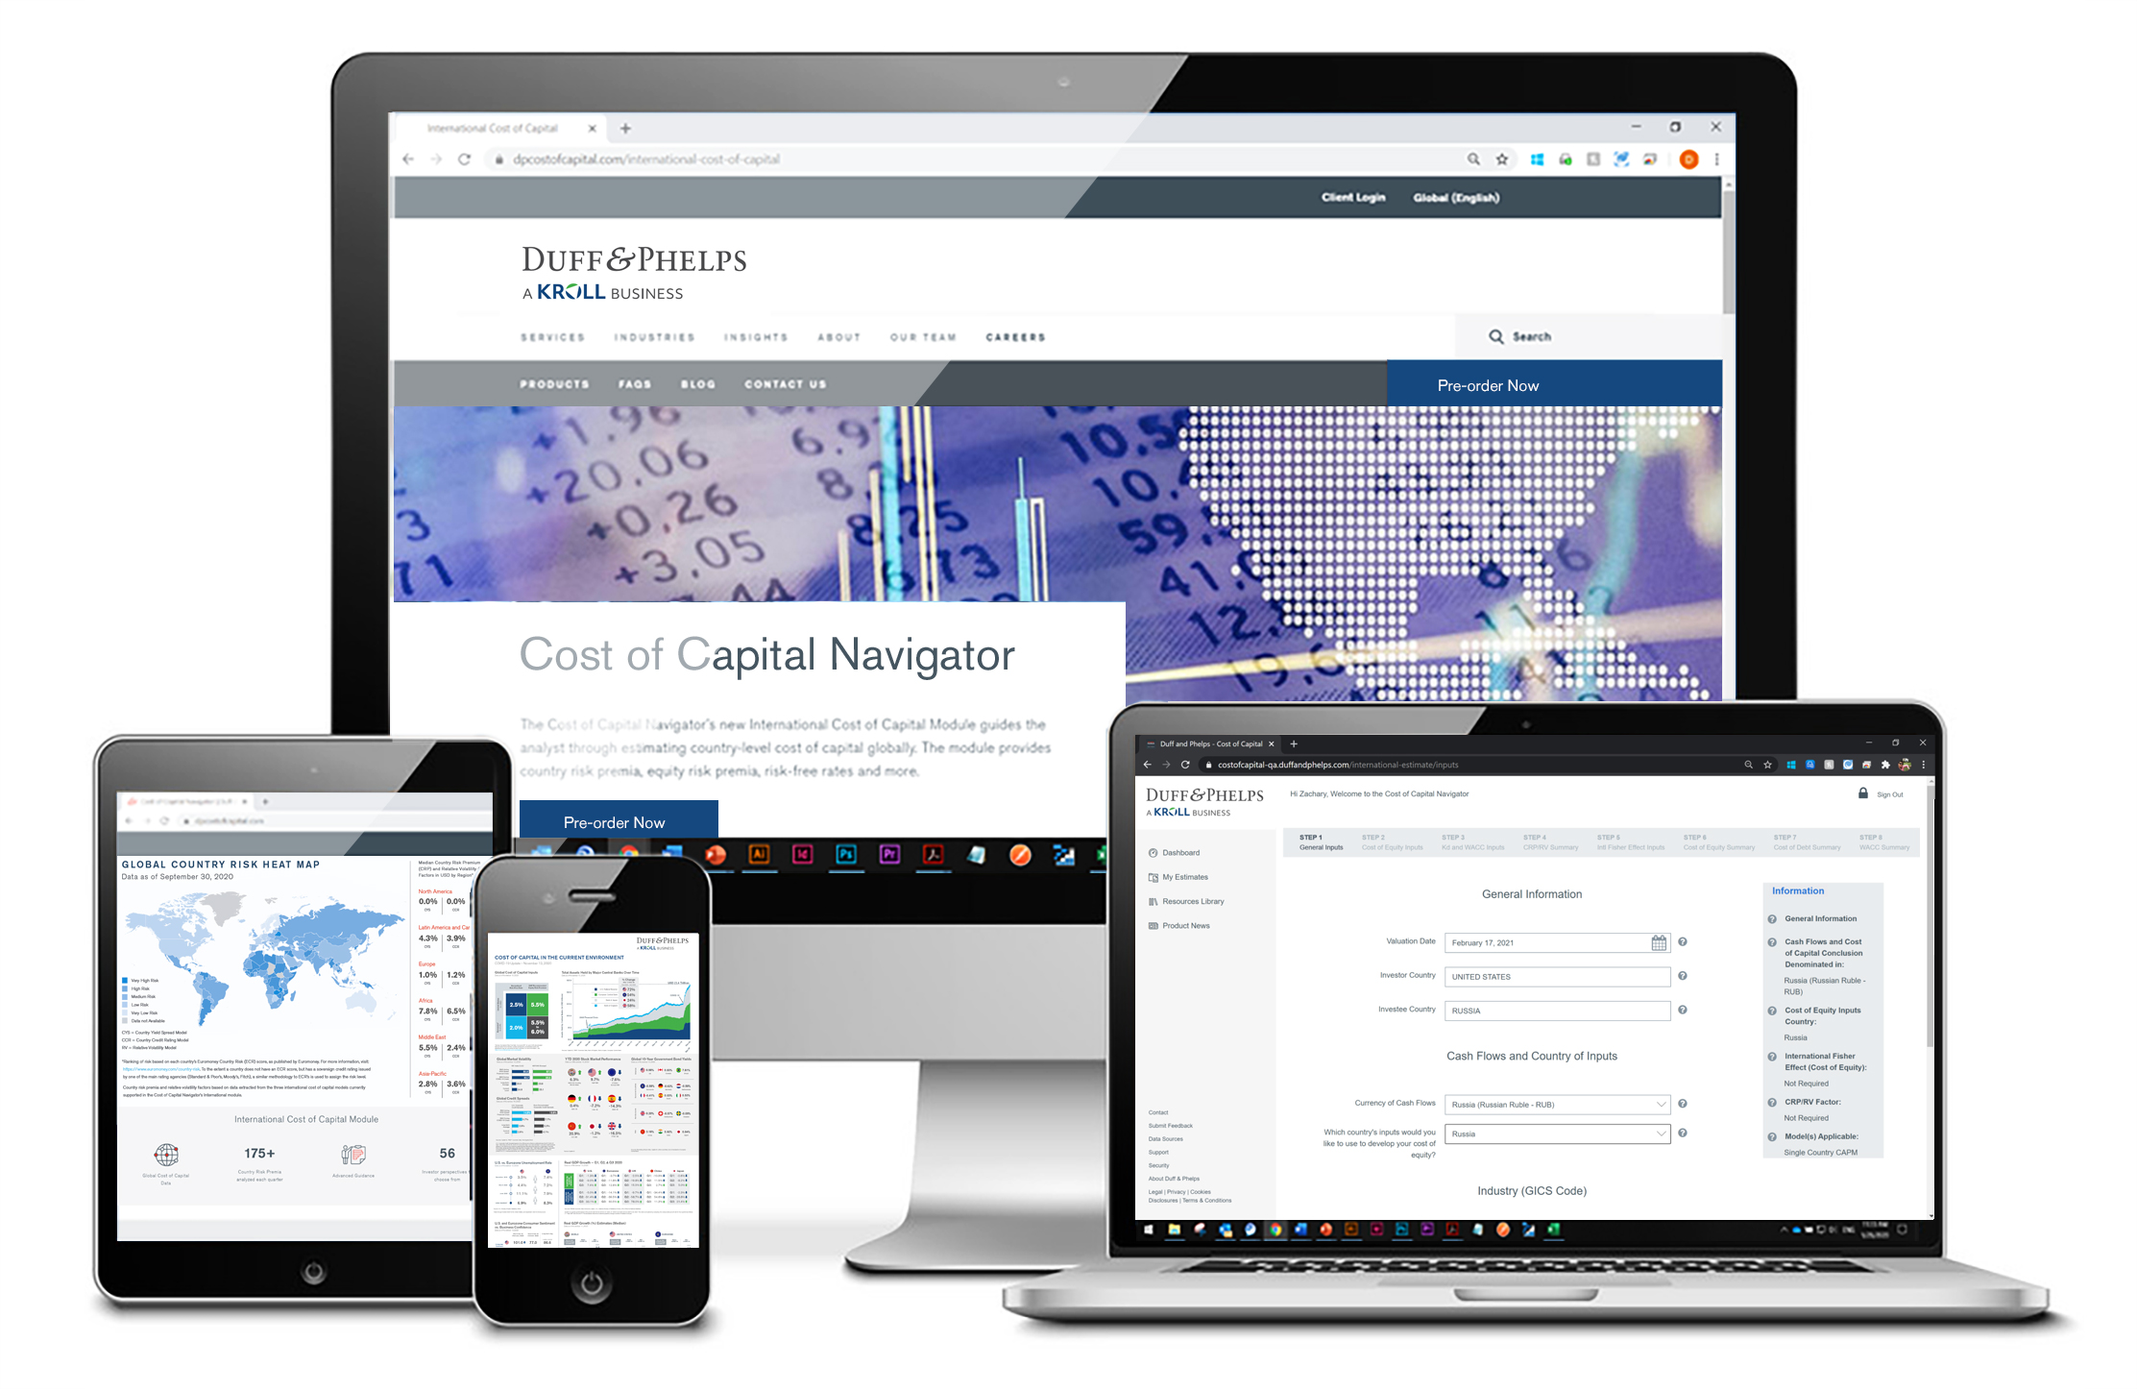
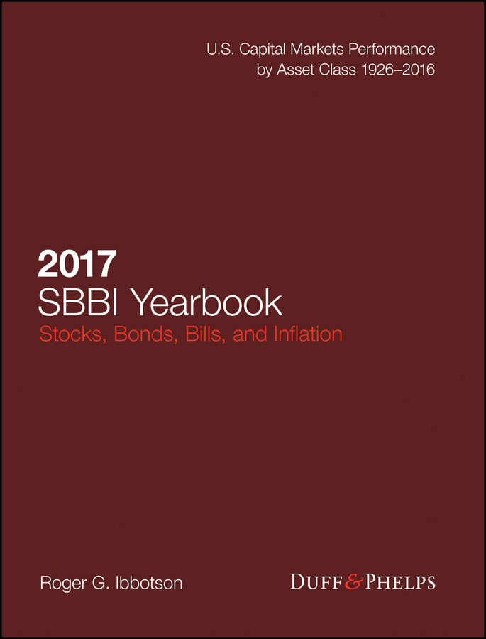
Carla S. Nunes, CFA, ABV
Carla S. Nunes is a Managing Director in the Office of Professional Practice of Kroll (previously Duff & Phelps). She has over 25 years of experience. In that role, Carla provides firm-wide technical guidance on a variety of valuation, financial reporting and tax issues. She also co-authors Kroll’s annual U.S. and European Goodwill Impairment Studies. In addition, Carla is the Global Leader of Kroll’s Valuation Digital Solutions group, which produces cost of capital thought leadership content and data housed in the Cost of Capital Navigator.
In 2011, Carla completed a one-year rotation in Kroll’s London office, where she promoted the firm's IFRS education efforts and marketing initiatives, as well dealing with IFRS implementation issues.
Prior to this role, Carla was part of the Valuation Advisory Services business unit, performing engagements primarily for financial reporting and tax purposes at Kroll and its predecessor firms, PricewaterhouseCoopers and Standard & Poor’s.
Carla has conducted numerous business and asset valuations for a variety of purposes, including purchase price allocations, goodwill impairment testing, M&A, corporate tax restructuring and debt analysis. She has been involved in multiple valuation assignments for a wide range of industries, including pharma & biotech, healthcare, vitamin retail, specialty chemicals, industrial manufacturing and gaming & hospitality. Carla has substantial experience with cross-border valuations, working with multinational corporations to address complex tax, international cost of capital and foreign exchange issues.
Carla is one of Kroll's’ experts addressing valuation issues related to cost of capital. She is a co-author of the “Valuation Handbook” series and is a co-creator of the Kroll Cost of Capital Navigator. Carla is a frequent speaker in webinars and conferences on the topics of cost of capital, goodwill impairment and valuation in general.
Carla is a Kroll Institute Fellow, a Practitioner Director in the Board of the Financial Management Association (FMA) International, and a member of the Education Committee of the International Institute of Business Valuers (iiBV).
Carla received her M.B.A. in finance from the University of Rochester's Simon School, an honors degree is busines administration from Lisbon's School of Economics and Management (ISEG Lisbon) and completed coursework for a Masters of Taxation from Villanova University School of Law. Additionally, she holds a Chartered Financial Analyst (CFA) designation, an Accredited in Business Valuation (ABV) credential, and has passed the exam and fulfilled all the requirements for the Certified in Entity and Intangibles Valuations (CEIV) credential.
Managing Director
Philadelphia, PA
carla.nunes@kroll.com
Kroll Valuation Digital Solutions products:
Cost of Capital Navigator
Stocks, Bonds, Bills, and Inflation® (SBBI®) Yearbook

Slide 3
About Kroll (Formerly, Duff & Phelps)
Kroll is the world’s premier provider of services and digital products related to valuation, governance, risk and transparency. We work with clients across diverse sectors in the areas of valuation, expert services, investigations, cyber security, corporate finance, restructuring, legal and business solutions, data analytics and regulatory compliance.
The firm’s nearly 5,000 professionals are located in
30 countries and territories around the world.
~5,000
TOTAL PROFESSIONALS GLOBALLY
13,400
clients including NEARLY
48% of the
S&P 500
THE
AMERICAS
2,700+
PROFESSIONALS
EUROPE AND
MIDDLE EAST
1,250+
PROFESSIONALS
ASIA
PACIFIC
950+
PROFESSIONALS

Slide 4
Disclaimer
Any positions presented in this session are those of the panelists and do not represent the official position of Kroll, LLC. This material is offered for educational purposes with the understanding that neither the authors nor Kroll, LLC or its affiliates are engaged in rendering legal, accounting or any other professional service through presentation of this material.
The information presented in this session has been obtained with the greatest of care from sources believed to be reliable, but is not guaranteed to be complete, accurate or timely. The authors and Kroll, LLC or its affiliates expressly disclaim any liability, including incidental or consequential damages, arising from the use of this material or any errors or omissions that may be contained in it.
Name Change to Kroll
As of January 1, 2022, Duff & Phelps, LLC has become, and will henceforth be known as Kroll, LLC.

Slide 5
Introduction: Are Country Risks Real?
A Common Error: Mismatched Currencies
A Framework for Cross-Border Valuations
The Risk-free Rate
International Equity Risk Premia (ERPs)
Conditional Equity Risk Premium Framework
Industry Betas
Sources of Size Premia
Incorporating Country Risk in a DCF Valuation
Which International Cost of Equity Model Should I Use?
Country Risk – Kroll Supported Models
Case Study: U.S. Investor Investing in Brazil
Key Points to Remember
Additional Information at kroll.com/costofcapitalnavigator
01

Slide 6
Estimating
Equity Risk Premia (ERPs)

Slide 7
Equity Risk Premium (ERP) – Setting the Stage
The ERP (often interchangeably referred to as the market risk premium, or equity market risk premium) is defined as the extra return (over the expected yield on risk-free securities) that investors expect to receive from an investment in a diversified portfolio of common stocks.
The ERP (or notational RP_{m}) can be expressed as:
RP_{m}
R_{m}
R_{f}
–

Slide 8
Estimating the Equity Risk Premium (ERPs)
There are two broad approaches to ERP estimation:
Realized Risk Premium
Bottom-Up
Top-Down
Surveys
Historical
(ex post) approaches
Forward-looking
(ex ante) approaches

Slide 9

Because No Single ERP Estimation Model is Perfect
There is no single universally accepted method for estimating the equity risk premium (ERP).
Each ERP model has strengths / weaknesses
None of the ERP models can stand alone
Multiple ERP models should be used
  GOAL:
  To estimate the “true” expected ERP as of the valuation date.

Slide 10

Historical Equity Risk Premia – International
Dimson, Marsh, and Staunton
“Global Evidence on the Equity Risk Premium,” The Journal of Applied Corporate Finance (Summer, 2003)
“The Worldwide Equity Premium: A Smaller Puzzle,” Handbook of the Equity Risk Premium, Rajnish Mehra, editor (Elsevier, 2008), Chapter 11, pp 467-514
Credit Suisse Global Investment Returns Yearbook 2021 (Credit Suisse/London Business School, 2021)

Slide 11
Historical Equity Risk Premia – International
Unconditional ERPs Relative to Bonds, NOT Adjusted for Non-Recurring Items 1900–2020
COUNTRY | GEOMETRIC MEAN (%) | ARITHMETIC MEAN (%) | STANDARD ERROR (%)
Australia | 4.8 | 6.3 | 1.6
Austria * | 2.5 | 20.6 | 13.7
Canada | 3.3 | 4.9 | 1.6
Germany * | 4.8 | 8.1 | 2.6
Japan | 5.1 | 8.9 | 2.9
United Kingdom | 3.4 | 4.7 | 1.5
United States | 4.4 | 6.5 | 1.9
Europe | 2.8 | 4.0 | 1.4
World ex-U.S. | 2.7 | 3.8 | 1.3
World incl. U.S. | 3.1 | 4.3 | 1.4
Source of underlying data: Credit Suisse Global Investment Returns Yearbook 2021 (Credit Suisse Research Institute, 2021) by Elroy Dimson, Paul Marsh, and Mike Staunton. Copyright © Elroy Dimson, Paul Marsh, and Mike Staunton.
* For Austria and Germany, statistics are based on 119 years, excluding 1921–1922 for Austria and 1922–1923 for Germany. For Russia, statistics are based on 26 years, from 1995-2020.

Slide 12
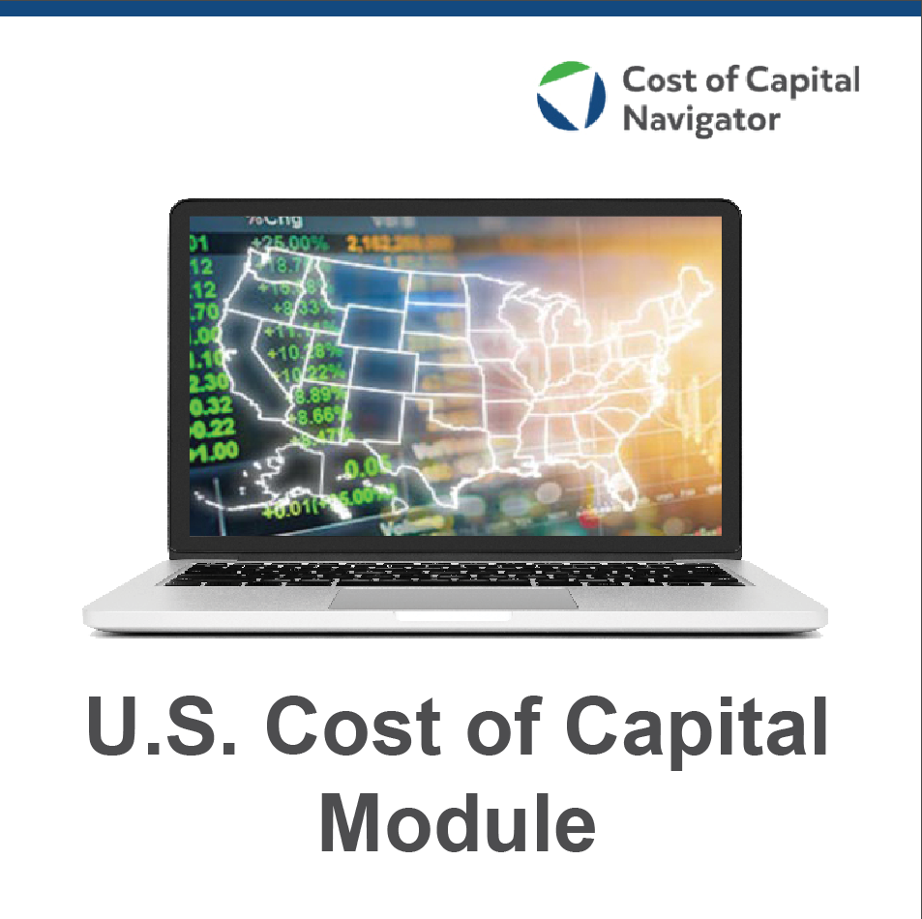
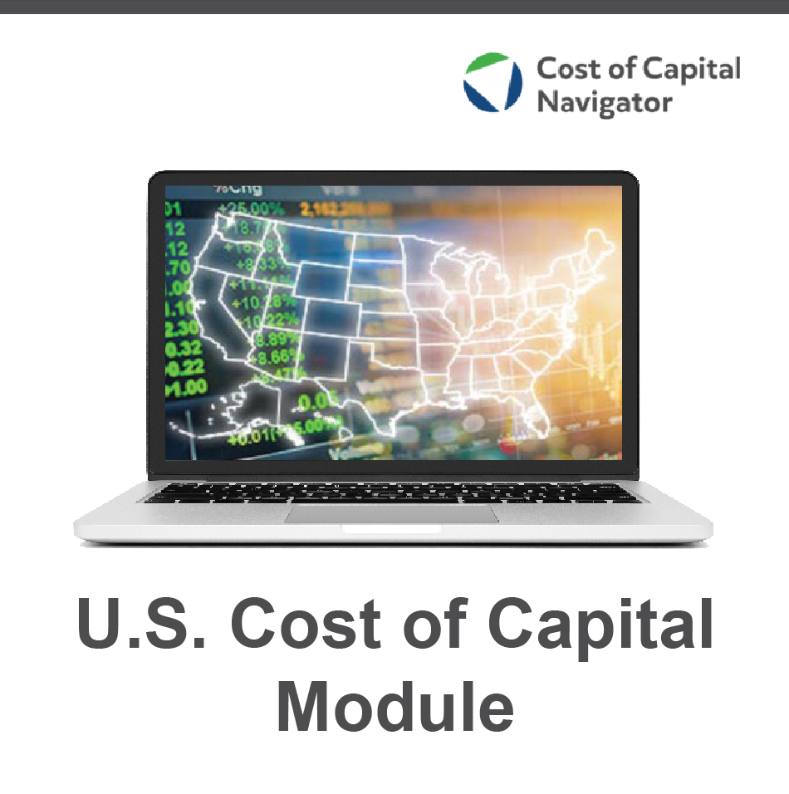
Historical Equity Risk Premia – United States
Against 20-Year U.S. Government Bond Income Returns
Source: Kroll Cost of Capital Navigator
Realized risk premium | Period | Arithmetic average
Long-term “Historical” ERP | 1926 – 2021 | 7.5%
Long-Term “Supply-side” ERP ** | 1926 – 2021 | 6.2%
To learn more about the underlying data in the Kroll Cost of Capital Navigator, visit:
www.kroll.com/costofcapitalnavigator

Slide 13
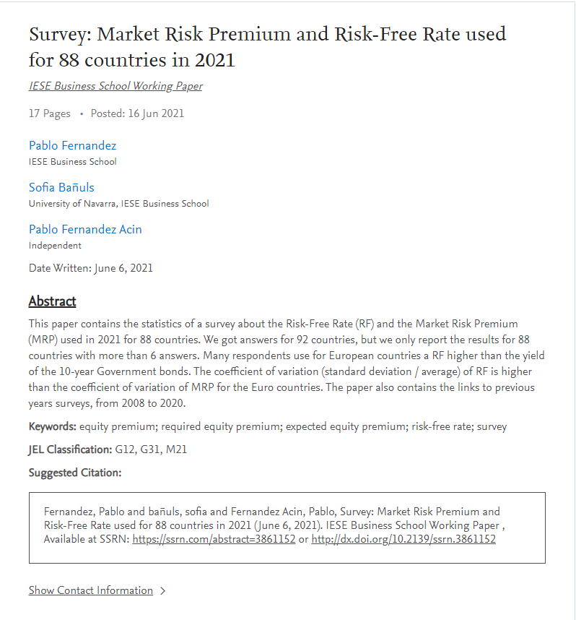


Survey-based Equity Risk Premiums – International
“Survey: Market Risk Premium and Risk-Free Rate used for 88 countries in 2021” (June 2021)
Pablo Fernandez, Sofia Bañuls, and Pablo Fernandez Acin
Survey conducted by asking:
        Professors
        Analysts
        Managers of companies

Slide 14
Survey-based Equity Risk Premiums – International
 | # of Answers | AVERAGE (%) | MEDIAN (%) | Min (%) | Max (%)
Australia | 31 | 6.4 | 6.3 | 2.0 | 10.0
Austria | 96 | 5.9 | 6.0 | 4.0 | 8.0
Canada | 38 | 5.6 | 5.5 | 3.5 | 9.2
Germany | 287 | 5.8 | 5.5 | 1.0 | 17.0
Japan | 29 | 5.2 | 5.4 | 0.5 | 12.1
United Kingdom | 68 | 5.6 | 5.7 | 1.0 | 13.0
United States | 1,756 | 5.5 | 5.5 | 3.1 | 8.0
Source: Pablo Fernandez, Sofia Bañuls, and Pablo Fernandez Acin, “Survey: Market Risk Premium and Risk-Free Rate used for 88 countries in 2021”, June 2021

Slide 15
Conditional Equity Risk Premium Framework

Slide 16
The Kroll (formerly D&P) Recommended ERP is a Two-Step Process
Step 1: What is a reasonable range of unconditional ERP that can be expected over an entire business cycle?
“What is the range?”
Step 2: Research has shown that ERP is cyclical during the business cycle. We use the term conditional ERP to mean the ERP that reflects current market conditions.
“Where are we in the range?”

Slide 17
Kroll Considers Multiple Models to
Estimate Recommended ERP
“Historical” ERP Estimates
Forward-looking ERP Estimates
＋

Slide 18

Kroll Considers Multiple Models to
Estimate a Recommended ERP
“Historical” ERP Estimates
Forward-looking ERP Estimates
＋
3.5%
Range of Unconditional ERP
6.0%

Slide 19
Current Recommended U.S. Equity Risk Premium (ERP)
As of December 9, 2020 – Present
Kroll
Recommended
U.S. ERP
5.5%
Range of Unconditional ERP
3.5%
6.0%

Slide 20
Summary of Factors Considered in U.S. ERP Recommendation
Changes from December 9, 2020 to March 31, 2022

Slide 21


2022 Real GDP Growth Rates of U.S., Eurozone, and UK
Median Estimates
Estimates as of December 1, 2021 and March 31, 2022
Sources of underlying data: OECD, IMF, World Bank, Blue Chip Economic Indicators, Consensus Economics, Economist Intelligence Unit, Fitch Ratings, IHS Markit, Moody’s Analytics, Oxford Economics, S&P Global Ratings

Slide 22
Damodaran Implied Equity Risk Premium
Disclosed Base Cost of Equity = Spot 10-Year Yield + Implied ERP (in %)
 | Average cash flow yield from the previous 12 months | Average cash flow yield from the previous 10 years | COVID-19 Adjusted
December 31, 2019 | 7.12 | 7.35 | n/a
March 31, 2020 | 6.86 | 6.01 | 6.72 H
June 30, 2020 | 6.03 | 6.31 | 5.89
July 31, 2020 | 5.65 | 5.92 | 5.56 (#2)
August 31, 2020 | 5.46 | 5.71 (#3) | 5.34 L
September 30, 2020 | 5.43 | 6.45 | 5.66
December 31, 2020 | 5.13 L | 7.05 | 5.65
September 30, 2021 | 6.39 | 9.23 (#4) | 6.45 (#2)
December 31, 2021 | 5.76 | 8.14 | n/a
March 31, 2022 | 7.05 | 8.31 | n/a
Source of underlying data: https://pages.stern.nyu.edu/~adamodar/

Slide 23
U.S. Normalized Risk-free Rate and ERP Recommendations
December 31, 2007 – April 7, 2021
3.0%
+
5.5%
=
8.5%
8.5%
Base Cost of Equity assumes a capital asset pricing model (CAPM) beta of 1.0 for the overall market.

Slide 24
Spot 20-Year U.S. Government Bond Yield in Conjunction
with Unadjusted “Historical” Equity Risk Premium*
December 31, 2007 – April 7, 2022
* The Historical Equity Risk Premium is defined as the ERP over the years 1926–Present as of the most recently completed calendar year. For example, the Historical Equity Risk Premium for December 2019 spans the years 1926–2019 while the Historical ERP for 2020 spans the years 1926–2020.

Slide 25
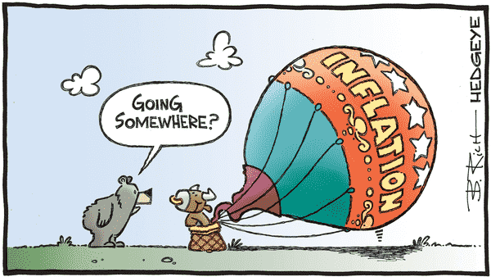
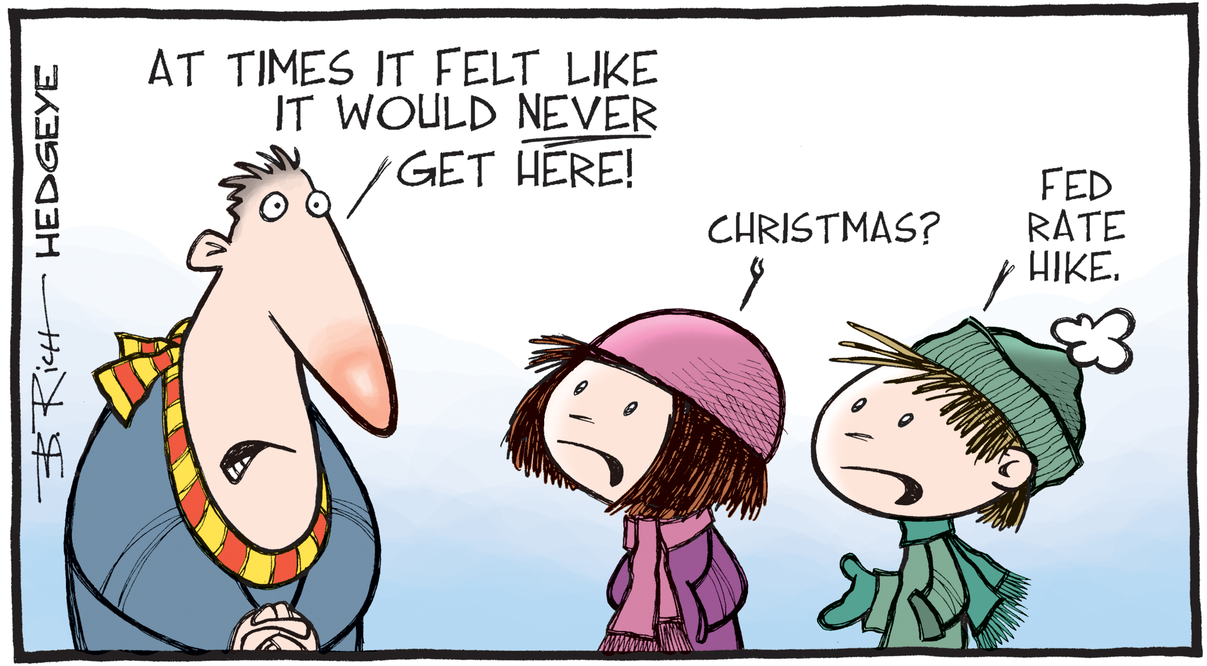
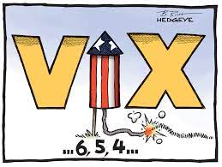
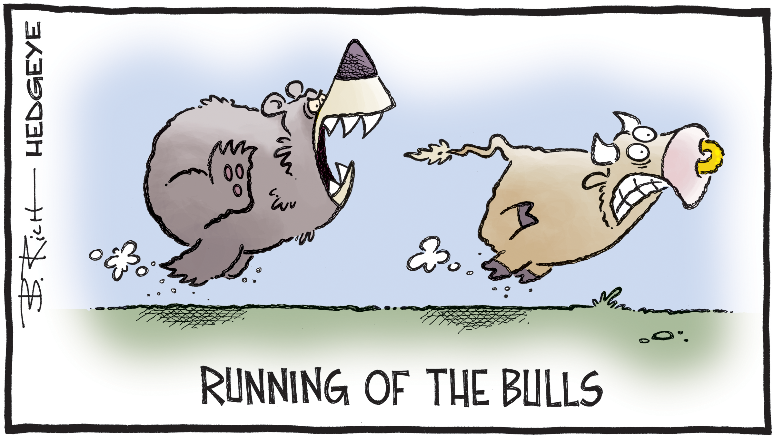
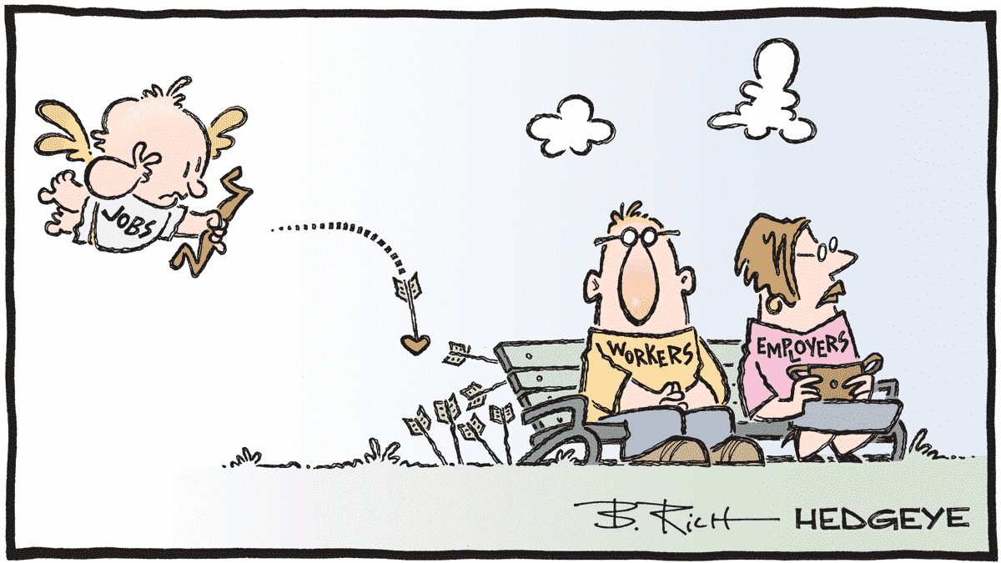
Conditional U.S. ERP – What are we monitoring?

Slide 26
January 1982 –– March 2022
12-Month Percentage Change, CPI vs. Core Inflation (%)
Source: U.S. Bureau of Labor Statistics. Based on data series not seasonally adjusted.

Slide 27
Estimates as of March 31, 2021 (approximately)
Long-Term Inflation Expectations (5 to 10 Years Ahead)
SOURCES | Long-Term Average (%)
Aruoba Term Structure of Inflation Expectations | 2.3
Blue Chip Economic Indicators | 2.4
Blue Chip Financial Forecasts | 2.6
Consensus Economics | 2.8
Federal Reserve Bank of Cleveland | 1.9
IHS Markit | 2.6
Livingston Survey (Federal Reserve Bank of Philadelphia) | 2.4
Oxford Economics | 2.6
Survey of Professional Forecasters (Federal Reserve Bank of Philadelphia) | 2.5
University of Michigan Survey 5-10 Year Ahead Inflation Expectations | 3.0
Range of Inflation Estimates | 1.9% – 3.0%
What was the median estimated long-term inflation as of December 31, 2020?
2.1%
2.5%
Median

Slide 28
Key Points to Remember

Slide 29
Key Points to Remember
The ERP is forward-looking and cannot be observed
The ERP is cyclical (it changes depending on the overall economic environment)
There is no single "perfect" ERP estimation method. Each model has its strengths and weaknesses, so using multiple models is recommended.
The ERP is NOT independent from your choice of risk-free rate. Ultimately, the Base Cost of Equity (= Rf + ERP) should make sense

Slide 30
Thank you

Slide 31
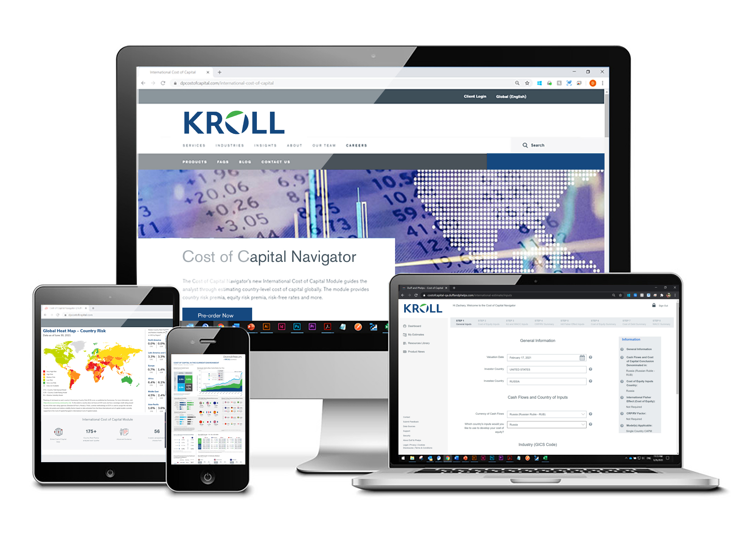
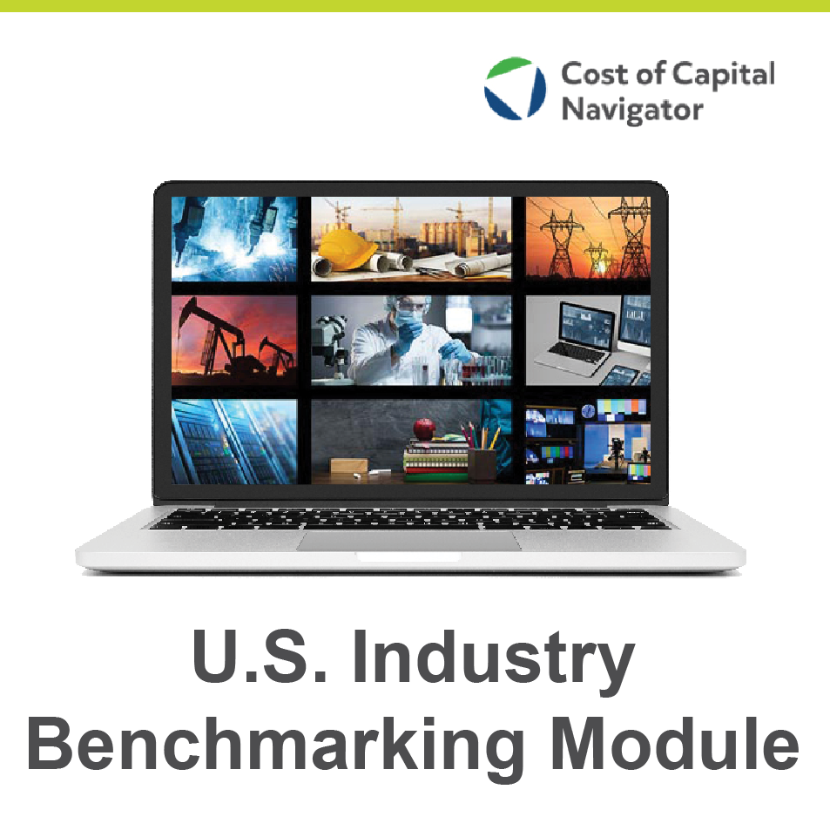
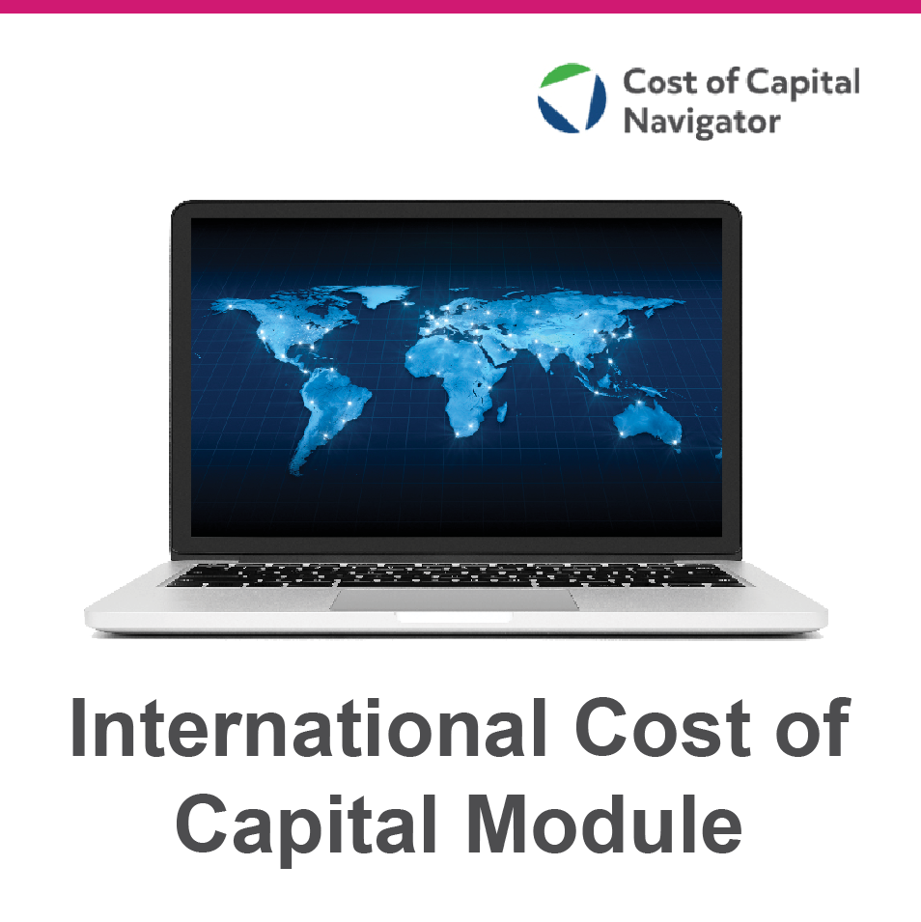
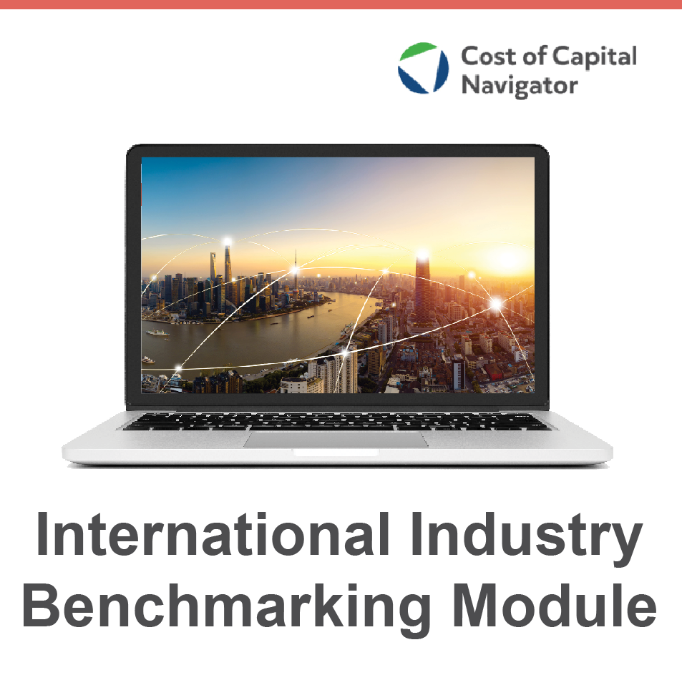
About the Cost of Capital Navigator
The Cost of Capital Navigator is an online platform that guides you through the process of developing global cost of capital estimates, a key component of any valuation analysis. The four Modules are available for 1-year subscriptions.
U.S. Cost of Capital
U.S. Industry Benchmarking
International Cost of Capital
International Industry Benchmarking
www.kroll.com/costofcapitalnavigator

