Slide 1
Utility EV Programs in New York
Overview of NYS Programs & Deployments
April 21, 2023

Slide 2
NY’s Nation-Leading Climate Policy
Climate Leadership & Community Protection Act (CLCPA)
Battery & Plug-in Hybrid EVs in NY
Historic and Future Light Duty Vehicle Count Anticipated by ZEV MOU (2025) and CLCPA (2030+)
Net Zero GHG emissions by 2050
40% reduction in GHG emissions by 2030
100% zero-carbon electricity by 2040
70% renewable electricity by 2030
9,000 MW of offshore wind by 2035
3,000 MW of energy storage by 2030
6,000 MW of distributed solar by 2025
185 TBtus on-site energy efficiency by 2025
35-40% of benefits to Disadvantaged Communities
Source: Atlas Public Policy EValuateNY and NYS Climate Action Council Integration Analysis; range of forecasts depicted in 2030
Ambitious ZEV growth is required… supporting charging infrastructure deployments is a suitable role for the utilities

Slide 3
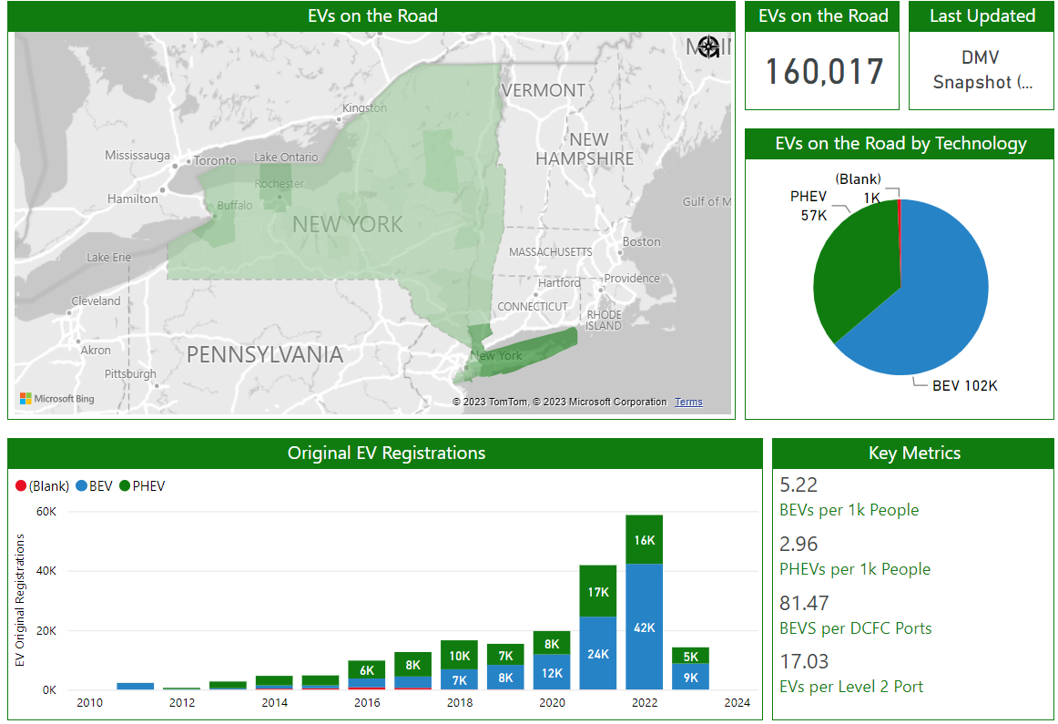
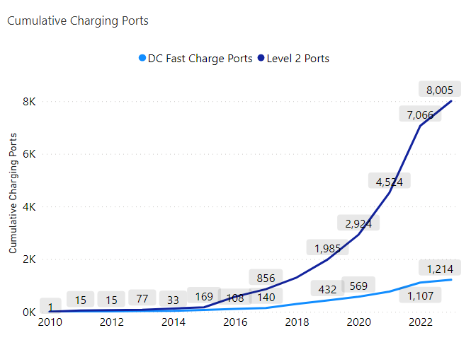
50% YoY Growth in NYS EV Sales
4/2/23
~60% of EVs Downstate, significant increase in charging throughout NYS needed

Slide 4
Range anxiety & public charging make up 4 of top 5 concerns citied by potential EV buyers in the US
Greatest concern regarding BEVs: US Consumers
Deloitte: 2023 Global Automotive Consumer Survey
$65,000 BEV median price in 2022… ~$16,000 premium over sales weighted average new car price in 2022.¹
47% of US consumers expect² range >400 miles… 2022 sales weighted range for new EVs was 305 miles.¹
Range anxiety and lack of public charging infrastructure were top 2 concerns in 2022 Deloitte survey
Increased charging station availability and vehicle range can help boost EV adoption while auto market continues to roll out more affordable BEV models
1 – BNEF, “New EV Models Catalyze Stalled US Market”, March 2, 2023
2 – Deloitte survey Q: How much driving range would a fully charged all-battery electric vehicle need to have in order for you to consider acquiring one?

Slide 5
Commission timeline for EV proceedings
Orders Approving Managed Charging Programs and Modifications to MRP Program
7/14/2022
Per Plug Incentive Program Order
2/07/2019
Demand Charge Alternatives Whitepaper
9/26/2022
Make Ready Program (MRP) Whitepaper
1/13/2020
Order Initiating Proceeding
4/24/2018
Utilities File Managed Charging Proposals
6/4/2021
MRP Midpoint Review Whitepaper
3/1/2023
2018
2019
2020
2021
2022
2023
2024
Order Directing Tariff Revisions for TOU rates
11/15/2018
Demand Charge Alt. Legislation
12/31/2021
Order establishing Framework for Alternatives to Traditional Demand-Based Rate Structures
1/19/2023
Order Establishing Make-Ready Program and Other Programs
7/16/2020
Notice Commencing Make-Ready Midpoint Review
8/30/2022
Make Ready
18-E-0138
Managed Charging & TOU
18-E-0138, 18-E-0206
Demand Charge Alt.
18-E-0138, 22-E-0236

Slide 6
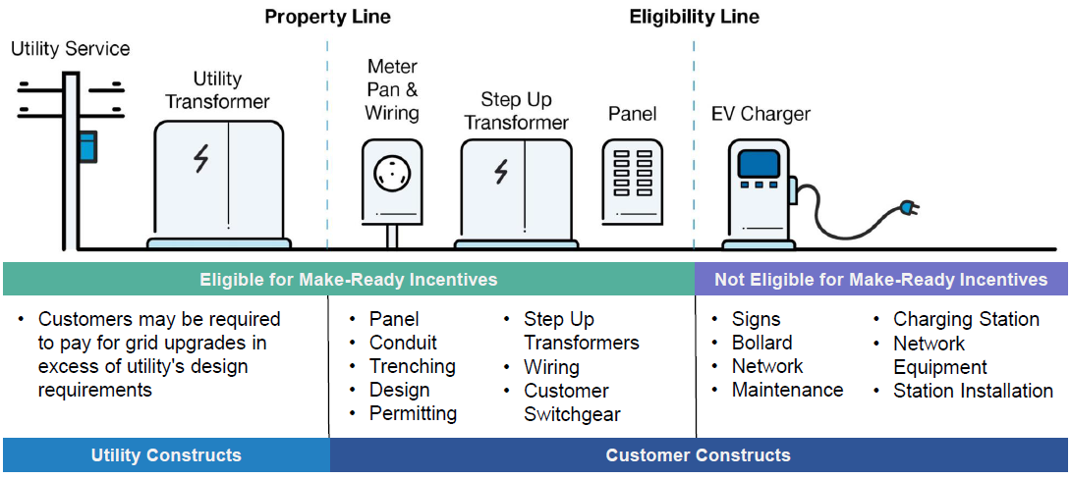
Make-Ready Order Adopted July 16, 2020
  $701 million budget; $206 million dedicated to disadvantaged communities
    Supports 850,000 ZEVs by 2025
    >50,000 L2 and 1,500 DCFC
  Fleet Assessment Service to aide fleet owners with site feasibility and rate analysis
  $85 million dedicated to prize competitions for disadvantaged communities
  $34 million for other MHDV make-ready programs
  EV Make-Ready Program Eligible Costs
Source: Joint Utilities of New York, November 18, 2022, EV Make-Ready Program Midpoint Review Technical Conference (image modified by DPS Staff).
  Three incentive tiers for eligible costs:
  Up to 100% - chargers serving disadvantaged communities
  Up to 90% public non-proprietary chargers
  Up to 50% - private access or proprietary chargers
Staff proposed increasing budget to $1.1 billion following the midpoint review on March 1, 2023 … Comments due May 15

Slide 7
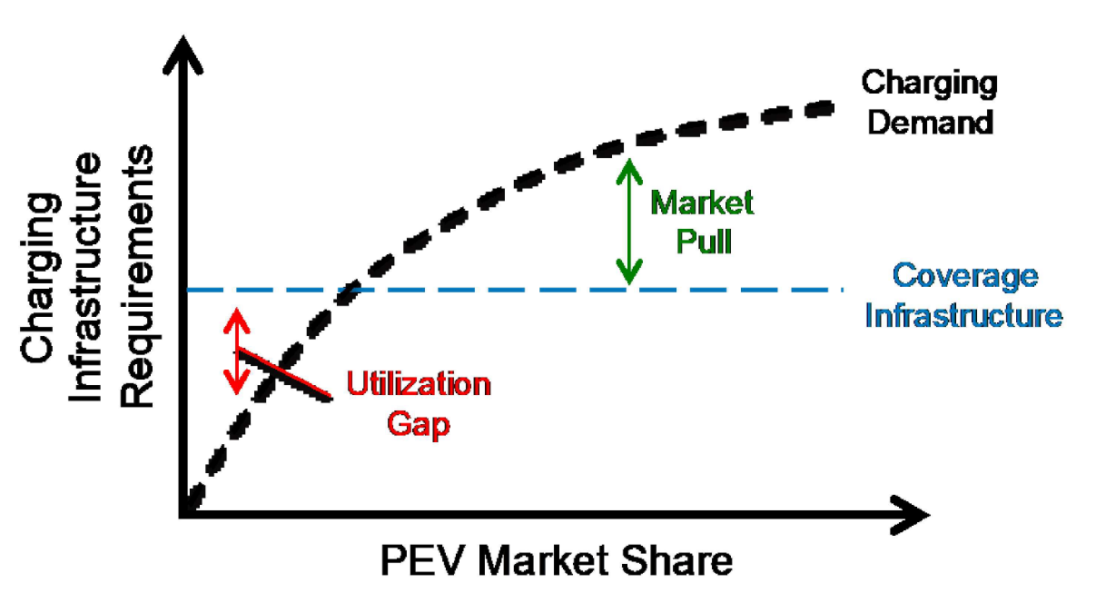
Charging demand per EV declines as EV adoption grows
Charging infrastructure requirements per vehicles is higher when PEV share is low because the market needs a minimum geographic distribution of chargers
As PEV share increase, utilization of the existing infrastructure increases along with additional new chargers
Charging demand falls below coverage demand when EV adoption is low
Image source: NREL
Make-Ready Program size tied to charging demand

Slide 8
DCFC economics challenging w/out subsidy given low EV deployments at the start of MRP (2020)
2020 In Service Date
2023 In Service Date
Make-ready support improved economics in 2020 scenarios but Upstate 150kW stations remain poor
NYPA and NYSERDA programs allowed limited access to make-ready program to ensure early investment Upstate¹
As station economics improve, Commission and utilities will consider lowering incentive levels
Appr. Investment Grade IRR
Program will adapt to changing developer economics
1 – New York Power Authority, or NYPA and New York State Energy Research and Development Authority or NYSERDA

Slide 9
$206M in Utility Funding to Disadvantaged Communities
Light-Duty Make-Ready Program
NY Clean Transportation Prizes
20% of MRP incentive budget dedicated to the DAC tier
Higher 100% incentive tier for charging stations within a 0–2-mile radius of DAC:
  Publicly accessible DCFC chargers
  Level 2 chargers in multi-unit dwellings
  Radius for DAC-tier eligibility:
    Zero miles in Con Edison
    One mile in some Upstate metro areas
    Two miles outside metro areas Upstate
Clean Neighborhood Challenge to reduce air pollution and create transportation "green zones" in DACs
Electric Mobility Challenge for electric mobility solutions that address DAC transportation needs
Electric Truck & Bus Challenge to address MDHD emissions in DACs through innovative electric solutions
$103M¹ budget, administered by NYSERDA
Winners announced November 16, 2022
Midpoint review proposed micromobility make-ready program and curbside L2s in DAC, invites comment on workforce development adder
  1 – $85M funding in the 7/14/2020 PSC Order. Additional budget provided by The Long Island Power Authority and the Clean Energy Fund

Slide 10
EV-specific tariffs ↓ utility bills for fast charging
Residential Time-of-Use Rates
(Available since April 2019)
Commercial EV Phase-in Rate
(Utilities currently implementing following 1/19/2023 PSC Order¹)
Lower off-peak delivery and supply rates
Reduced customer charge with proof of EV registration
One-year bill guarantee
Customers can save $150-$300 per year compared to standard rates
Demand Charge phases in as load factor increases
  LF ≤ 10%: TOU Energy Rates only
  LF [>10%, ≤ 15%]: 75% of RR² through TOU Energy Rates, 25% Demand Charge
  LF [>15%, ≤ 20%]: 50% RR through TOU Energy Rates, 50% Demand Charge
  LF [>20%, <25%]: 25% RR through TOU Energy Rates, 75% Demand Charge
No further treatment when Load Factor ≥ 25%
Demand charge relief needed in advance of wide-spread EV deployments
1 – Utilities will provide a 50% demand charge discount until the Commercial Phase-in Rate is available.
2 – RR = Revenue Requirement.

Slide 11
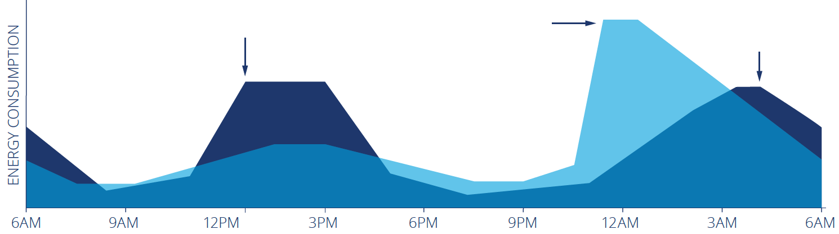
Managed Charging Drives Beneficial Behavior
Residential Programs
(Approved in 7/14/2022 PSC Order)
Commercial Programs
(Approved in 1/19/2023 PSC Order)
$98 million administrative budget for 6 IOUs
5 passive and 4 active programs approved
$/kW & $/kWh value-based credits to avoid system and local area network peaks
Additional subsidies to offset utility bills in near-term
Active
(To match solar peak)
Passive
(11 pm off-peak TOU)
Active
(smooth charging load)
Source: BMW of North America, 2016 with edits by Smart Electric Power Alliance, 2017 & NYS Department of Public Service, 2022
Up to $13.4 billion¹ in avoided distribution costs by 2050
1 - Transportation Electrification Distribution System Impact Study, NYSERDA Report Number 22-13

Slide 12

Widespread adoption of managed charging required to maximize ratepayer benefits of EVs
Technical Standards Working Group to develop metering standards for managed charging enabling tech.
1/10/23
Joint utilities of New York proposed testing method for managed charging enabling technologies
managed charging enabling technologies includes EVSE and onboard vehicle telematics
7/14/23
Phase One: establish eligibility criteria to determine what equipment will be considered for testing purposes.
7/14/24
Phase Two: TSWG will measure & evaluate the accuracy of the eligible devices
10/1/24
Phase Three: TSWG will file recommendations to establish minimum standards and specifications for managed charging enabling technologies, for PSC approval
Development of metering standards for managed charging enabling technologies paves the way for a frictionless enrollment process

Slide 13
Proceeding to Address Barriers to Medium- and Heavy-Duty Electric Vehicle Charging Infrastructure
Medium- and Heavy-Duty Make-Ready
Proactive Planning
Exact scope to be developed with input from stakeholders
Questions in Initiating Order will gather initial feedback
Will prioritize disadvantaged communities and Clean Air Act nonattainment areas that bear a disproportionate burden of pollution from trucks and buses
Identify high priority utility T&D infrastructure upgrades before issues stemming from capacity needs arise
IDing “hotspots” (existing depot clusters, high traffic destinations) can allow for well placed hubs
Critical for broader adoption of EVs, especially trucks and buses whose chargers can exceed a MW in capacity
Comments in case 23-E-0070 due May 15, 2023; Staff to expeditiously issue whitepaper proposals following comments

Slide 14
Thank you

Slide 15
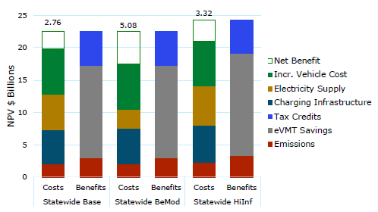
Societal benefits of EV Deployments in NY
Behavioral Modification has highest benefits because smart charging minimizes grid costs.
Avoided gasoline and vehicle O&M expenses drive eVMT Savings
EV adoption lowers the average cost of service, which exerts downward pressure on rates
Positive state-wide, and regionally in all scenarios

Slide 16
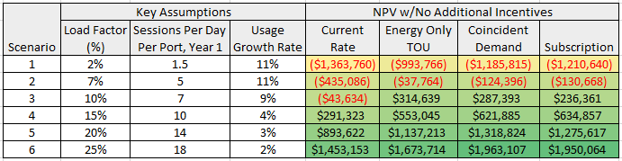
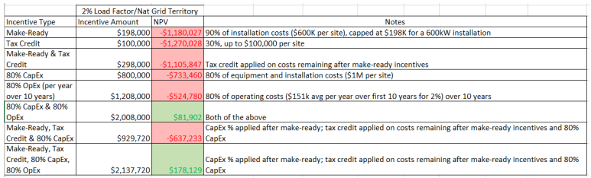
DCFC Project Economics w/Demand Charge Alt.
Analysis using National Grid rates

