Slide 1
Evolving Trends in Capital Structures and the
Weighted Average Cost of Capital (WACC)
Society of Utility and Regulatory Financial Analysts
SURFA
55th Financial Forum
Richmond, Virginia
Discussion Panel Presentation by Enrique Bacalao
Bacalao Consulting Services, LLC
Sun Prairie, Wisconsin
April 11, 2024

Slide 2
Presentation Contents
My perspective on this topic, based on:
  My work experience
  My training
Some key background information that informs my perspective
Some key conclusions I have reached on this topic
Some key implications I anticipate for:
  The management of a public utility company’s capital structure
  The review of a public utility company’s WACC
I offer my hypotheses to be challenged in this discussion panel

Slide 3
My Perspective on this Topic
Working with investors and learning what makes them tick
The objective function is to maximize value for all sides in a deal
One considers the past, but focuses on the future
Cash is a fact, earnings are an opinion
Marginal economic analysis is essential
Risk and the cost of capital are inextricably linked
Regulatory obligations includes that of raising capital efficiently
A public utility’s financial soundness serves the public interest

Slide 4
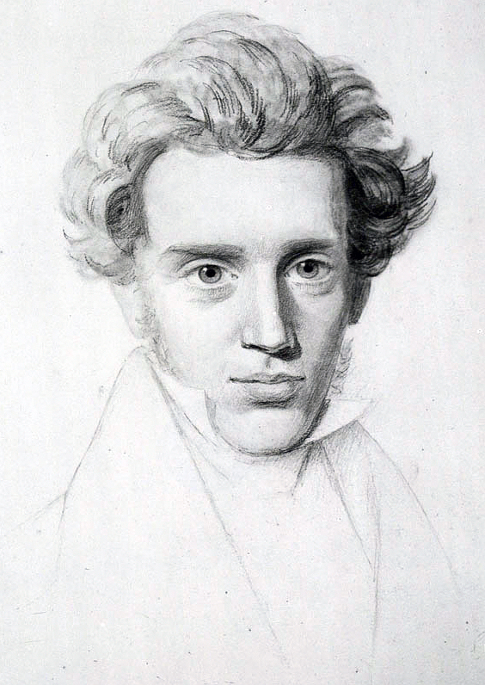
Consider the Past, but Focus on the Future
“It is really true what philosophy tells us, that life must be understood backwards. But with this, one forgets the second proposition, that it must be lived forwards.”
Søren Aabye Kierkegaard
Journals, 1843

Slide 5
Some Key Background Information
The investors’ perspective in the various capital markets
  They are not required to buy or hold particular public utility financial obligations
  They seek the highest rate of return for comparably risky alternatives
  Their focus is on the public utility’s future ability to honor its various obligations
  They evaluate how any given instrument fits into their particular portfolio
The public utility’s perspective
  The accuracy of the company’s cash flow forecasts is critical
  The appropriateness of the target capital structure is essential
  The accuracy of the company’s market expectations is important
  Should minimize the company’s WACC in order to maximize its market value

Slide 6
More Key Background Information
The customer’s perspective on this topic
  The customer ought to seek best value for the rates paid, more than the lowest rates
  A public utility must be able to raise needed capital at the time required, in the amounts required, and at the most attractive rates available to it
  A public utility must be able to afford the adoption of critical new technology
The regulator’s perspective on this topic
  Ensuring safe, reliable and affordable service for the public
  Balancing potentially competing interests, should they emerge
  Achieving inter-generational fairness over the foreseeable future
  Regulating natural monopolies to secure sound competitive outcomes

Slide 7
Some Key Conclusions
With respect to the various capital markets, public utilities tend to be buyers in a seller’s market.
In managing their functions well, company treasury officers need to:
  Anticipate future cash flows to determine a funding strategy
  Anticipate market conditions and project the impact of market fluctuations
  Manage the funding based on marginal decisions
  Remember that the company is the aggregate of its various investments
  Set ranges within which the corporate capital structure and the resulting WACC can be safely kept over time
  Bear in mind that the use of funds is the key, not the source of funds

Slide 8
More Key Conclusions
Public utility companies must be customer-centric to thrive:
  No company long survives disregarding their constituents’ best interests
  When the company’s objective function is to serve customers well, the evaluation of management options gains cohesion
  Marginal value added is the ultimate economic and financial metric to justify investments (i.e., the deployment of scarce capital on behalf of customers)
Capital structure and WACC should not be considered a zero-sum game, in which a company’s gain is a customer’s loss
  Too much or too little equity harms all interested parties
  Minimizing WACC best serves all interests, including the public interest

Slide 9
Optimizing the Capital Structure
Shareholder best interest:
Company’s market valuation, expressed as a present value of future net cash flows, where the discount rate (r) used is the WACC:
PV = NCF_{t} / (1 + r)^{i}
The lowest WACC yields the highest PV, r being in the denominator, and the market value is consequently maximized, all else being held equal.
Customer best interest:
Customer’s cost of service is minimized, where the revenue requirement’s cost of capital component, as reflected by WACC, is minimized.
The lower the WACC, the lower the revenue requirement, all else being held equal.
Both interests are aligned in benefitting from the lowest WACC.

Slide 10
Optimizing the Capital Structure

Slide 11
Optimizing the Capital Structure

Slide 12
Some Key Implications
These conclusions may fly in the face of some long-held notions:
  Public utilities are assumed to want the highest WACC possible, regardless.
  A public utility’s gain is viewed intrinsically as its customers’ loss.
These conclusions may unsettle those who prefer to rely as much as possible on audited financials:
  It’s difficult to audit results that have not yet materialized.
  The analysis does not rely on GAAP rules and guidelines.
Market valuation can be demanding and potentially controversial:
  Illiquid markets can make any estimate a challenging exercise.
  Concerns about bias in estimating market valuations are easier to make than they are to refute.

Slide 13
More Key Implications
Regulated natural monopolies may seem to lack the incentive to be customer-centric:
  Monopolies have market power that requires strong regulatory constraint.
  Customers lack alternative suppliers that would introduce competitive discipline.
  Self-interest appears to dissuade the various parties from seeking the optimal capital structure for mutual benefit.
  So a service franchise may come to be considered a license to inflict monopolist abuse with impunity.
The required analysis is undeniably hard work:
  It’s a very demanding analysis, with granular analysis at marginal investment level.
  It’s an ongoing, cyclical effort based on frequent data gathering and analysis.
  It requires ongoing education to keep abreast of continual change.

Slide 14
More Key Implications
The transparency required with stakeholders can be demanding:
  Critical information can be commercially sensitive and require confidentiality.
  Non-disclosure arrangements must be safe and workable, requiring mutual trust.
  A concerted and ongoing educational effort by utility companies is required.
Trust must be actively developed over time among the various parties:
  Public utilities must initiate and maintain meaningful dialogue with its customers.
  Regulators and public utilities must exchange information and alternatives freely.
  Regulators must engage client groups frequently and openly.
  All parties must protect regulators from the reality or the appearance of bias.
  Fairness must be seen to guide cost allocation and rate structures.
  The nature of the convergence of interests in capital structure needs acceptance.

Slide 15
Hypotheses to be Challenged
There is an optimal capital structure.
    That optimal structure minimizes the WACC
    Given forecasting uncertainty, an optimal structure is really an optimal range
The optimal capital structure serves the interests of both the company and its customers.
    Minimizing WACC maximizes the market value of the company
    Minimizing WACC minimizes the the cost of capital component of the revenue requirement for customers, lowering the cost of service

Slide 16
More Hypotheses to be Challenged
By minimizing the company’s financial risk profile, its financial soundness and its ability to serve well and reliably is enhanced, thus serving the public interest.
The optimal capital structure range is continuously fluctuating.
    The various capital markets are continually in flux
    The use of proceeds and funding requirements are also continually in flux
    Therefore, fixing a capital structure undermines its potential optimality

Slide 17
More Hypotheses to be Challenged
The risk profile of the company is not fixed.
    The optimal funding of incremental investment is not constant
    A reasonable range for the capital structure better serves the best interests of all the parties, as well as the public interest
The appropriate capital structure is unique to a particular company at the particular moment that it is considering its anticipated funding needs.

Slide 18
More Hypotheses to be Challenged
An optimal capital structure is specific to a given operating company, so the proxy group average (or other average) offers limited insights.
The optimal capital structure of a company must be determined at the margin:
    As its various investments take shape;
    As they are being funded; and
    As any changes occur to those investments as they are undertaken.

Slide 19
More Hypotheses to be Challenged
The historical capital structure continually loses relevance over time.
    Book value has limited use in determining the appropriate capital structure.
    The historical WACC’s value gradually erodes over time as well.
Since risk is determined by the use of funds, and risk in turn determines the marginal cost of capital, the appropriate capital structure is not determined by the source of funds.
    The nature and identity of the parent company, and how it funds its capital contributions to its operating subsidiary, are therefore irrelevant.
    Double leverage is therefore a destructive mythical concept.

Slide 20
More Hypotheses to be Challenged
Since WACC is a marginal cost of capital, and the market valuation of a company is also determined at the margin, a market value capital structure (despite its practical challenges) is the appropriate approach to take. Anything else undermines the pursuit of optimality.
Hypothetical capital structures also undermine the effort to achieve an optimal capital structure that minimizes the company’s WACC by not accurately reflecting reality.

Slide 21
More Hypotheses to be Challenged
I can only think of two exceptions in which hypothetical capital structures can be justified:
    When financial accounting rules do not recognize certain types of assets and liabilities:
      Leases, PPAs and similar debt-like off-balance sheet (OBS) financial obligations.
      Assets that similarly do not meet current accounting recognition criteria.
      One can correct this recognition shortcoming by using regulatory accounts to approve an appropriate capital structure, with ex post facto corrections.
    Very small operating subsidiaries that rely entirely on their corporate parent for funding (e.g., South Beloit Water, Gas and Electric Company).

Slide 22
Contact Details
Enrique Bacalao
Sole Member and Manager
Bacalao Consulting Services, LLC
(608) 444-0851
enrique@bacalaoconsultingservices.com
www.bacalaoconsultingservices.com

