Slide 1
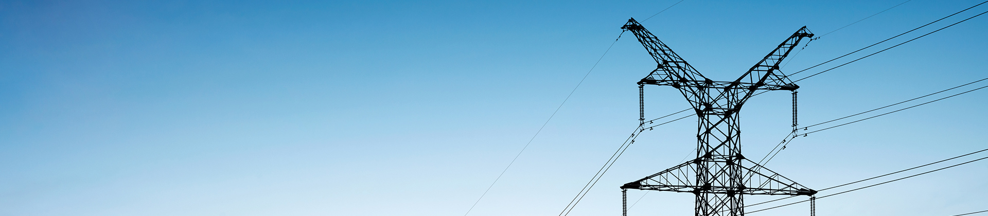
Securitization in the Utility Sector
Lillian Federico
Research Director, Energy
S&P Global Market Intelligence
Getting ahead of the curve reducing utility rate hikes caused by COVID-19
Society of Utility and Regulatory Financial Analysts
July 8, 2020
Permission to reprint or distribute any content from this presentation requires the prior written approval of S&P Global Market Intelligence.

Slide 2
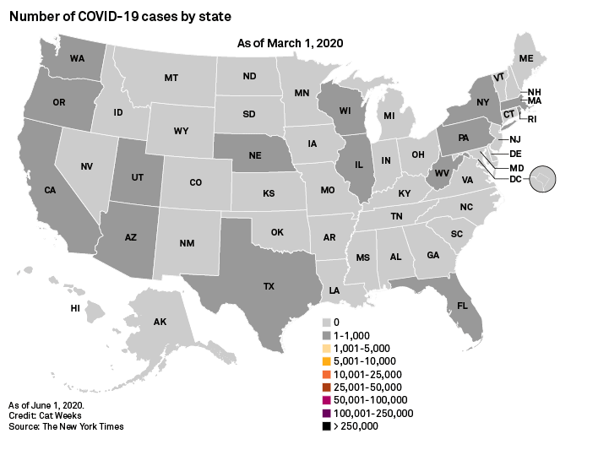
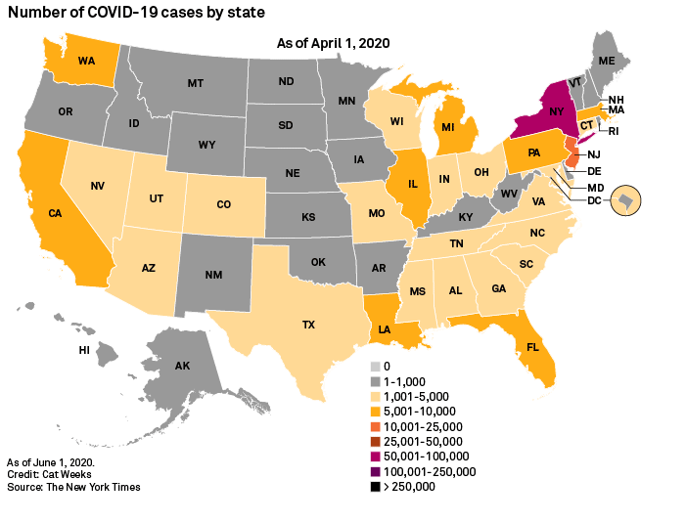
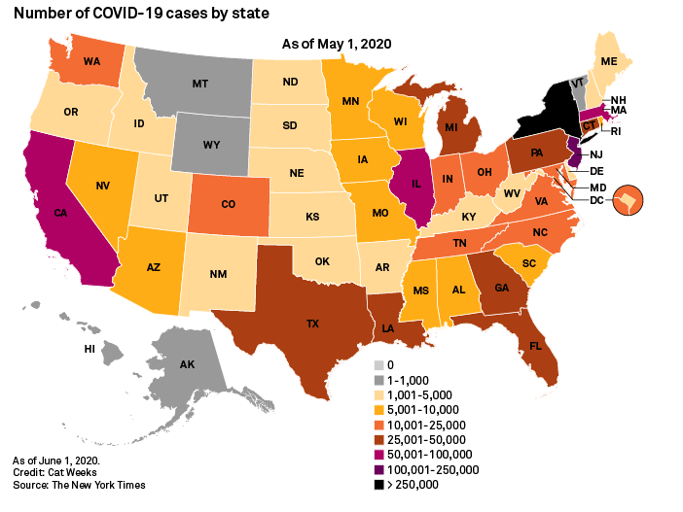
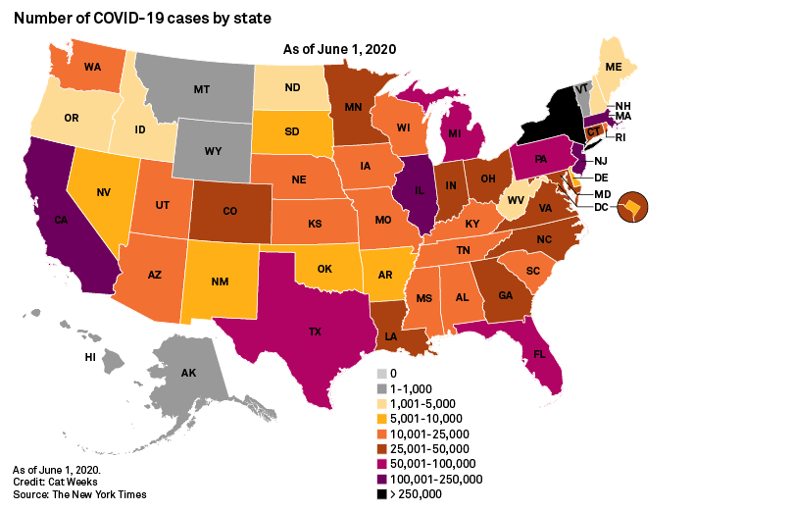
One-size fits all approach won’t fit all…
Copyright © 2020 S&P Global Market Intelligence, a division of S&P Global Inc. All rights reserved.

Slide 3
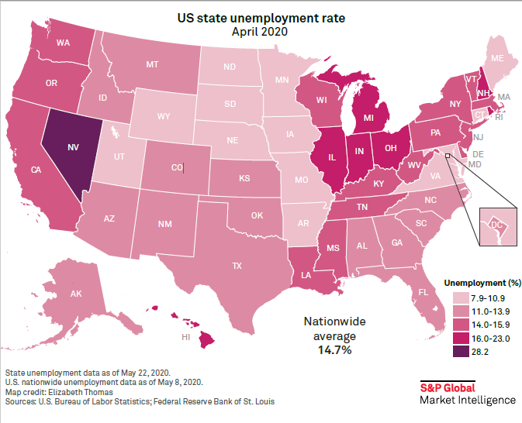
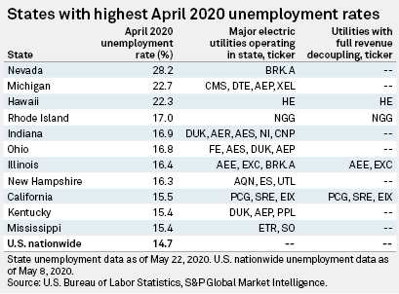
Unemployment rates — insight into revenue risk
Copyright © 2020 S&P Global Market Intelligence, a division of S&P Global Inc. All rights reserved.

Slide 4
Customer mix could complicate cost recovery
Copyright © 2020 S&P Global Market Intelligence, a division of S&P Global Inc. All rights reserved.

Slide 5
Cost recovery provisions so far…
Copyright © 2020 S&P Global Market Intelligence, a division of S&P Global Inc. All rights reserved.

Slide 6
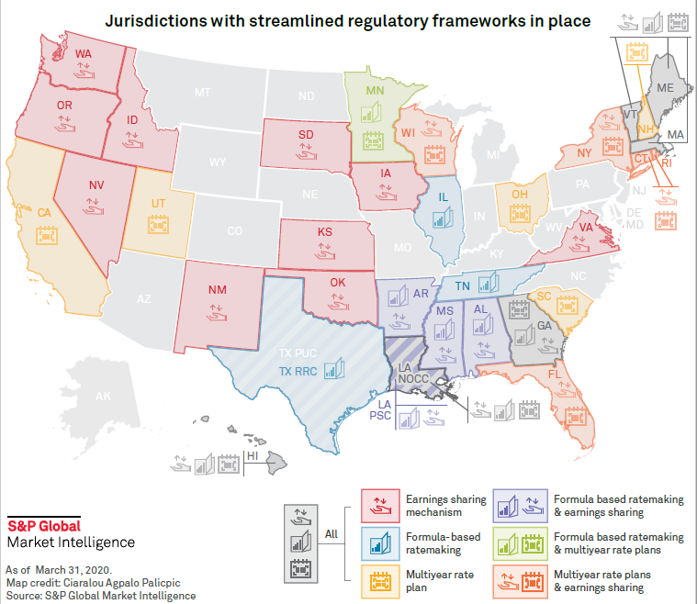
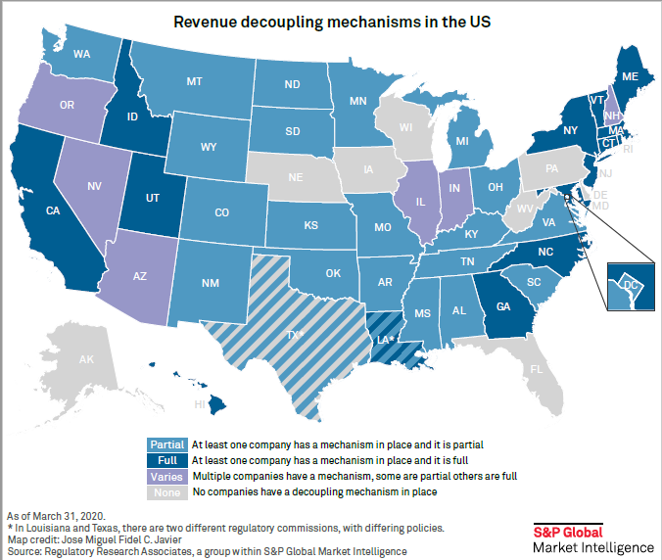
Other regulatory measures may address impacts on utilities
Copyright © 2020 S&P Global Market Intelligence, a division of S&P Global Inc. All rights reserved.

Slide 7
Thank you
Lillian Federico
Research Director, Energy
S&P Global Market Intelligence
Lillian.Federico@spglobal.com
Learn more at:
marketintelligence.spglobal.com/energy-sector

Slide 8
Copyright © 2020 by S&P Global Market Intelligence, a division of S&P Global Inc. All rights reserved.
These materials have been prepared solely for information purposes based upon information generally available to the public and from sources believed to be reliable. No content (including index data, ratings, credit-related analyses and data, research, model, software or other application or output therefrom) or any part thereof (Content) may be modified, reverse engineered, reproduced or distributed in any form by any means, or stored in a database or retrieval system, without the prior written permission of S&P Global Market Intelligence or its affiliates (collectively, S&P Global). The Content shall not be used for any unlawful or unauthorized purposes. S&P Global and any third-party providers, (collectively S&P Global Parties) do not guarantee the accuracy, completeness, timeliness or availability of the Content. S&P Global Parties are not responsible for any errors or omissions, regardless of the cause, for the results obtained from the use of the Content. THE CONTENT IS PROVIDED ON “AS IS” BASIS. S&P GLOBAL PARTIES DISCLAIM ANY AND ALL EXPRESS OR IMPLIED WARRANTIES, INCLUDING, BUT NOT LIMITED TO, ANY WARRANTIES OF MERCHANTABILITY OR FITNESS FOR A PARTICULAR PURPOSE OR USE, FREEDOM FROM BUGS, SOFTWARE ERRORS OR DEFECTS, THAT THE CONTENT’S FUNCTIONING WILL BE UNINTERRUPTED OR THAT THE CONTENT WILL OPERATE WITH ANY SOFTWARE OR HARDWARE CONFIGURATION. In no event shall S&P Global Parties be liable to any party for any direct, indirect, incidental, exemplary, compensatory, punitive, special or consequential damages, costs, expenses, legal fees, or losses (including, without limitation, lost income or lost profits and opportunity costs or losses caused by negligence) in connection with any use of the Content even if advised of the possibility of such damages.

