Slide 1
Sources of Utility Securitization Ratepayer NPV Savings

Slide 2
Traditional Regulatory Asset Revenue Declining Balance Requirements vs. Securitization Levelized Revenue Requirements $ Millions

Slide 3
No Customer Revenue Required for Utility Federal Taxes is Important to Savings Securitization NPV Savings Sensitivity to Discount Rate and Federal Taxes $ Millions

Slide 4
If Use Utility Weighted Average Cost of Capital DIscount Rate = ~8%
NO SAVINGS/COST

Slide 5
Judging Success in Capital Markets - Focus on Credit Spread

Slide 6
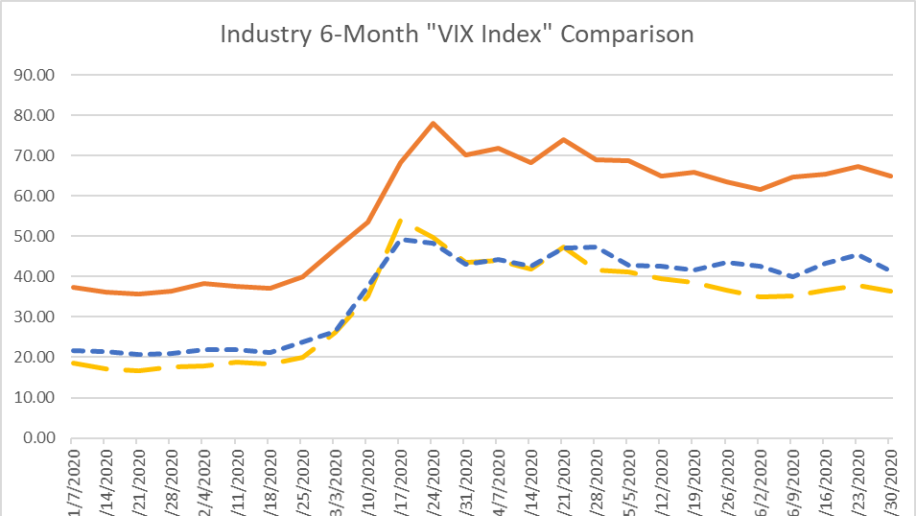

Slide 7
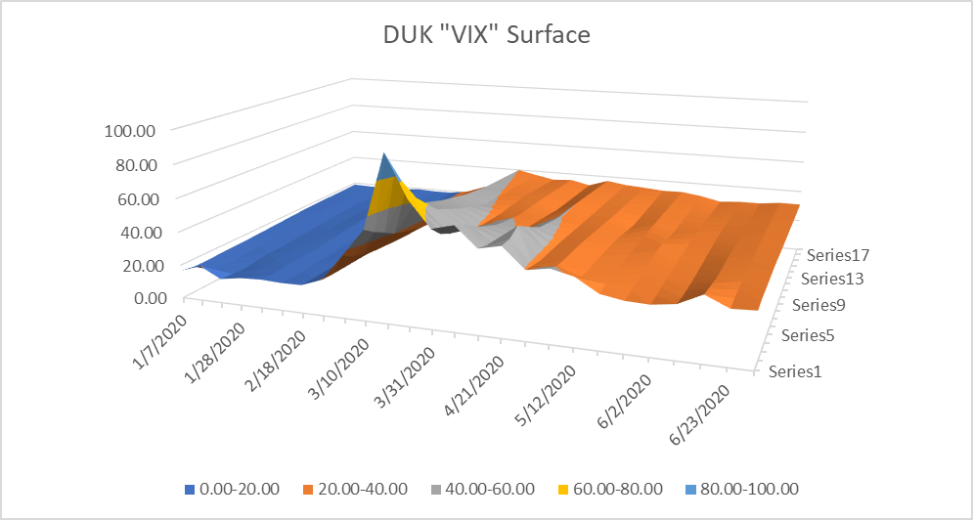

Slide 8
Underwriters disclose their primary conflict of interest
“The primary role of Goldman Sachs, as an underwriter, is to purchase securities, for resale to investors, in an arm’s-length commercial transaction between the Issuer and Goldman Sachs will act in its own interest and has financial and other interests that differ from those of the Issuer.” ¹
¹ See Public Service of New Hampshire d/b/a Eversource Energy Docket No. DE 17-096 Securitization Petition Attachment RR 1-013 Page 2

Slide 9
Underwriters Have No Fiduciary Duty to Ratepayers nor to Utility nor to Commission
Excerpt from Actual Securitization Bond “Underwriting Agreement” Underwriters Require of an Issuer
Section Entitled: “Absence of Fiduciary Relationship"
[The utility] acknowledges and agrees that the Underwriters are acting solely in the capacity of an arm’s length contractual counterparty to the [utility] with respect to the offering of the Bonds ... (including in connection with determining the terms of the offering) and not as a financial advisor or a fiduciary to, or an agent of, (the utility) …
1
2
[The utility will] consult with their own advisors concerning such matters and shall be responsible for making their own independent investigation and appraisal of the transactions contemplated, and the Underwriters shall have no responsibility or liability to [the utility] with respect thereto.
3
Any review by the Underwriters … of the structure and terms of the transactions ...will be performed solely for the benefit of the Underwriters and shall not be on behalf of [the utility] . . . .”*
*See the language quoted above in AEP Texas securitization transaction 2012 https://www.sec.gov/Archives/edgar/data/18734/000090514812000765/efc12-292_ex11.htm

Slide 10
In Utility Securitization, Conflicting Economic Interests Are Not Balanced or Checked and Create Hurdles to Lowest Cost Financing for Ratepayers
Underwriter Objectives vs. Ratepayer Interests – Need for Checks and Balances.
Underwriters “Price it to sell quickly, move on”
Little investor education on the unique securitization credit, true-up, charge on essential commodity
Investor and underwriter misperceptions of utility securitization credit and liquidity
Mispricing of bond credit and “relative value” to other investments
Higher cost to ratepayers.

Slide 11
Active Commission Oversight with Utility Cooperation Have Produced Better Market Results

Slide 12
The 1999 Texas Public Utilities Regulatory Act (PURA) Mandate –
Began the “Active Commission Involvement” Practice - A Best Practice
“The commission shall ensure that securitization provides tangible and quantifiable benefits to ratepayers, greater than would have been achieved absent the issuance of transition bonds.”
“The commission shall ensure that the structuring and pricing of the transition bonds result in the lowest transition bond charges consistent with market conditions and the terms of the financing order.”
See https://statutes.capitol.texas.gov/Docs/UT/htm/UT.39.htm
Notes:
As you seen from the graph showing the pricing of transactions in Texas and Florida, saving some Securitization are not automatic. There is a need for transparency and oversight – regulator and utility working together – to get the best results from often brutal capital markets

Slide 13
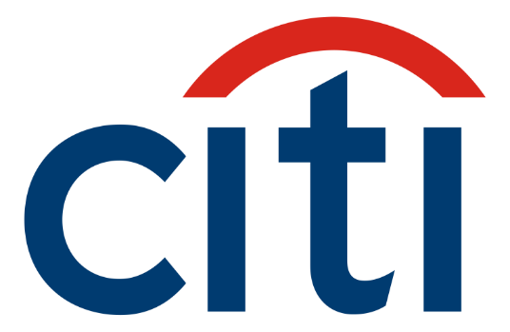
Via Email
Subject: TX savings summary (revised)
Date: Fri, 19 Sep 2003 17:44:00 -0400
From: "Donskaya, Marina [FI]" marina.donskaya@citigroup.com
To: "Joseph Fichera (E-mail)" jfichera@saberpartners.com
Cc: "Humphrey, Paul G [FI]" paul.g.humphrey@citigroup.com...
“To summarize, the difference in total savings vs other transition bonds
Reliant: $3,773,775 or 6.5 bps/yr (nominal), $2,955,295 or 5.1 bps/yr (PV)
CPL: $12,951,663 or 20.3 bps/yr (nominal), $9,748,976 or 15.3 bps/yr (PV)
Oncor: $6,629,694 or 19.4 bps/yr (nominal), $5,278,669 or 15.4 bps/yr (PV)
Total: $23,355,132 (nominal), 17,982,941 (PV)”
Example: Citigroup and Other Studies* Confirmed Savings From Active Commission Oversight – First 3 Texas Deals 2001-2003
Prior to the first Texas securitization bond sale in 2001, $21 billion utility securitization bonds were sold with no active Commission involvement. Beginning in 2001 Texas Commission took active role.
Citi’s analysis, sent to Texas’s financial advisor Saber Partners (email left) showed $23 million+ savings to Texas customers from the active PUC Texas oversight with their advisors on Texas’s first three securitization offerings.
See State of Wisconsin Public Service Commission at
Notes:
FROM SLIDE 36
Example: Citigroup and Other Studies Confirmed Savings From Active Commission Oversight
$23 million+ savings to Texas customers from active PUC Texas oversight with advisors on Texas’ first three securitization offerings
Subject: TX savings summary (revised)
Date: Fri, 19 Sep 2003 17:44:00 -0400
From: "Donskaya, Marina [FI]" marina.donskaya@citigroup.com
To: "Joseph Fichera (E-mail)" jfichera@saberpartners.com
Cc: "Humphrey, Paul G [FI]" paul.g.humphrey@citigroup.com...
“To summarize, the difference in total savings vs other transition bonds
Reliant: $3,773,775 or 6.5 bps/yr (nominal), $2,955,295 or 5.1 bps/yr (PV)
CPL: $12,951,663 or 20.3 bps/yr (nominal), $9,748,976 or 15.3 bps/yr (PV)
Oncor: $6,629,694 or 19.4 bps/yr (nominal), $5,278,669 or 15.4 bps/yr (PV)
Total: 23,355,132 (nominal), 17,982,941 (PV)”
For complete report/email See
https://saberpartners.com/testimonial/citigroup-shows-saber-partners-saves-texas-electricity-customers-23-million /
Basis points (bps) = .001th% PV= Present Value

Slide 14
Best Practice Example: Active Commission Ratepayer Savings 2001-2005
Basis points (bps) = .01%
Notes:
FROM SLIDE 37
From An ACTIVE Commission Vs. Other STATES 2001-2005 Comparing New Issue Pricings/Interest Rate Credit Spreads of Securitization Bond Offerings Differences Between 2 Lines = COSTS in % Vs Benchmark By Bond Maturity

Slide 15
Best Practice Example: Florida (Duke Energy Florida (DEF)) Ratepayer Savings From an Active Commission Vs. Other States 2010-2016
2016 Florida Public Service
Commission Actions
Established Lowest Cost Objective in Financing Order.
Created Bond Team – Commission and Utility.
Sold $500+ million LONG Duration 15-20 years .
Largest offering with longest maturity of its kind to date.
Offering was in untested long-term (>15 years) market.
Long maturities are most expensive to ratepayers.
All Other States
Florida
Basis points (bps) = .01%
Notes:
*FROM SLIDE 38/39

Slide 16
Best Practice Example: Florida (Duke Energy Florida (DEF)) Ratepayer Savings From an Active Commission Vs. Other States 2010-2016
Basis points (bps) = .01%
Notes:
*FROM SLIDE 38/39

